Slide 1
Web Development & Design Foundations with H T M L 5
Ninth Edition
Chapter 12
E-Commerce Overview
Slides in this presentation contain hyperlinks. JAWS users should be able to get a list of links by using INSERT+F7
Copyright © 2019, 2017, 2015 Pearson Education, Inc. All Rights Reserved
Notes:
If this PowerPoint presentation contains mathematical equations, you may need to check that your computer has the following installed:
1) MathType Plugin
2) Math Player (free versions available)
3) NVDA Reader (free versions available)

Slide 2
Learning Objectives
12.1 define e-commerce
12.2 identify benefits and risks of e-commerce
12.3 describe e-commerce business models
12.4 describe e-commerce security and encryption
12.5 define Electronic Data Interchange (E D I)
12.6 describe trends and projections for e-commerce
12.7 describe issues related to e-commerce
12.8 describe options for order and payment processing

Slide 3
What is E-Commerce?
The integration of communications, data management, and security technologies to allow individuals and organizations to exchange information related to the sale of goods and services.
Major functions of E–Commerce include:
the buying of goods,
the selling of goods, and
performance of financial transactions on the Internet.

Slide 4
E-Commerce Advantages for Businesses
Reduced Costs
Increased Customer Satisfaction
More Effective Data Management
Potentially Higher Sales

Slide 5
E-Commerce Advantages for Consumers
Convenience
Easier Comparison Shopping
Wider Selection of Goods

Slide 6
E-Commerce Risks for Businesses
Need for a robust, reliable web site
Fraudulent transactions
Customer reluctance to purchase online
Increased competition

Slide 7
E-Commerce Risks for Consumers
Possible Security Issues
Possible Privacy Issues
Purchasing from photos & descriptions
Possible difficulty with returns

Slide 8
E-Commerce Business Models
B2C – Business-to-Consumer
B2B – Business-to-Business
C2C – Consumer-to-Consumer
B2G – Business-to-Government

Slide 9
Electronic Data Interchange (E D I)
The transfer of data between different companies using networks.
Facilitates the exchange of standard business documents including purchase orders and invoices
E D I is not new -- In existence since the 1960s
Trading Partners
Organizations that exchange E D I transmissions
Newer technologies
X M L and Web Services are replacing traditional E D I
Provide opportunities to customize secure information exchange over the Internet

Slide 10
E-Commerce U.S. Retail Sales
What do people buy online?
Clothing, accessories, and footwear ($58.2 billion)
Furniture and home furnishings ($32.4 billion)
Electronics and appliances ($30 billion)
Sporting goods ($13.1 billion)
Books and magazines ($12.6 billion)
Toys, hobby goods, and games ($12.1 billion)
Office equipment and supplies ($10.6 billion)
Food, beer, and wine ($9.8 billion)
2015 Sales Figures http://www2.census.gov/retail/releases/current/arts/ecommerce4541.xls

Slide 11
Who’s on the Internet? (1 of 2)
Table 12.1 Online population
Category | Percentage That Use the Internet
Men | 89%
Women | 86%
Age: 18-29 | 99%
Age: 30-49 | 96%
Age: 50-64 | 87%
Age: Over 65 | 57%
Household Income: Less than $30,000 | 79%
Household Income: $30,000 to $49,999 | 90%
Household Income: $50,000 to $74,999 | 95%
Household Income: $75,000 or higher | 98%
Education: High school graduate | 81%
Education: Some college | 94.1%
Education: College graduate | 98%

Slide 12
Who’s on the Internet? (2 of 2)
Source: http://www.pewinternet.org/data-trend/internet-use/latest-stats/
Other Demographics:
http://www.pewinternet.org/
http://www.clickz.com
http://www.census.gov/eos/www/ebusiness614.htm

Slide 13
E-Commerce Issues
Intellectual Property
Security
Fraud
Taxation
International Commerce

Slide 14
E-Commerce Security
Encryption
Ensures privacy within an organization and on the Internet.
The conversion of data into an unreadable form, called a ciphertext.
Decryption
The process of converting the ciphertext back into its original form, called plaintext or cleartext, so it can be understood.
The encryption/decryption process requires an algorithm and a key.

Slide 15
E-Commerce Security Encryption Types
Secure E-Commerce transactions use the encryption technologies below:
Symmetric-key Encryption
Asymmetric-key Encryption
Hash Encryption
S S L (Secure Sockets Layer)
Utilizes these encryption technologies
Provides for secure transmission of data on the Internet.

Slide 16
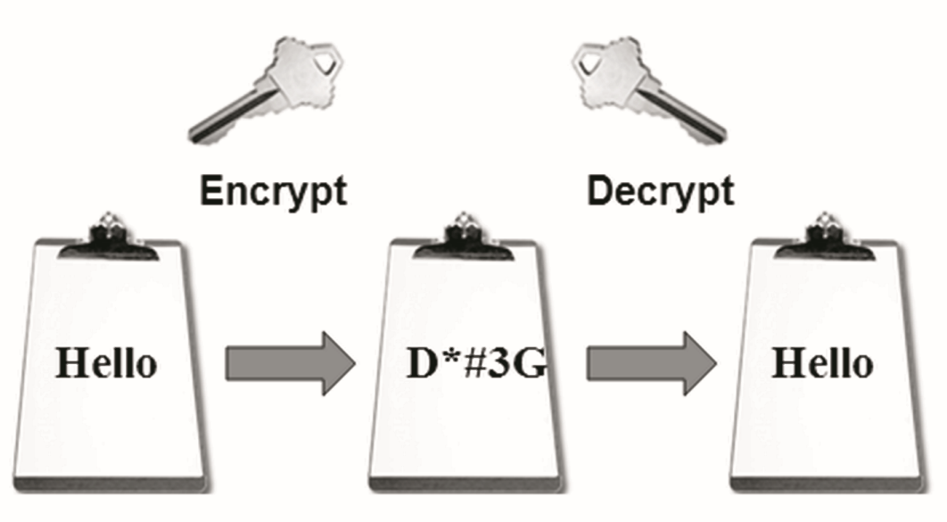
E-Commerce Security: Symmetric-Key
Symmetric-Key Encryption
Also called single-key encryption
Both encryption and decryption use the same key
Both the sender and receiver must know the key before communicating using encryption.
Advantage: speed

Slide 17
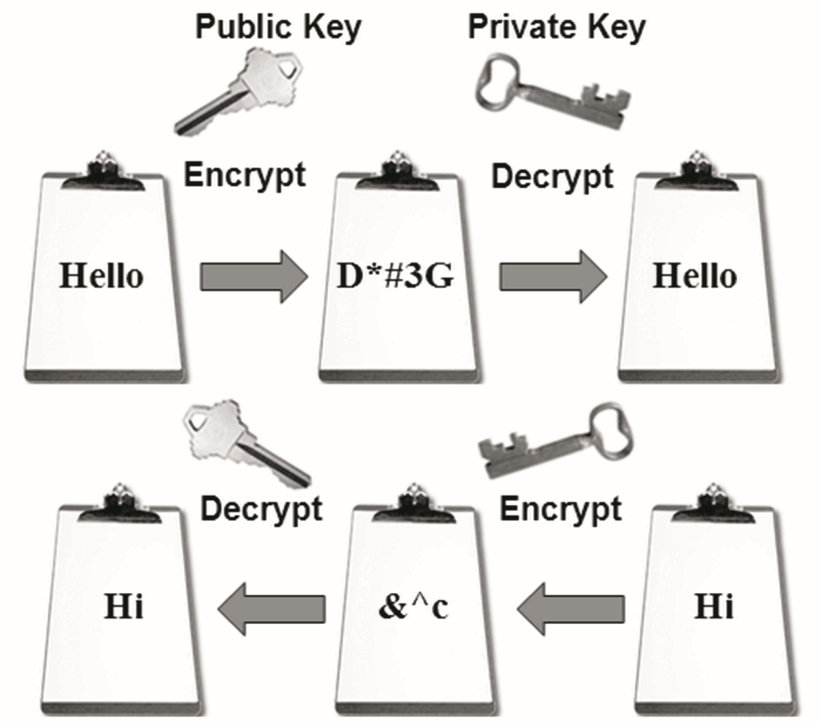
E-Commerce Security: Asymmetric-Key
Asymmetric-Key Encryption
Also called public-key encryption
There is no shared secret
Two keys are created at the same time:
Public key
Private key
Asymmetric-key encryption is much slower than symmetric-key encryption.

Slide 18
E-Commerce Security: Hash
Hash Encryption
A hash algorithm transforms a string of characters into a “digest”
A shorter fixed-length value or key that represents the original string
One-way encryption
Used for information that will not be read or decrypted
Purpose: verify the integrity of information

Slide 19
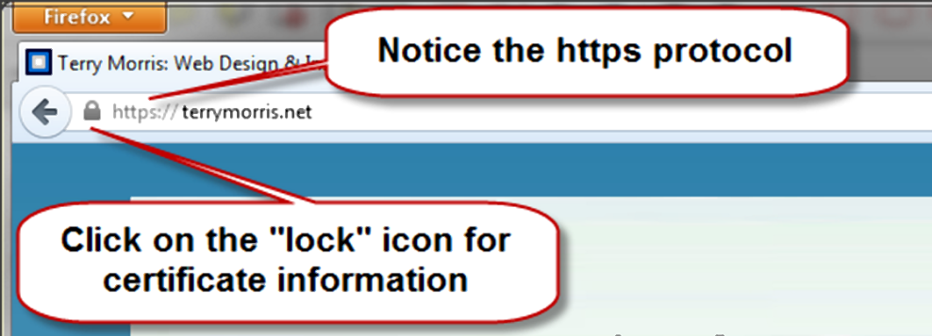
Secure Sockets Layer (S S L) (1 of 2)
A protocol that allows data to be privately exchanged over public networks
Developed by Netscape
Encrypts data sent between a client (usually a Web browser) and a Web server.
Utilizes both symmetric and asymmetric keys.
“https” protocol
Browsers display a “lock” icon

Slide 20
Secure Sockets Layer (S S L) (2 of 2)
S S L provides secure communication between a client and server by using:
Server and (optionally) client digital certificates for authentication
Symmetric-key cryptography using a "session key" for bulk encryption
Public-key cryptography for transfer of the session key
Message Digests (hash encryption) to verify the integrity of the transmission

Slide 21
S S L & Digital Certificate
Digital Certificate
A form of an asymmetric key
Also contains information about the certificate, the holder of the certificate, and the issuer of the certificate.
Used by S S L to authenticate the identity of the web server

Slide 22
Digital Certificate
The contents of a digital certificate include:
The public key
Effective date of the certificate
Expiration date of the certificate
Details about the Certificate Authority -- the issuer of the certificate
Details about the certificate holder
A digest of the certificate content

Slide 23
Certificate Authority
A trusted third-party organization or company that issued digital certificates.
Well-known Certificate Authorities:
Verisign
http://www.verisign.com
Thawte
http://www.thawte.com

Slide 24
Checkpoint 12.1
Describe three advantages of e-commerce for an entrepreneur just starting a business.
Describe three risks that businesses face when engaging in e-commerce.
Define S S L. Describe how an online shopper can tell that an e-commerce site is using S S L.

Slide 25
Order & Payment Processing
E-Commerce Payment Methods:
Credit Card
Stored-value Card
Smart Card
Digital Cash

Slide 26
E-Commerce Storefront Solutions
Instant Online Storefront
Shopify, BigCommerce
Off-The-Shelf Shopping Cart Software
Agoracart, osCommerce, ZenCart
Custom Built Solution
I B M's WebSphere Commerce Suite, Microsoft's Commerce Server
Microsoft Visual Studio, Adobe Dreamweaver
Semi-Custom Built Solutions on a Budget
Paypal order processing
Free shopping cart scripts

Slide 27
Checkpoint 12.2
List three payment methods commonly used on the Web.
Have you purchased online? If so, think of the last item that you purchased.
a. Why did you purchase it online instead of at a store?
b. Did you check to see if the transaction was secure? Why or why not?
c. How will your shopping habits be different in the future?
Describe three types of e-commerce solutions available. Which provides the easiest entry to e-commerce? Explain.

Slide 28
Summary
This chapter introduced you to basic e-commerce concepts and implementations.
Consider taking an E-Commerce course in the future to continue your study of this dynamic and growing area of web development.

Slide 29
Copyright

