Slide 1
Web Development & Design Foundations with H T M L 5
Ninth Edition
Chapter 14
A Brief Look at JavaScript and jQuery
Slides in this presentation contain hyperlinks. JAWS users should be able to get a list of links by using INSERT+F7
Copyright © 2019, 2017, 2015 Pearson Education, Inc. All Rights Reserved
Notes:
If this PowerPoint presentation contains mathematical equations, you may need to check that your computer has the following installed:
1) MathType Plugin
2) Math Player (free versions available)
3) NVDA Reader (free versions available)

Slide 2
Learning Objectives (1 of 2)
14.1 Describe common uses of JavaScript in web pages.
14.2 Describe the purpose of the Document Object Model and list some common events.
14.3 Create a simple JavaScript using the script element and the alert() method.
14.4 Use variables, operators and the if control structure.
14.5 Create a basic form validation script.
14.6 Describe common uses of jQuery.

Slide 3
Learning Objectives (2 of 2)
14.7 Describe how to obtain jQuery.
14.8 Use jQuery selectors and methods.
14.9 Configure an image gallery with jQuery.
14.10 Describe the purpose of jQuery plugins.

Slide 4
What is JavaScript? (1 of 2)
Object-based scripting language
Works with the objects associated with a Web page document
the window
the document
the elements
such as forms, images, hyperlinks, etc.

Slide 5
What is JavaScript? (2 of 2)
Originally developed by Netscape
Named LiveScript
Netscape & Sun Microsystems Collaboration
LiveScript renamed JavaScript
JavaScript is Not Java

Slide 6
Common Uses of JavaScript
Display a message box
Select list navigation
Edit and validate form information
Create a new window with a specified size and screen position
Image Rollovers
Status Messages
Display Current Date
Calculations

Slide 7
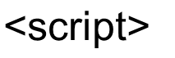
Coding JavaScript
JavaScript statements can be coded on a web page using two different techniques:
Place JavaScript code between
tags
Place JavaScript code as part of an event attached to an H T M L element

Slide 8
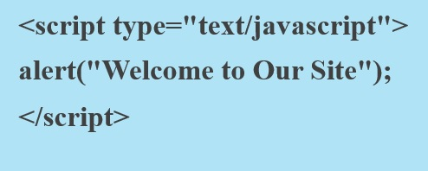
Javascript: Using the Script Element
The script element
A container tag
May be placed in either the head or the body section of a web page

Slide 9
Checkpoint 14.1
Describe at least three popular uses for JavaScript.
How many JavaScript code blocks can be embedded in an H T M L document?
Describe a method that can be used to find an error in a JavaScript code block.

Slide 10
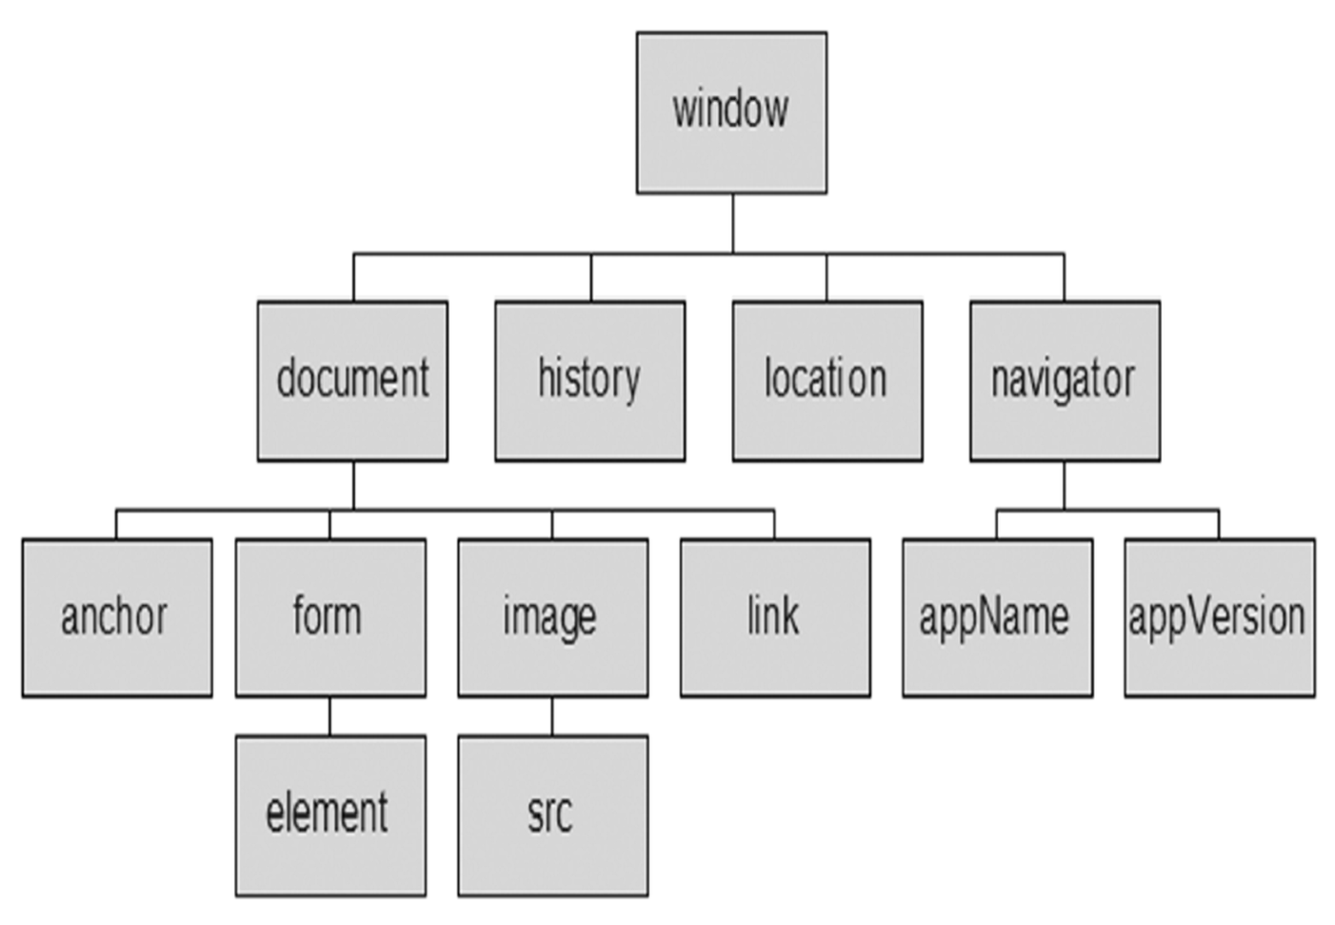
Document Object Model (D O M)
A portion of the D O M is shown at the left.
Defines every object and element on a web page
Hierarchical structure
Accesses page elements and apply styles to page elements

Slide 11
Object
An object is a thing or entity.
Browser window
Submit button
Web page document

Slide 12
Property
A property is a characteristic or attribute of an object.
The background color of a web page document document.bgcolor
The date the web page file was last modified document.lastmodified
The src file of an image object image1.src

Slide 13
Method
A method is an action (a verb)
Writing text to a web page document
Submitting a form

Slide 14
JavaScript and Events (1 of 2)
Events: actions taken by the web page visitor
clicking (onclick),
placing the mouse on an element (onmouseover),
removing the mouse from an element (onmouseout),
loading the page (onload),
unloading the page (onunload), etc.

Slide 15
Events
Event | Event Handler
click | onclick
load | onload
mouseover | onmouseover
mouseout | onmouseout
submit | onsubmit
unload | onunload

Slide 16
JavaScript and Events (2 of 2)
JavaScript can be configured to perform actions when events occur.
The event name is coded as an attribute of an H T M L tag
The value of the event attribute contains the JavaScript code
Example:
Display an alert box when the mouse is placed over a hyperlink.

Slide 17
JavaScript Debugging (1 of 2)
Check the syntax of the statements
Pay very close attention to upper and lower case letters, spaces, and quotations
Verify that you have saved the page with your most recent changes
Verify that you are testing the most recent version of the page (refresh or reload the page)
If you get an error message, use the error messages that are displayed by the browser
In Firefox:

Slide 18
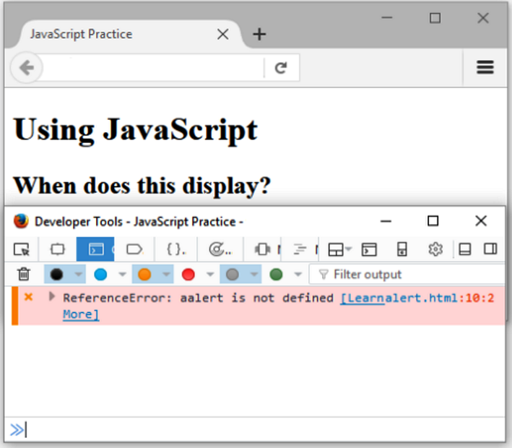
JavaScript Debugging (2 of 2)
Using the Firefox browser:
Select the top right menu icon (“Hamburger” icon)
The Web Console will indicate an issue and the line number
This may not be exactly where the problem is
Sometimes the error is one or two lines above the indicated line number.

Slide 19
Checkpoint 14.2
With respect to objects, describe the difference between a property and a method. Feel free to use words like “thing,” “action,” “description,” “attribute,” and so forth.
What is the difference between an event and an event handler?
Where are event handlers placed in the H T M L document?

Slide 20
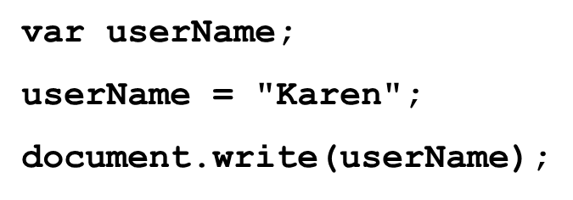
Variable
A variable is a placeholder for information.
The variable is stored in the computer’s memory (R A M).

Slide 21
Prompts
Displays a message and accepts a value from the user
The value typed by the user is stored in the variable myName

Slide 22
Arithmetic Operators
Operator | Description | Example | Value of Quantity
= | assign | quantity = 10 | 10
+ | addition | quantity = 10 + 6 | 16
− | subtraction | quantity = 10 − 6 | 4
* | multiplication | quantity = 10 * 210 times 2 | 20
/ | division | quantity = 10 / 2 10 divided by 2 | 5

Slide 23
Comparison Operators
Operator | Description | Example | Sample values of quantity that would result in true
= = | Double equals sign (equivalent) “is exactly equal to” | quantity = = 10 | 10
> | Greater than | quantity > 10 | 11, 12 (but not 10)
> = | Greater than or equal to | quantity > = 10 | 10, 11, 12
< | Less than | quantity < 10 | 8, 9 (but not 10)
<= | Less than or equal to | quantity < = 10 | 8, 9, 10
Exclamation point ! = | Not equal to | quantity exclamation point! = 10 | 8, 9, 11 (but not 10)

Slide 24
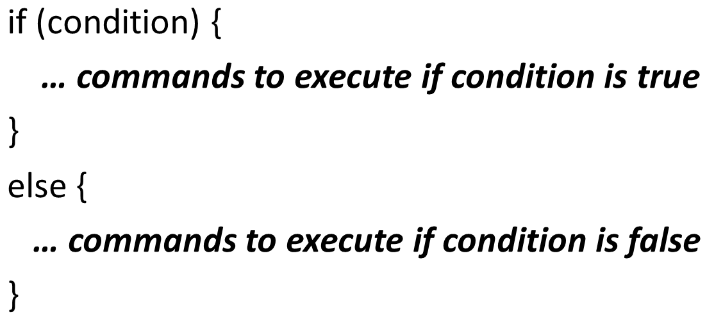
Decision Making

Slide 25
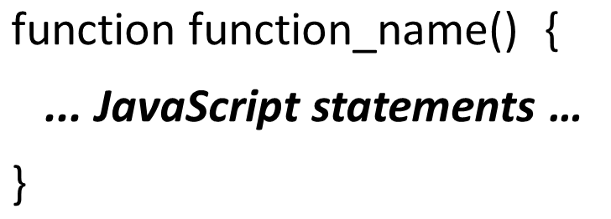
Function
A function is a block of one or more JavaScript statements with a specific purpose, which can be run when needed.

Slide 26
Using Functions
Defining the Function
Calling the Function

Slide 27
Checkpoint 14.3
Describe a method that can be used to gather a piece of data such as the user’s age.
Write the JavaScript code to display an alert message for users who are under 18 years old and a different alert message for users who are 18 years or older.
What is a function definition?

Slide 28
Form Validation
It is common to use JavaScript to validate form information before submitting it to the web server.
Is the name entered?
Is the e-mail address of correct format?
Is the phone number in the correct format?
See Hands-on Practice 14.8

Slide 29
Validating Form Fields
Use the "" or null to check to determine if a form field has information

Slide 30
JavaScript & Accessibility
Don’t expect JavaScript to always function for every visitor
Some may have JavaScript disabled
Some may be physically unable to click a mouse
Provide a way for your site to be used if JavaScript is not functioning
Plain text links
E-mail contact info

Slide 31
Checkpoint 14.4
What is meant by the term “form data validation”?
Give three examples of form data that may require validation.
Should you always expect your JavaScript to “work” – why or why not?

Slide 32
What is JQuery?
J Query is a free open-source JavaScript Library
Provides interaction and dynamic effects on web pages
Resources
http://jquery.com
http://jquery.org

Slide 33
Common Uses of JQuery
Dynamically manipulate the C S S properties of elements
Detect and react to events – such as mouse movements
Animate elements on a web page – such as image slideshows
And much more...

Slide 34
Adding JQuery to a Web Page
Two Options:
Download j Query
http://jquery.com/download
Access j Query via a C D N

Slide 35
The Ready Event
Triggered when the browser has loaded the Document Object model( D O M) for the web page

Slide 36
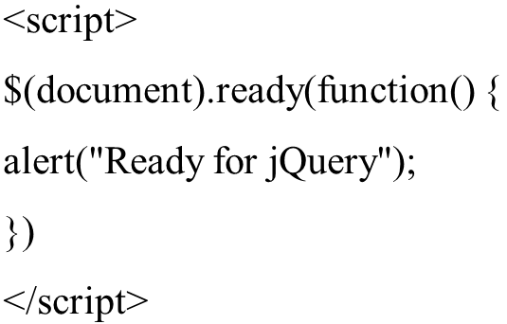
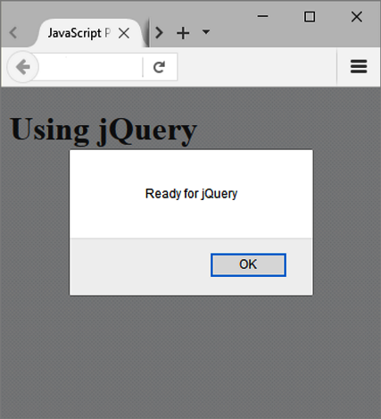
Display an Alert When the Page Loads

Slide 37
JQuery Selectors
A selector indicates which D O M elements j Query will affect
http://api.jquery.com/category/selectors
Some commonly used jQuery selectors
Selector | Purpose
$('*') | wildcard – selects all elements
$('li') | HTML element selector – selects all li elements
$('.myclass') | Class selector – selects all elements assigned to the class named myclass
$('#myid') | Id selector – selects the element assigned to the id named myid
$('nav a') | HTML element selector – selects all anchor elements contained within the nav element
$('#resources a') | Id selector and HTML element selector – selects all anchor elements contained within the id named resources
$('li:first') | Positional selector that selects the first element of that type on the page
$('li:odd') | Positional selector- selects every other li element on the page

Slide 38
JQuery Methods
A method acts upon the D O M elements you have selected
http://api.jquery.com
Some commonly used j Query methods
Method | Purpose
click() | Binds a j Query event handler to the JavaScript click event
css() | Sets the specified CSS property for the selected element(s
fadeToggle() | Displays or hides the selected element(s) by animating their opacity
hover() | Binds a j Query event handler to the JavaScript onmouseover event
slideToggle() | Displays or hides the selected element(s) with a sliding motion
toggle() | Displays or hides the selected element(s)
attr() | Gets or sets attributes for the selected element(s)
html() | Gets or sets HTML contents for the selected element(s)

Slide 39
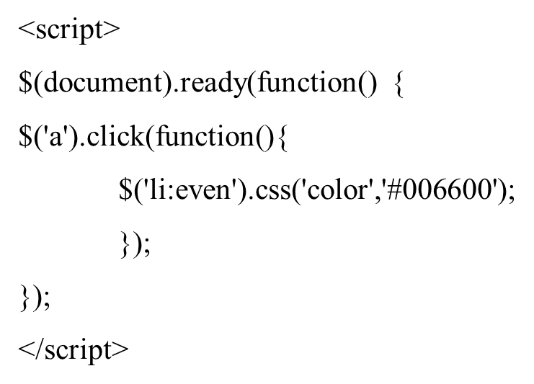
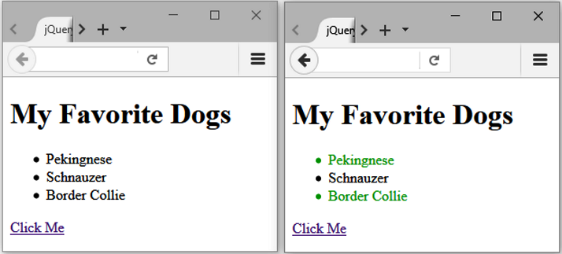
Using the Click() and C S S() Methods

Slide 40
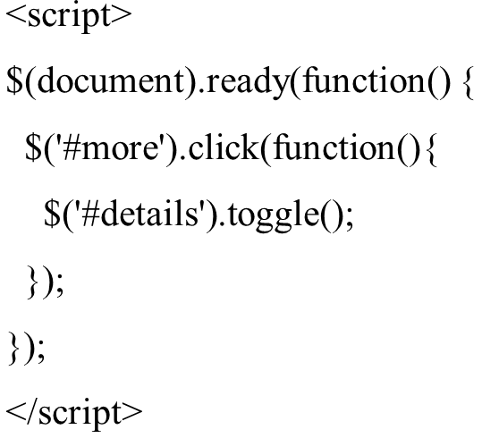
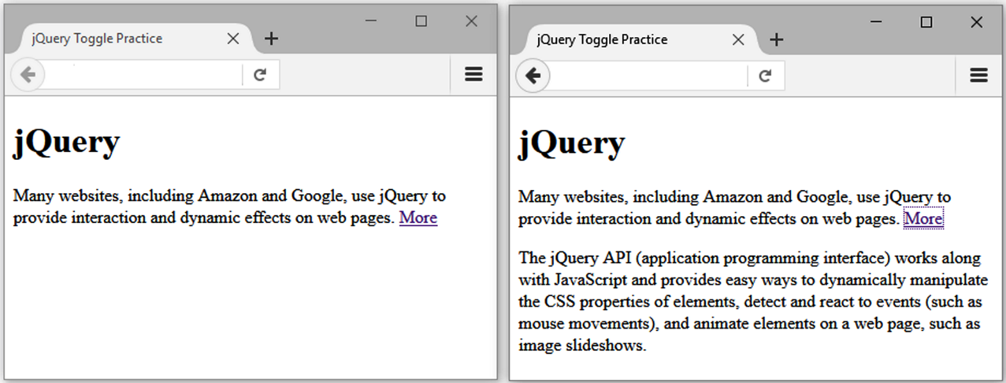
Using the Toggle() Method

Slide 41
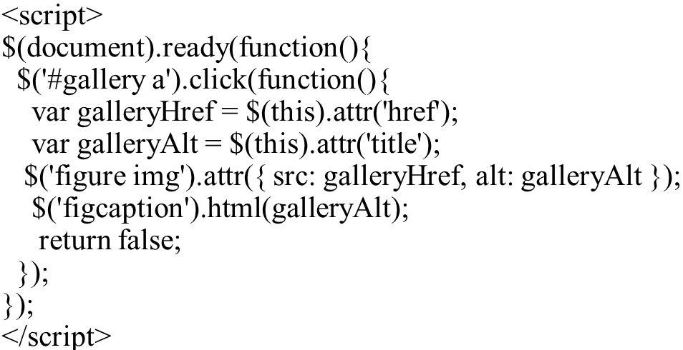
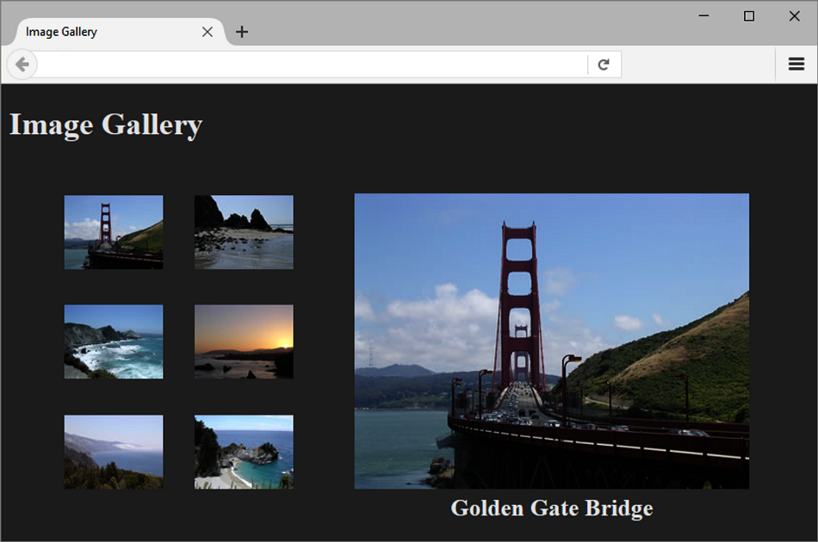
JQuery Image Gallery

Slide 42
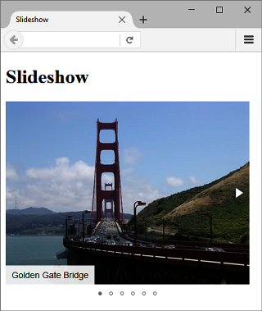
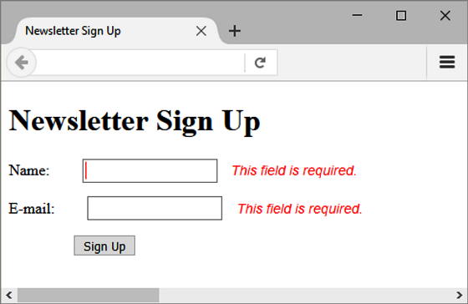
JQuery Plugin
JavaScript that extends the functionality of j Query
http://plugins.jquery.com
M I T license: http://opensource.org/licenses/MIT
Examples:
fotorama plugin
http://fotorama.io
Validate plugin
https://jqueryvalidation.org

Slide 43
Checkpoint 14.5
Describe the two ways the web developers can obtain the jQuery JavaScript Library
Explain the purpose of the c s s() method.
Describe the purpose of the ready event.

Slide 44
Summary
This chapter introduced the use of JavaScript and jQuery on web pages.

Slide 45
Copyright

