Slide 1
Web Development & Design Foundations with H T M L 5
Ninth Edition
Chapter 4
Visual Elements and Graphics
Slides in this presentation contain hyperlinks. JAWS users should be able to get a list of links by using INSERT+F7
Copyright © 2019, 2017, 2015 Pearson Education, Inc. All Rights Reserved
Notes:
If this PowerPoint presentation contains mathematical equations, you may need to check that your computer has the following installed:
1) MathType Plugin
2) Math Player (free versions available)
3) NVDA Reader (free versions available)

Slide 2
Learning Objectives (1 of 2)
4.1 Create and format lines and borders on web pages
4.2 Apply the image element to add graphics to web pages
4.3 Optimize an image for web page display
4.4 Configure images as backgrounds on web pages
4.5 Configure images as hyperlinks

Slide 3
Learning Objectives (2 of 2)
4.6 Configure visual effects with C S S 3 including multiple background images, rounded corners, box shadow, text shadow, opacity, and gradients
4.7 Configure R G B A and H S L A color with C S S 3
4.8 Use H T M L 5 elements to caption a figure
4.9 Use the H T M L 5 meter and progress elements
4.10 Find free and fee-based graphics sources
4.11 Follow recommended web design guidelines for graphics on web pages

Slide 4
Horizontal Rule Element
Configures a horizontal line

Slide 5
C S S Border Property
Configures a border on the top, right, bottom, and left sides of an element
Consists of
border-width
border-style
border-color

Slide 6
C S S Borders: Block / Inline Elements
Block display element
Default width of element content extends to browser margin (or specified width)
Inline display element
Border closely outlines the element content

Slide 7
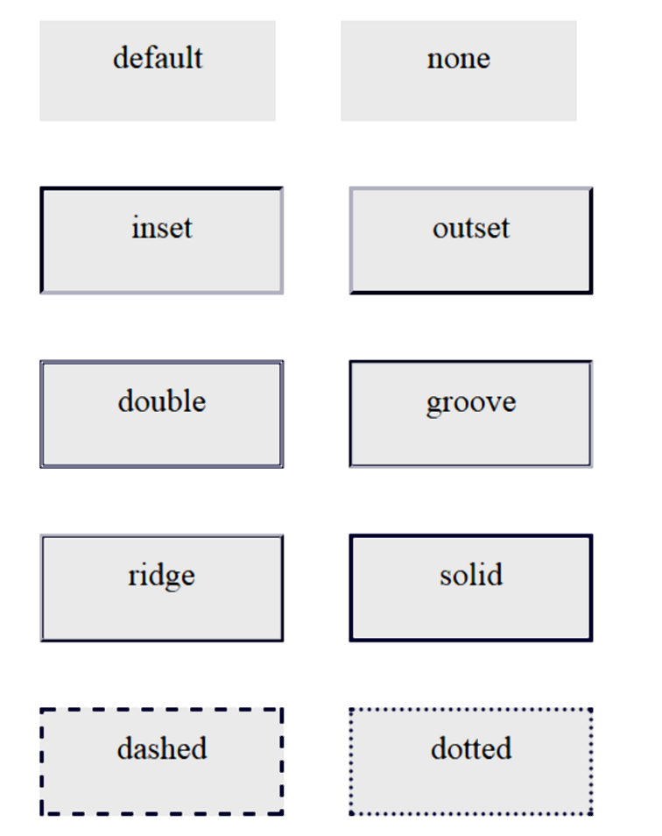
Border Display Can Vary by Browser
Firefox:

Slide 8
Configuring Specific Sides of a Border
Use C S S to configure a line on one or more sides of an element
border-bottom
border-left
border-right
border-top

Slide 9
C S S Padding Property
Configures empty space between the content of the H T M L element and the border
Set to 0px by default
No padding property configured:

Slide 10
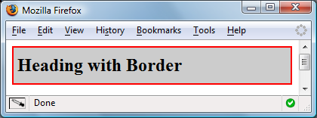
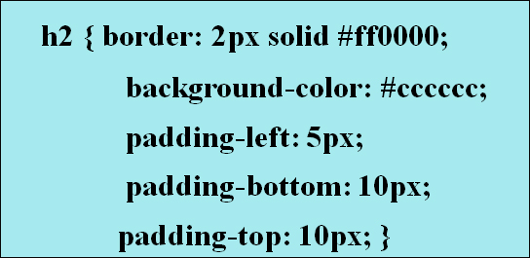
Configure Padding on Specific Sides of an Element
Use C S S to configure padding on one or more sides of an element
padding-bottom
padding-left
padding-right
padding-top

Slide 11
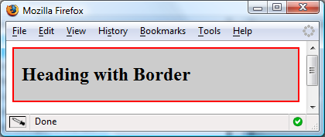
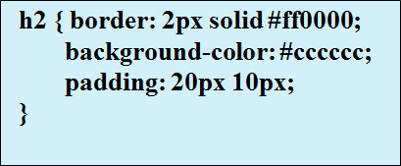
C S S Padding Property Shorthand: Two Values
Two numeric values or percentages
first value configures top and bottom padding
the second value configures left and right padding

Slide 12
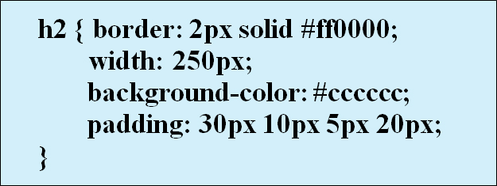
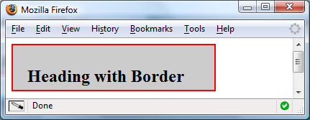
C S S Padding Property Shorthand: Four Values
Four numeric values or percentages
Configure top, right, bottom, and left padding

Slide 13
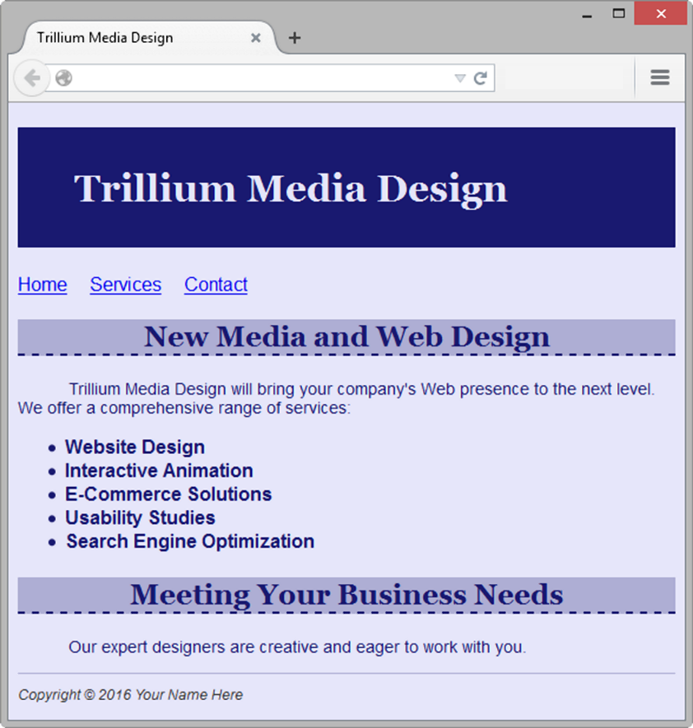
Hands-On Practice

Slide 14
Checkpoint 4.1
Is it reasonable to try to code a web page that looks exactly the same on every browser and every platform? Explain your answer.
When a web page containing the style rules below is rendered in a browser, the border does not display. Describe what is incorrect with the following code:
True or False? C S S can be used to configure visual elements such as rectangular shapes and lines on web pages

Slide 15
Types of Graphics
Graphic types commonly used on web pages:
G I F
J P G
P N G

Slide 16
G I F
Graphics Interchange Format
Best used for line art and logos
Maximum of 256 colors
One color can be configured as transparent
Can be animated
Uses lossless compression
Can be interlaced

Slide 17
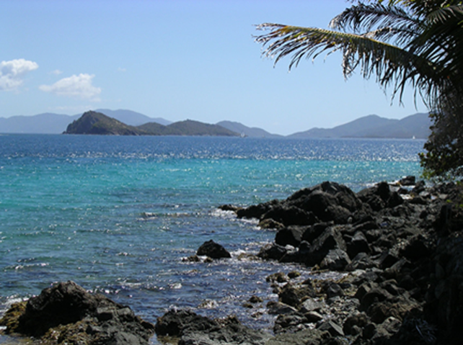
J P E G
Joint Photographic Experts Group
Best used for photographs
Up to 16.7 million colors
Use lossy compression
Cannot be animated
Cannot be made transparent
Progressive J P E G – similar to interlaced display

Slide 18
P N G
Portable Network Graphic
Support millions of colors
Support multiple levels of transparency (but most browsers do not -- so limit to one transparent color for Web display)
Support interlacing
Use lossless compression
Combines the best of G I F & J P E G
Browser support is growing

Slide 19
H T M L Image Element
Configures graphics on a web page
src Attribute
File name of the graphic
alt Attribute
Configures alternate text description
height Attribute
Height of the graphic in pixels
width Attribute
Width of the graphic in pixels

Slide 20
Accessibility & Images
Required:
Configure the alt attribute
Alternate text content to convey the meaning/intent of the image
Not the file name of the image
Use alt="" for purely decorative images
Recommended:
If your site navigation uses image links for the main navigation, provide simple text links at the bottom of the page.

Slide 21
Image Link
To create an image hyperlink use an anchor element to contain an image element
Some browsers automatically add a border to image links.
Configure C S S to eliminate the border

Slide 22
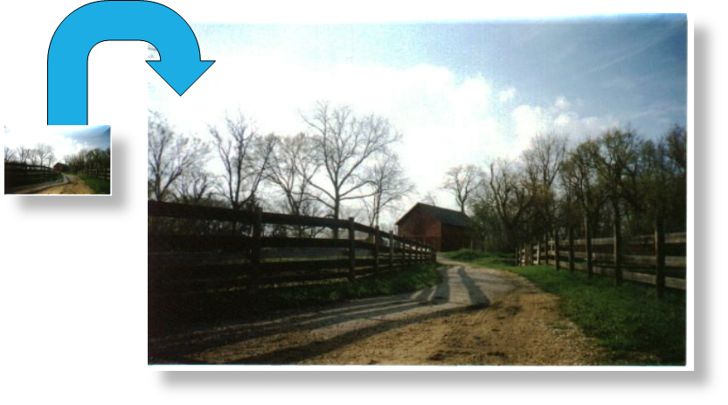
Thumbnail Image
A small image configured to link to a larger version of that image.

Slide 23
Image Optimization
The process of creating an image with the lowest file size that still renders a good quality image— balancing image quality and file size.
Photographs taken with digital cameras are not usually optimized for the Web

Slide 24
Optimize an Image for the Web
Image Optimization
Reduce the file size of the image
Reduce the dimensions of the image to the actual width and height of the image on the web page.
Image Editing Tools:
G I M P (free!)
Adobe Photoshop
https://pixlr.com/editor (free!)

Slide 25
Choosing Names for Image Files
Use all lowercase letters
Do not use punctuation symbols and spaces
Do not change the file extensions (should be .gif, .jpg, .jpeg, or .png)
Keep your file names short but descriptive
i1.gif is probably too short
myimagewithmydogonmybirthday.gif is too long
dogbday.gif may be just about right

Slide 26
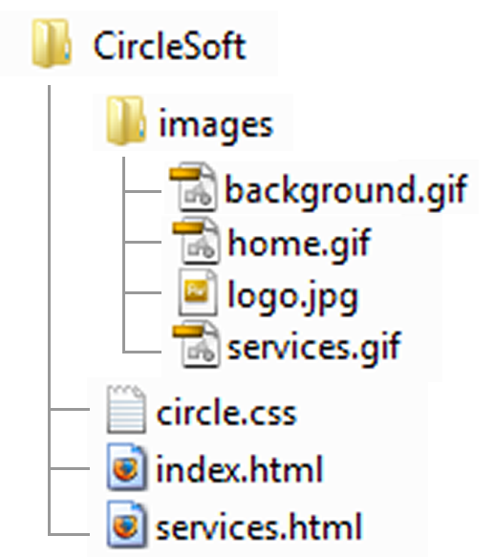
Organizing Your Site
Place images in their own folder
Code the path to the file in the src attribute

Slide 27
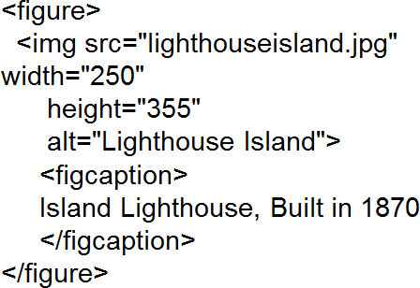
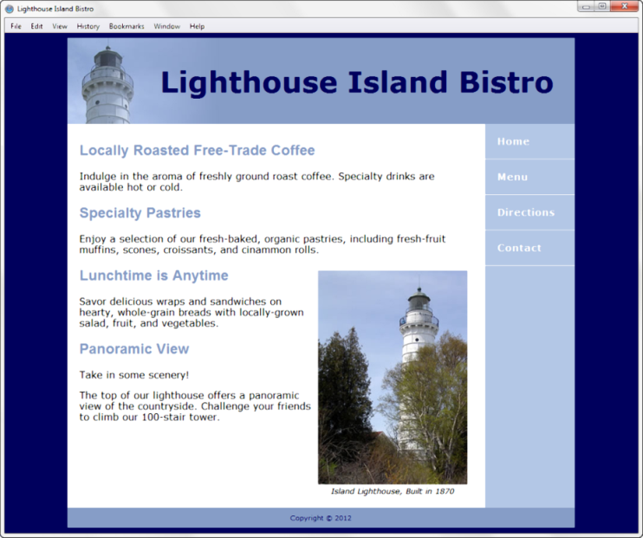
H T M L5 Figure and Figcaption Elements
Figure Element: contains a unit of content that is self-contained, such as an image, along with one optional figcaption element.

Slide 28
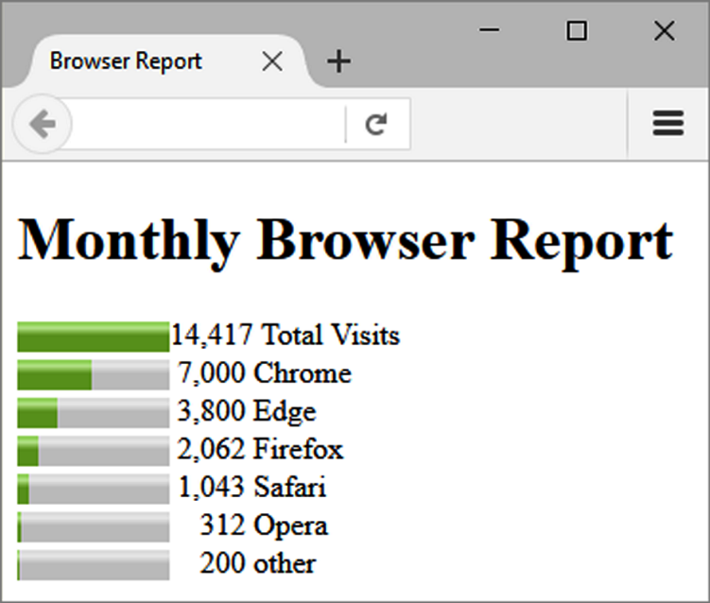
H T M L5 Meter Element
Displays a visual gauge of a numeric value within a known range

Slide 29
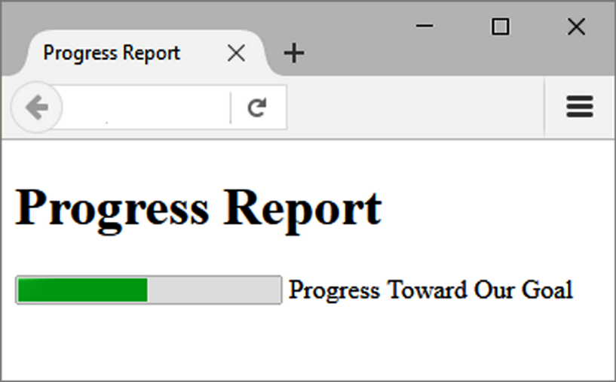
H T M L5 Progress Element
Displays a bar that depicts a numeric value within a specified range

Slide 30
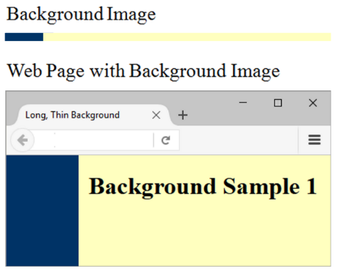
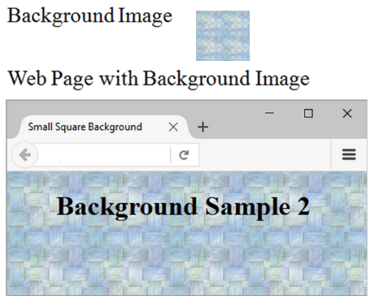
C S S Background-Image Property
Configures a background-image
By default, background images tile (repeat)

Slide 31
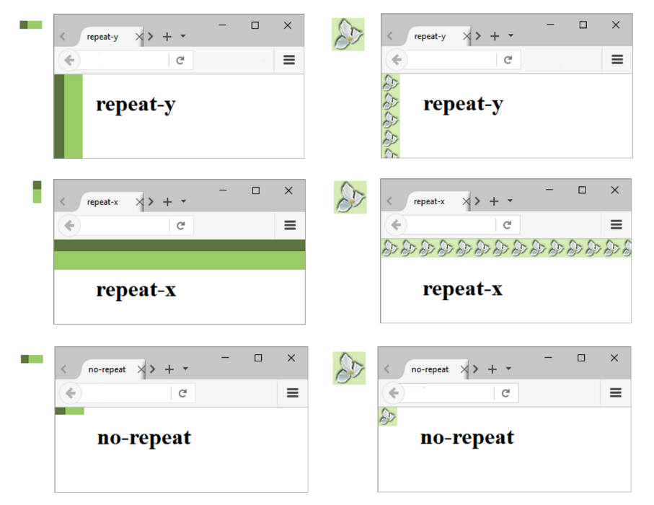
C S S Background-Repeat Property

Slide 32
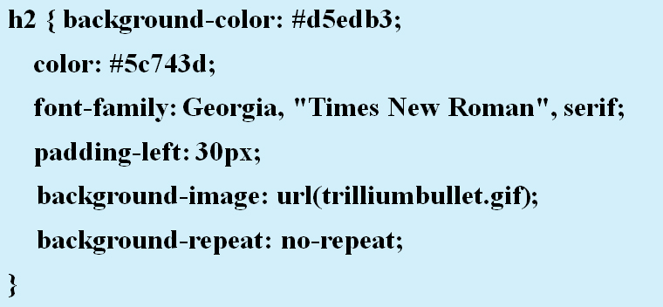
Using Background-Repeat
trilliumbullet.gif:

Slide 33
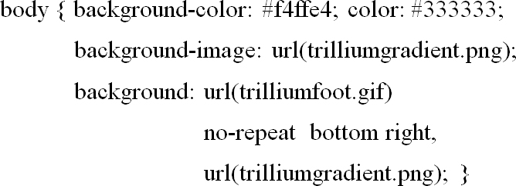
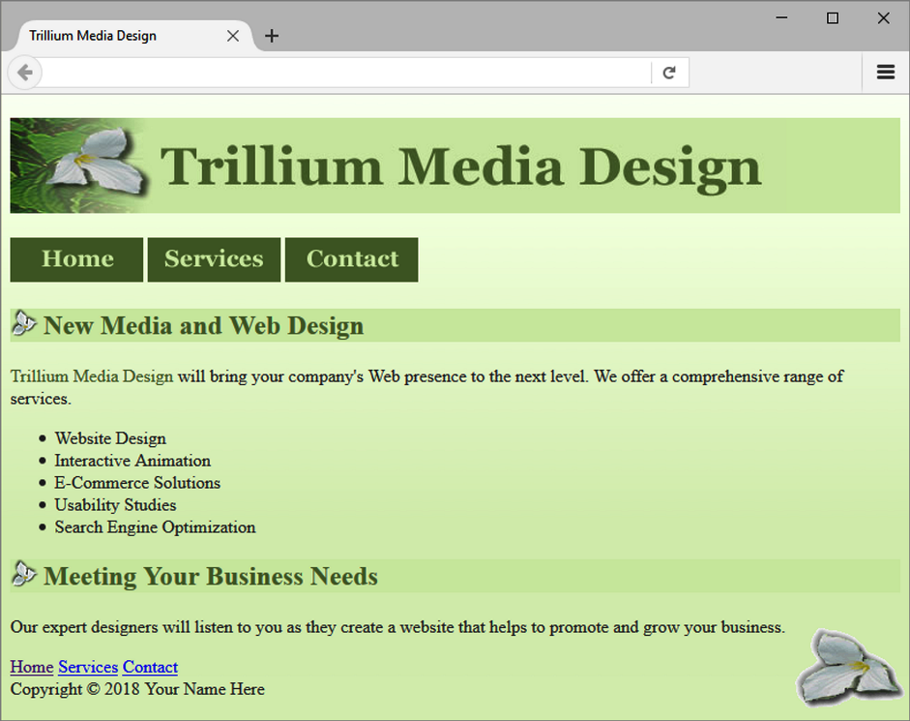
C S S3 Multiple Background Images

Slide 34
Checkpoint 4.2
Describe the C S S to configure a graphic named circle.jpg to display once in the background of all
elements. Code sample C S S to demonstrate this.
Describe the C S S that configures a file named bg.gif to repeat vertically down the background of a web page. Code sample C S S to demonstrate this.
Explain how the browser will render the web page if you use C S S to configure both a background image and a background color.

Slide 35
More About Images
Image Map
Favorites Icon
C S S Sprites
Sources for Graphics
Guidelines for Using Images
Accessibility & Visual Elements

Slide 36
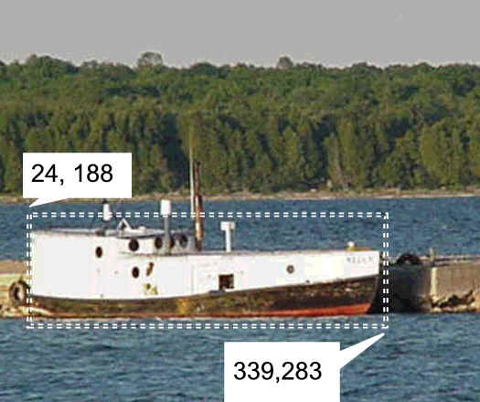
Image Map
map element
Defines the map
area element
Defines a specific area on a map
Can be set to a rectangle, circle, or polygon
href Attibute
shape Attribute
coords Attribute

Slide 37
Favorites Icon - Favicon
A square image associated with a web page
Usually named: favicon.ico
May display in the browser address bar, tab, or favorites/bookmarks list
Configure with a link tag:

Slide 38
C S S Sprites
Sprite –
an image file that contains multiple small graphics that are configured as background images for various web page elements
Modern technique to optimize use of multiple icon or small images
Saves overhead by reducing the number of http requests made by the browser.
You’ll use C S S Sprites in Chapter 7!

Slide 39
Sources for Graphics (1 of 2)
Create them yourself using a graphics application:
G I M P
Adobe Photoshop
Adobe Fireworks
Google’s Picasa (http://picasa.google.com/)
Download graphics from a free site

Slide 40
Sources for Graphics (2 of 2)
Purchase/download professional-quality graphics
Purchase a graphics collection on a C D
Take digital photographs
Scan your photographs
Scan your drawings
Hire a graphic designer to create graphics

Slide 41
Guidelines for Using Images
Reuse images
Consider image file size with image quality
Consider image load time
Use appropriate resolution
Specify dimensions
Be aware of brightness and contrast

Slide 42
Images and Accessibility
Don’t rely on color alone.
Some visitors may have color perception deficiencies. Use high contrast between background and text color.
Provide a text equivalent for non-text elements.
Use the alt attribute on your image elements
If your site navigation uses image links, provide simple text links at the bottom of the page.

Slide 43
Checkpoint 4.3
Search for a site that uses image links to provide navigation. List the U R L of the page.
What colors are used on the image links?
If the image links contain text, is there good contrast between the background color and letters on the image links?
Would the page be accessible to a visitor who is sight-challenged?
How have accessibility issues been addressed?
Is the alt attribute used to describe the image link?
Is there a row of text links in the footer section of the page?
Answer the questions above and discuss your findings.

Slide 44
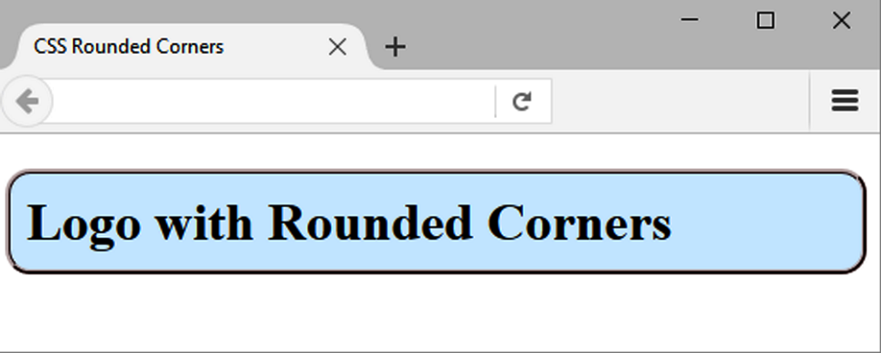
C S S3 Rounded Corners
border-radius property
Configures the horizontal radius and vertical radius of the corner
Numeric value(s) with unit (pixel or em) or percentage
Example

Slide 45
Examples of Rounded Corners
One value for border-radius configures all four corners Example: border-radius: 15px;
Four values for border-radius configure each corner separately Ordered by top left, top right, bottom right, bottom left Example: border-radius: 15px 30px 100px 5px;

Slide 46
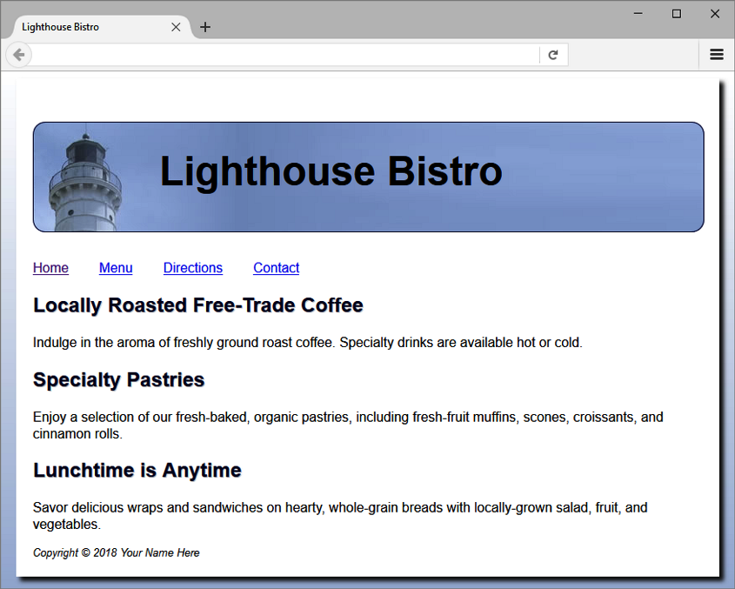
C S S3 Box-Shadow Property
Configure the horizontal offset, vertical offset, blur radius, and valid color value
Example:
Optional keyword: inset

Slide 47
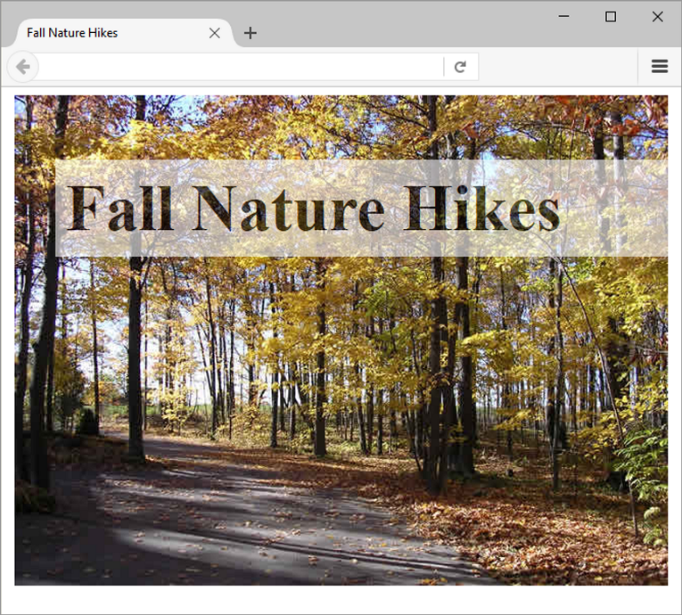
C S S3 Opacity Property
Configure the opacity of the element
Opacity range:
0 Completely Transparent
1 Completely Opaque horizontal offset, vertical offset, blur radius, and valid color value
Example:

Slide 48
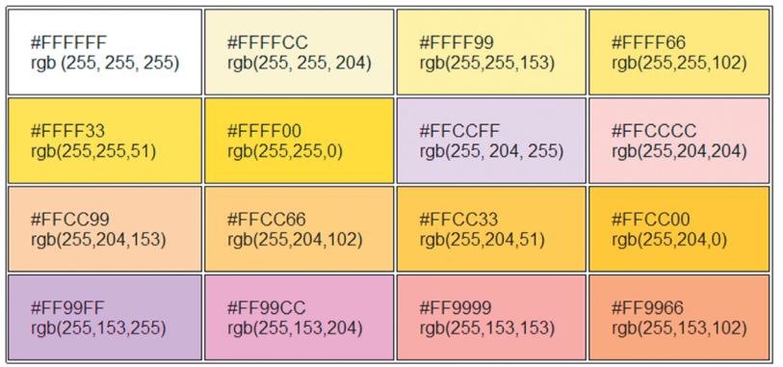
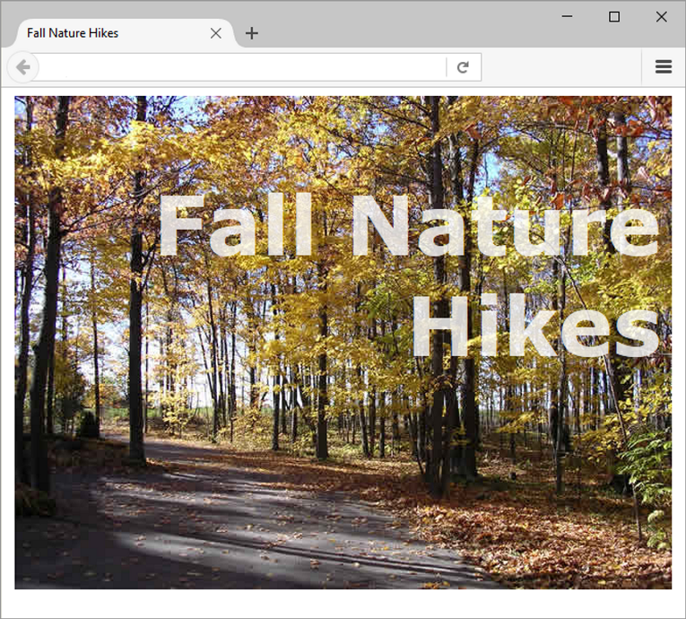
Rgba Color
Four values are required:
red color, green color, blue color, and alpha(transparency)
The values for red, green, and blue must be decimal values from 0 to 255.
The alpha value must be a number between 0 (transparent) and 1 (opaque).
Example:

Slide 49
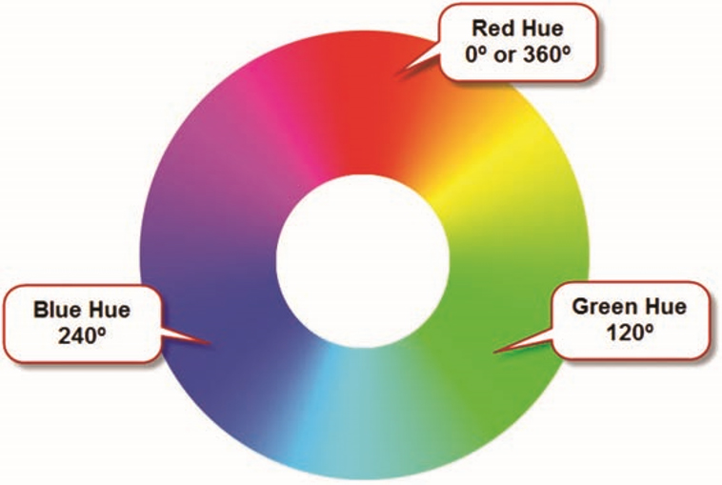
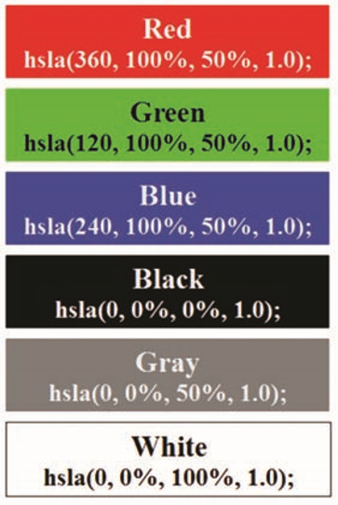
H S L A Color (Hue, Saturation, Light, Alpha)
Hue is a value between 0 and 360
Saturation: percent
Lightness: percent
Optional alpha: from 0 to 1

Slide 50
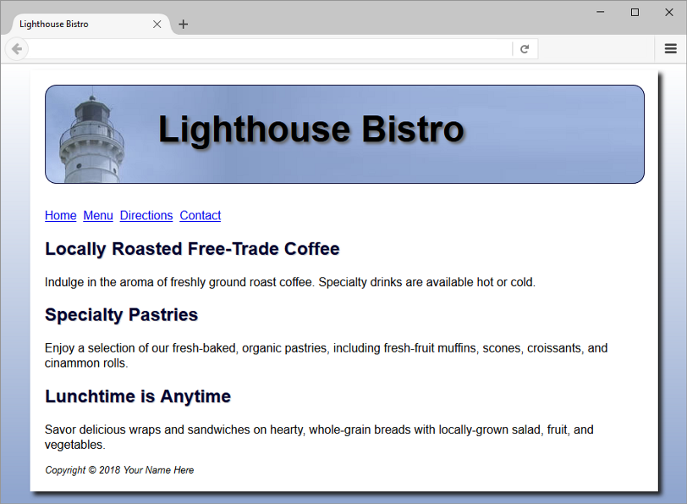
C S S3 Gradients
Gradient: a smooth blending of shades from one color to another
Use the background-image property
linear-gradient()
radial-gradient()
Example:

Slide 51
Summary
This chapter introduced the use of visual elements and graphics on web pages.
As you continue to create web pages, look back at the guidelines and accessibility issues related to graphics.
The number one reason for visitors to leave web pages is too long of a download time. When using images, be careful to minimize this issue.
Provide alternatives to images (such as text links) and use the alt attribute on your pages.

Slide 52
Copyright

