Slide 1
Web Development & Design Foundations with H T M L 5
Ninth Edition
Chapter 5
Web Design
Slides in this presentation contain hyperlinks. JAWS users should be able to get a list of links by using INSERT+F7
Copyright © 2019, 2017, 2015 Pearson Education, Inc. All Rights Reserved
Notes:
If this PowerPoint presentation contains mathematical equations, you may need to check that your computer has the following installed:
1) MathType Plugin
2) Math Player (free versions available)
3) NVDA Reader (free versions available)

Slide 2
Learning Objectives
5.1 Describe the most common types of website organization
5.2 Describe principles of visual design
5.3 Design for your target audience
5.4 Create clear, easy-to-use navigation
5.5 Improve the readability of the text on your web pages
5.6 Use graphics appropriately on web pages
5.7 Apply the concept of universal design to web pages
5.8 Describe web page layout design techniques
5.9 Apply best practices of web design

Slide 3
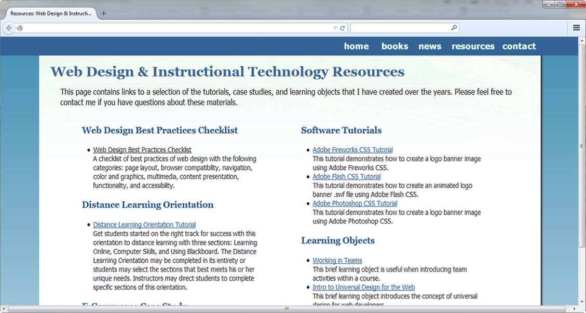
Overall Design Is Related to the Site Purpose
Consider the target audience of these sites.

Slide 4
Website Organization
Hierarchical
Linear
Random (sometimes called Web Organization)

Slide 5
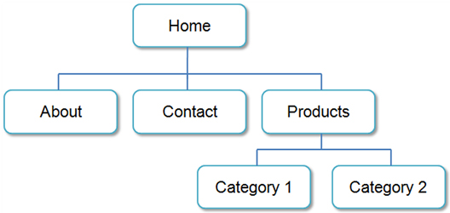
Hierarchical Organization
A clearly defined home page
Navigation links to major site sections
Often used for commercial and corporate websites

Slide 6
Hierarchical & Shallow
Be careful that the organization is not too shallow.
Too many choices → a confusing and less usable web site
Information Chunking
Research by Nelson Cowan: adults typically can keep about four items or chunks of items in short-term memory (http://www.ncbi.nlm.nih.gov/pmc/articles/PMC2864034/)
Be aware of the number of major navigation links
Try group navigation links visually into groups with no more than about four links.

Slide 7
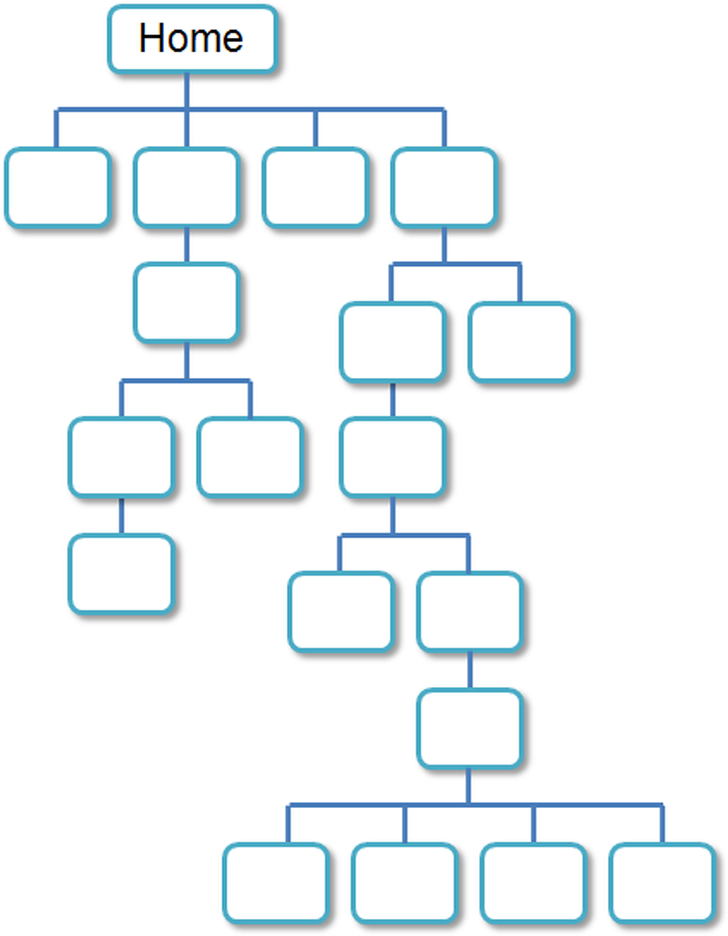
Hierarchical & Deep
Be careful that the organization is not too deep.
This results in many “clicks” needed to drill down to the needed page.
User Interface “Three Click Rule”
A web page visitor should be able to get from any page on your site to any other page on your site with a maximum of three hyperlinks

Slide 8
Linear Organization
A series of pages that provide a tutorial, tour, or presentation.
Sequential viewing

Slide 9
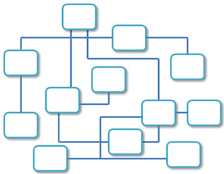
Random Organization
Sometimes called “Web” Organization
Usually there is no clear path through the site
May be used with artistic or concept sites
Not typically used for commercial sites

Slide 10
Design Principles
Repetition
Repeat visual elements throughout design
Contrast
Add visual excitement and draw attention
Proximity
Group related items
Alignment
Align elements to create visual unit

Slide 11
Design to Provide for Accessibility
“The power of the Web is in its universality. Access by everyone regardless of disability is an essential aspect.” – Tim Berners-Lee
Who benefits from increased accessibility?
A person with a physical disability
A person using a slow Internet connection
A person using an old, out-dated computer
A person using a mobile phone
Legal Requirement: Section 508
Standards: W C A G 2.0

Slide 12
Design for Accessibility
Web Content Accessibility Guidelines 2.0 W C A G 2.0 http://www.w3.org/TR/WCAG20/Overview http://www.w3.org/WAI/WCAG20/quickref
Based on Four Principles (P O U R)
1. Perceivable
Content must be Perceivable
2. Operable
Interface components in the content must be Operable
3. Understandable
Content and controls must be Understandable
4. Robust.
Content should be Robust enough to work with current and future user agents, including assistive technologies

Slide 13
Writing for the Web
Avoid long blocks of text
Use bullet points
Use headings and subheadings
Use short paragraph

Slide 14
Design “Easy to Read” Text
Use common fonts:
Arial, Helvetica, Verdana, Times New Roman
Use appropriate text size:
medium, 1em, 100%
Use strong contrast between text & background
Use columns instead of wide areas of horizontal text

Slide 15
More Text Design Considerations
Carefully choose text in hyperlinks
Avoid “click here”
Hyperlink key words or phrases, not entire sentences
Chek yur spellin (Check your spelling)

Slide 16
Color Theory
Color Theory:
the study of color and its use in design
Color Wheel
Primary Colors
Secondary Colors
Tertiary Colors

Slide 17
Color Schemes Based on the Color Wheel (1 of 2)
Monochromatic – shades, tints, or tones of the same color http://meyerweb.com/eric/tools/color-blend
Analogous – a main color and two colors adjacent to it on the color wheel
Complementary – two colors that are opposite each other on the color wheel

Slide 18
Color Schemes Based on the Color Wheel (2 of 2)
Split Complementary – a main color, the color opposite it on the color wheel (the complement) and two colors adjacent to the complement
Triadic- three colors that are equidistant on the color wheel
Tetradic – two complementary color pairs

Slide 19
Implementing a Color Scheme
Choose one color to be dominant
Use other colors in the color scheme as accent colors
headings,
subheadings
borders,
list markers, etc.
Use neutrals such as white, off-white, gray, black, or brown
Do not restrict yourself to web-safe colors
Feel free to use tints, shades, or tones of colors

Slide 20
Verify Sufficient Contrast
When you choose colors for text and background, sufficient contrast is needed so that the text is easy to read.
Use one of the following online tools to verify contrast:
http://webaim.org/resources/contrastchecker
http://snook.ca/technical/colour_contrast/colour.html
http://juicystudio.com/services/luminositycontrastratio.php

Slide 21
Color Scheme Resources
http://meyerweb.com/eric/tools/color-blend
http://colorschemedesigner.com
http://www.colorsontheweb.com/colorwizard.asp
http://www.leestreet.com/QuickColor.swf
https://color.adobe.com
http://www.colorspire.com
http://colrd.com
http://hslpicker.com

Slide 22
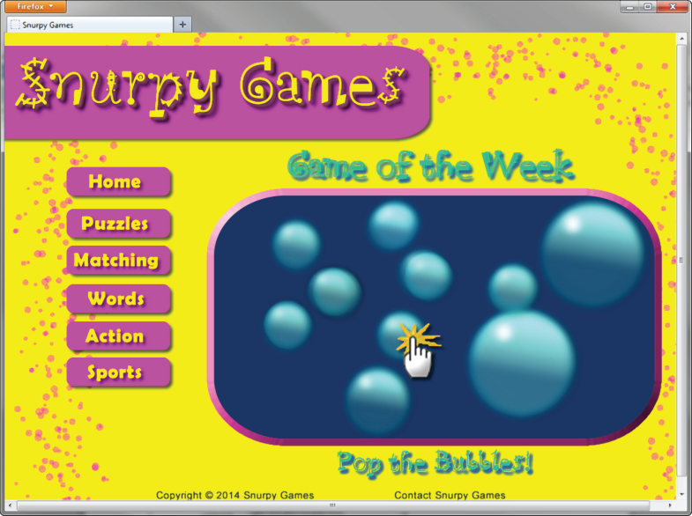
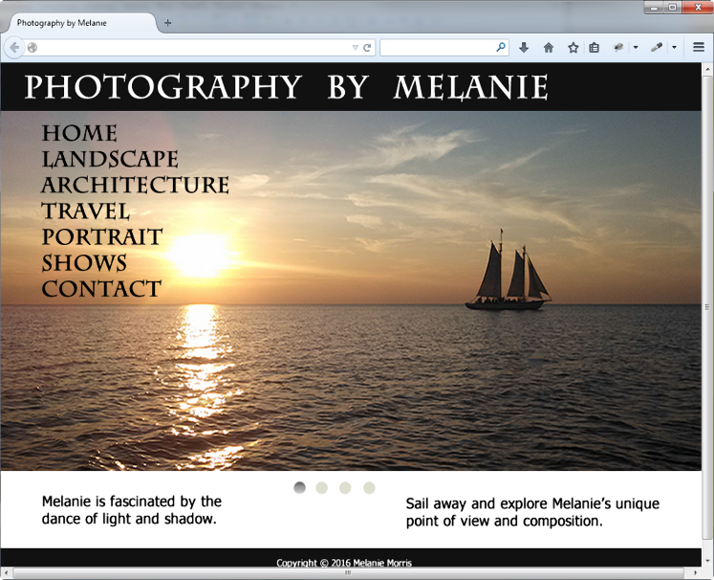
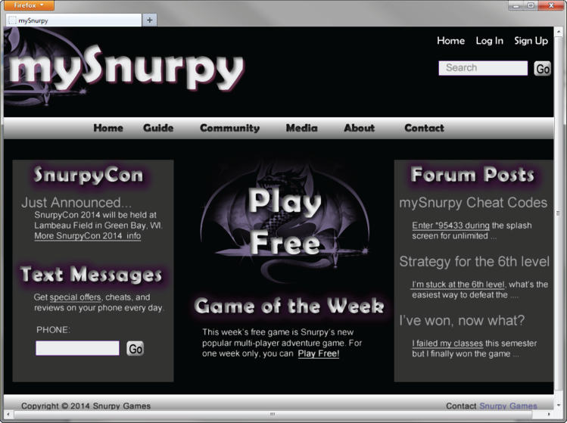
Color & Target Audience
Appealing to Kids & Preteens
Appealing to Everyone
Appealing to Young Adults
Appealing to Older Adults

Slide 23
Checkpoint 5.1
List the four basic principles of design.
View the home page of your school and describe how each principle is applied.
View http://www.walmart.com, http://www.willyporter.com, and http://www.sesamestreet.org/muppet
Describe the target audience for each site.
How do their designs differ?
Do the sites meet the needs of their target audiences?

Slide 24
Use of Graphics & Multimedia
File size and dimension matter
Provide for robust navigation
Antialiased/aliased text considerations
Provide alternate text
Use only necessary multimedia

Slide 25
Graphic Design Best Practices (1 of 3)
Be careful with large graphics!
Remember 60K recommendation
Use the alt attribute to supply descriptive alternate text
Be sure your message gets across even if images are not displayed.
If using images for navigation provide plain text links at the bottom of the page.
Use animation only if it makes the page more effective and provide a text description.

Slide 26
Graphic Design Best Practices (2 of 3)
There is no requirement to limit your color choices to web safe colors.
Use anti-aliased text in images

Slide 27
Graphic Design Best Practices (3 of 3)
Use only necessary images
Reuse images
Goal: image file size should be as small as possible with acceptable display quality

Slide 28
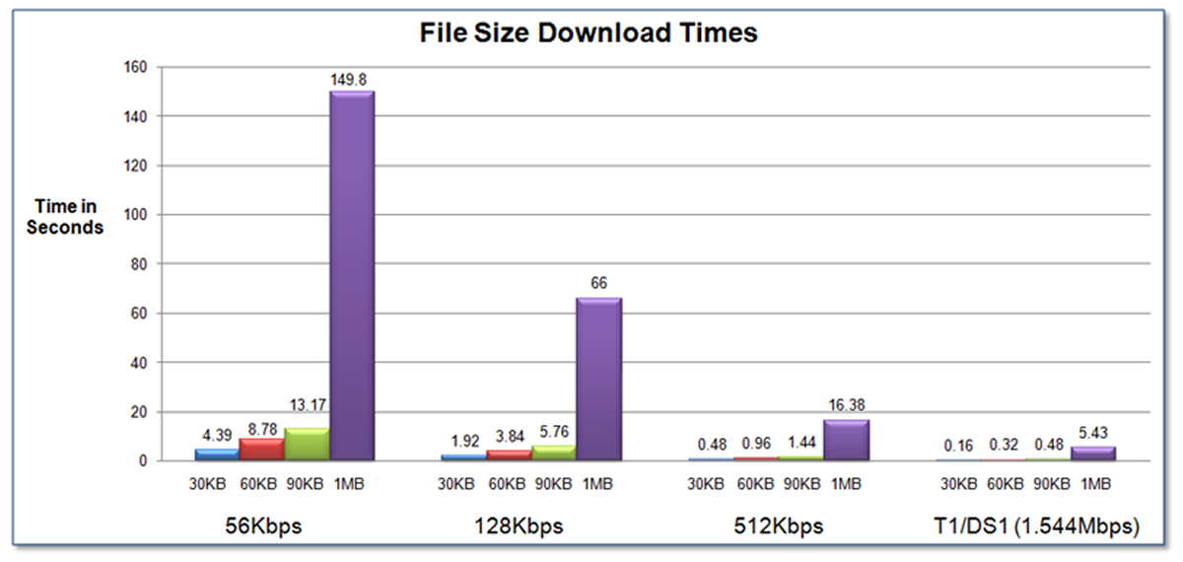
Web Page Design Load Time
Watch the load time of your pages
Try to limit web page document and associated media to under 60K on the home page

Slide 29
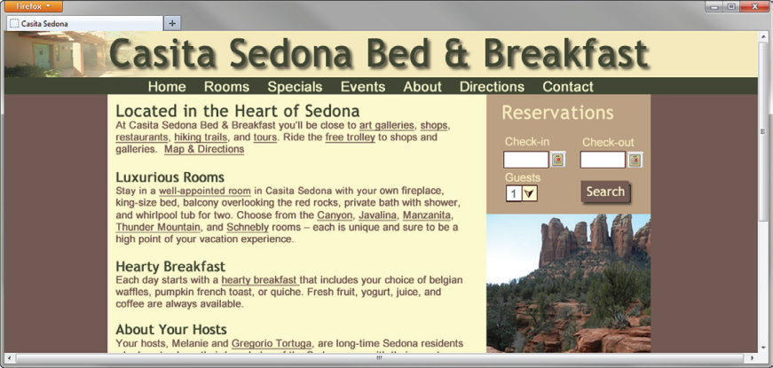
Web Page Design Browsers & Screen Resolution
Test with multiple browsers
Internet Explorer, Google Chrome, Mozilla Firefox, Apple Safari
Test at various screen resolutions
Design to look good at various screen resolutions
Centered page content
Set to either a fixed or percentage width

Slide 30
Navigation Design
Make your site easy to navigate
Provide clearly labeled navigation in the same location on each page
Most common – across top or down left side
Consider:
Navigation Bars
Breadcrumb Navigation
Using Graphics for Navigation
Dynamic Navigation
Site Map
Site Search Feature
“Skip to Content” Hyperlink

Slide 31
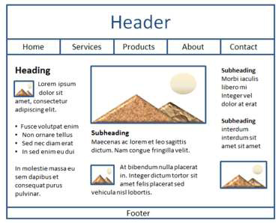
Wireframe
A sketch or blueprint of a web page
Shows the structure of the basic page elements, including:
Header
Navigation
Content
Footer
Image locations

Slide 32
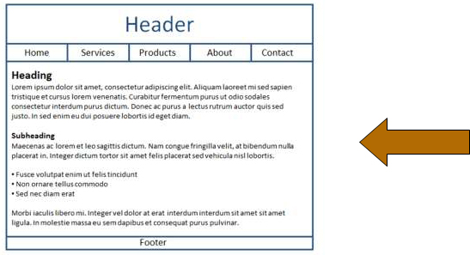
Web Page Design Page Layout (1 of 3)
Place the most important information “above the fold”
Use adequate “white” or blank space
Use an interesting page layout
This is usable, but a little boring. See the next slide for improvements in page layout.

Slide 33
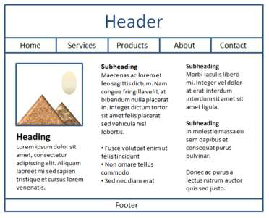
Web Page Design Page Layout (2 of 3)
Better
Columns make the page more interesting and it’s easier to read this way.

Slide 34
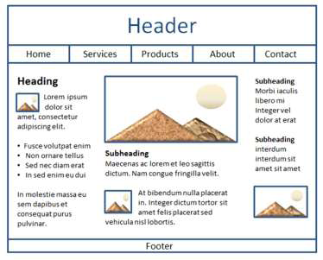
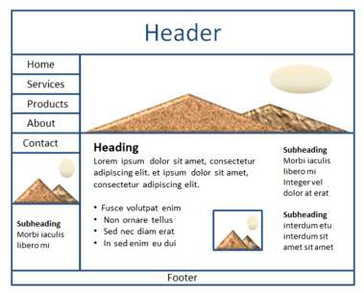
Web Page Design Page Layout (3 of 3)
Columns of different widths interspersed with graphics and headings create the most interesting, easy to read page.
Best

Slide 35
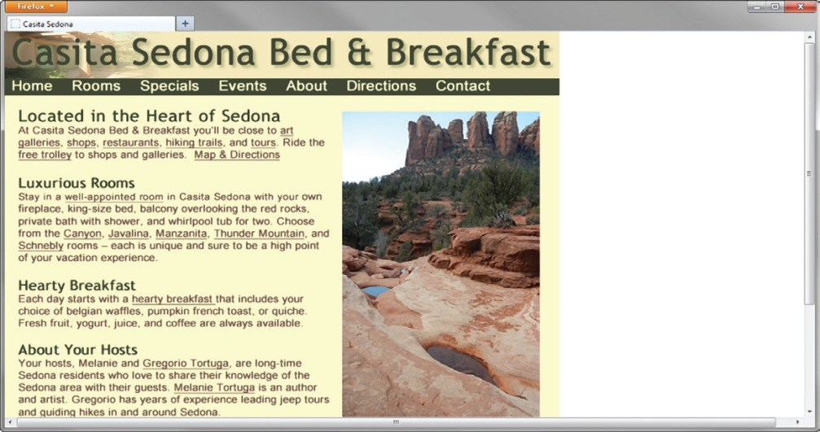
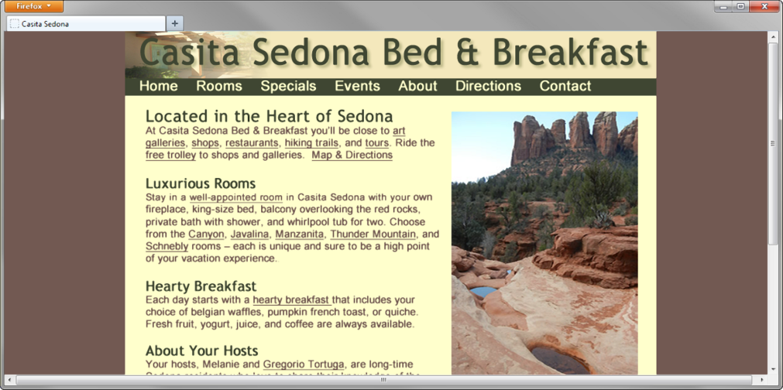
Page Layout Design Techniques (1 of 2)
Fixed Layout
A K A rigid or “ice” design
Fixed-width often at left margin
More appealing if fixed with content is centered

Slide 36
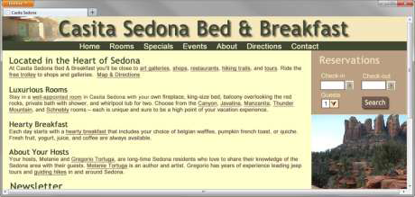
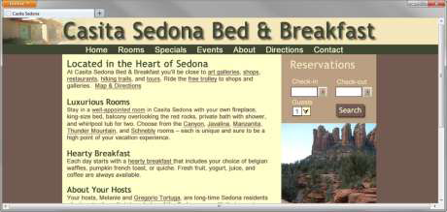
Page Layout Design Techniques (2 of 2)
Fluid Layout
A K A “liquid” design
Expands to fill the browser at all resolutions.
Adaptation:
Page content typically centered and often configured with a percentage width such as 80%

Slide 37
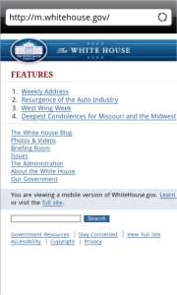
Design for the Mobile Web
Predicted that by 2015, more users will access websites using mobile devices than with desktop computers
Three Approaches:
Separate .mobi mobile site
Host the mobile site within your current domain
Configure your current website for mobile display using responsive web design techniques

Slide 38
Mobile Design Quick Checklist
Small screen size
Bandwidth issues
Single-column layout
Maximize contrast
Optimize images for mobile display
Descriptive alternate text for images
Avoid display of non-essential content

Slide 39
Responsive Web Design
Ethan Marcotte, noted web developer http://www.alistapart.com/articles/responsive-web-design
Progressively enhancing a web page for different viewing contexts (such as smartphones and tablets) through the use of coding techniques, including flexible layouts and media queries.
Examples: http://www.mediaqueri.es

Slide 40
Web Design Best Practices Checklist
http://terrymorris.net/bestpractices
Page Layout
Browser Compatibility
Navigation
Color and Graphics
Multimedia
Content Presentation
Functionality
Accessibility

Slide 41
Checkpoint 5.2
View the home page of your school. Use the Best Practices Checklist (Table 5.1) to evaluate the page. Describe the results.
View your favorite web site (or a U R L provided by your instructor).
Maximize and resize the browser window.
Decide whether the site uses fixed or fluid design.
Adjust the screen resolution on your monitor
to a different resolution than you normally use.
Does the site look similar or very different?
List two recommendations for improving the design of the site.
List three best practices of using graphics on web pages. View the home page of your school. Describe the use of graphic design best practices on this page.

Slide 42
Table 5.1 Web Design Best Practices Checklist Note (1 of 7)
Page Layout
Appealing to target audience
Consistent site header/logo
Consistent navigation area
Informative page title that includes the company/organization/site name
Page footer area includes copyright, last update, contact e-mail address
Good use of basic design principles: repetition, contrast, proximity, and alignment
Displays without horizontal scrolling at 1024 × 768 and higher resolutions
Balance of text/graphics/white space on page
Good contrast between text and background
Repetitive information (header/logo and navigation) occupies less than one-quarter to one-third of the browser window at 1024 × 768 resolution

Slide 43
Table 5.1 Web Design Best Practices Checklist Note (2 of 7)
Home page has compelling, interesting information above the fold (before scrolling down) at 1024 × 768 resolution
Home page downloads within 10 seconds on dial-up connection
Viewport meta tag is used to enhance display on smartphones
Media queries configure responsive page layout for smartphone and tablet display
Browser Compatibility
Displays on current versions of Microsoft Edge
Displays on current versions of Firefox
Displays on current versions of Google Chrome
Displays on current versions of Safari
Displays on current versions of Internet Explorer
Displays on mobile devices (including tablets and smartphones)

Slide 44
Table 5.1 Web Design Best Practices Checklist Note (3 of 7)
Navigation
Main navigation links are clearly and consistently labeled
Navigation is easy to use for target audience
If main navigation uses images, clear text links are in the footer section of the page
If main navigation uses Flash, clear text links are in the footer section of the page
Navigation is structured in an unordered list
Navigation aids (such as site map, skip to content link, and/or breadcrumbs) are used
All navigation hyperlinks work
Color and Graphics
Color scheme is limited to a maximum of three or four colors plus neutrals
Color is used consistently
Background and text colors have sufficient contrast
Color is not used alone to convey meaning
Use of color and graphics enhances rather than detracts from the site

Slide 45
Table 5.1 Web Design Best Practices Checklist Note (4 of 7)
Graphics are optimized and do not slow download significantly
Each graphic used serves a clear purpose
Image tags use the alt attribute to configure alternate text replacement
Animated images do not distract from the site and do not endlessly repeat
Multimedia
Each audio/video/Flash file used serves a clear purpose
The audio/video/Flash files used enhance rather than distract from the site
Captions or transcripts are provided for each audio or video file used
The file size is indicated for audio or video file downloads
Hyperlinks to downloads for media plug-ins are provided

Slide 46
Table 5.1 Web Design Best Practices Checklist Note (5 of 7)
Content Presentation
Common fonts such as Arial, Verdana, Georgia, or Times New Roman are used
Writing techniques for the Web are used: headings, bullet points, brief paragraphs, and so on
Fonts, font sizes, and font colors are consistently used
If web fonts are configured, no more than one font typeface is used.
Content provides meaningful, useful information
Content is organized in a consistent manner
Information is easy to find (minimal clicks)
Timeliness: The date of the last revision and/or copyright date is accurate
Content does not include outdated material
Content is free of typographical and grammatical errors
Avoids the use of “Click here” when writing text for hyperlinks
Hyperlinks use a consistent set of colors to indicate visited/nonvisited status
Alternate text equivalent to content is provided for graphics and media

Slide 47
Table 5.1 Web Design Best Practices Checklist Note (6 of 7)
Functionality
All internal hyperlinks work
All external hyperlinks work
All forms function as expected
No JavaScript errors are generated by the pages
Accessibility
When the main navigation consists of images and/or multimedia, the page footer area contains text hyperlinks
Navigation is structured in an unordered list
Navigation aids, such as site map, skip navigation link, or breadcrumbs are used
Color is not used alone to convey meaning
Text color has sufficient contrast with background color

Slide 48
Table 5.1 Web Design Best Practices Checklist Note (7 of 7)
Image element use the alt attribute to configure alternate text replacement
If graphics are used to convey meaning, the alternate text equivalent is provided
If media is used to convey meaning, the alternate text equivalent is provided
Captions or transcripts are provided for each audio or video file used
Attributes designed to improve accessibility, such as alt and title, are used where appropriate
Use the id and headers attributes to improve the accessibility of table data
If the site uses frames, frame titles are configured and meaningful content is placed in the no-frames area
To assist screen readers, the spoken language of the page is indicated with the H T M L element’s lang attribute

Slide 49
Summary
This chapter introduced you to best practices of web design.
The choices you make in the use of color, graphics, and text should be based on your particular target audience.

Slide 50
Copyright

