Slide 1

Web Development & Design Foundations with H T M L 5
Ninth Edition
Chapter 6
Page Layout
Slides in this presentation contain hyperlinks. JAWS users should be able to get a list of links by using INSERT+F7
Copyright © 2019, 2017, 2015 Pearson Education, Inc. All Rights Reserved
Notes:
If this PowerPoint presentation contains mathematical equations, you may need to check that your computer has the following installed:
1) MathType Plugin
2) Math Player (free versions available)
3) NVDA Reader (free versions available)

Slide 2
Learning Objectives
  6.1 Describe and apply the C S S Box Model
  6.2 Configure margin with C S S
  6.3 Configure float with C S S
  6.4 Configure fixed, relative, and absolute positioning with C S S
  6.5 Create two-column page layouts using C S S
  6.6 Configure navigation in unordered lists and style with C S S
  6.7 Add interactivity to hyperlinks with C S S pseudo-classes
  6.8 Configure web pages with H T M L 5 structural elements, including section, article, and aside

Slide 3
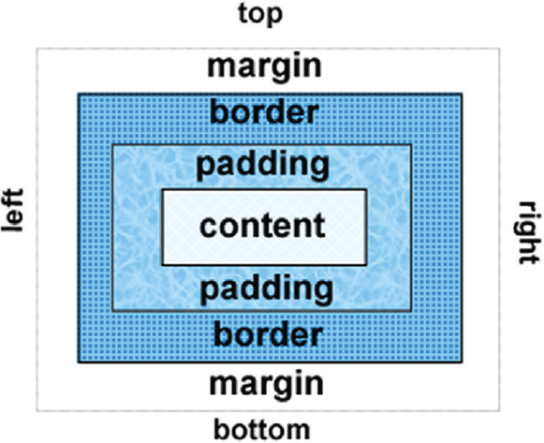
The Box Model
Content
  Text & web page elements in the container
Padding
  Area between the content and the border
Border
  Between the padding and the margin
Margin
  Determines the empty space between the element and adjacent elements

Slide 4
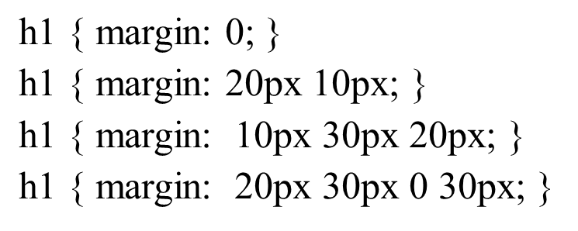
Configure Margin with C S S
  The margin property
  Related properties:
    margin-top, margin-right, margin-left, margin-bottom
  Configures empty space between the element and adjacent elements
  Syntax examples

Slide 5
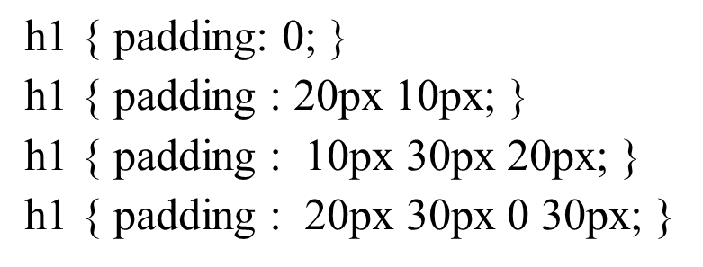
Configure Padding with C S S
  The padding property
  Related properties:
    padding-top, padding-right, padding-left, padding-bottom
  Configures empty space between the content of the H T M L element (such as text) and the border
  Syntax examples

Slide 6
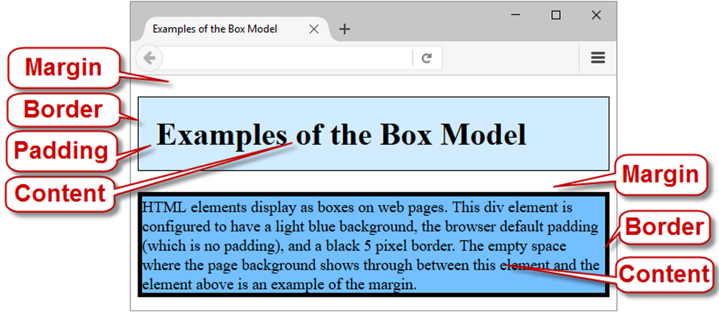
Box Model in Action

Slide 7
The C S S Box-Sizing Property
Default value for width or height is the value for Only the content (not including border and padding).
The box-sizing property is used to selector to direct the browser to calculate the width and height of an element to include the value for content, padding, and border.
Use the universal selector (*) to apply this to all the element on the page
Example:
  * { box-sizing: border-box; }

Slide 8
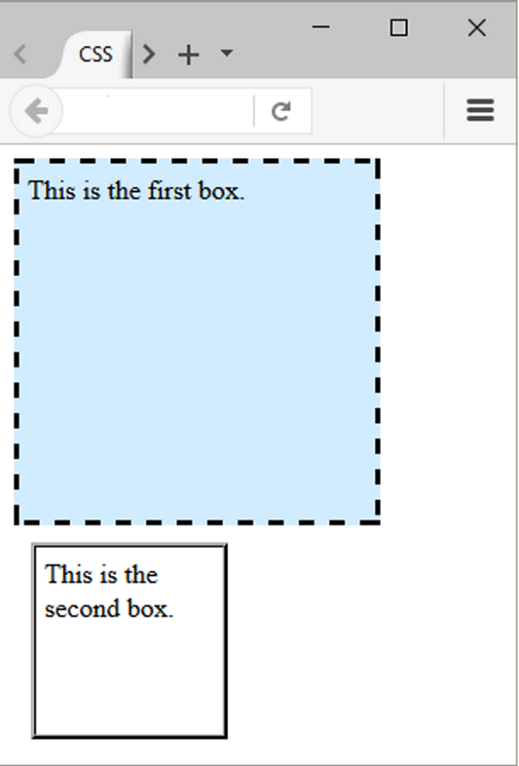
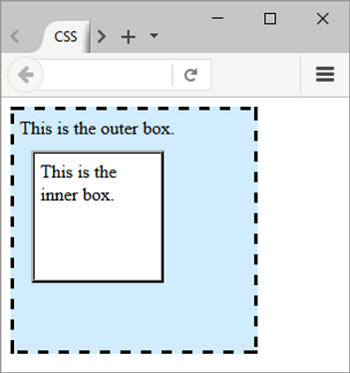
Normal Flow
Browser display of elements in the order they are coded in the web page document

Slide 9
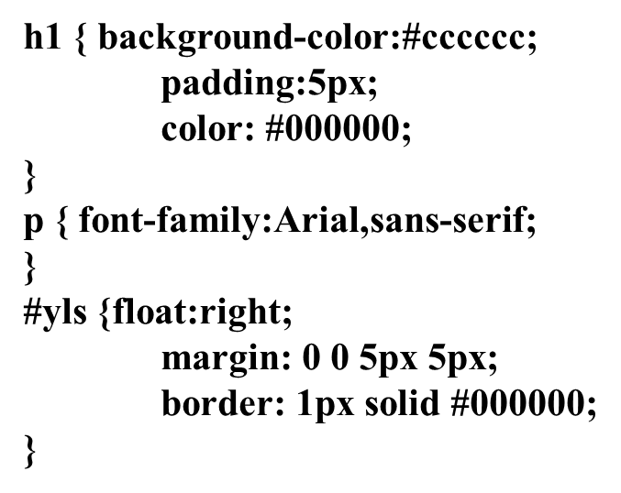
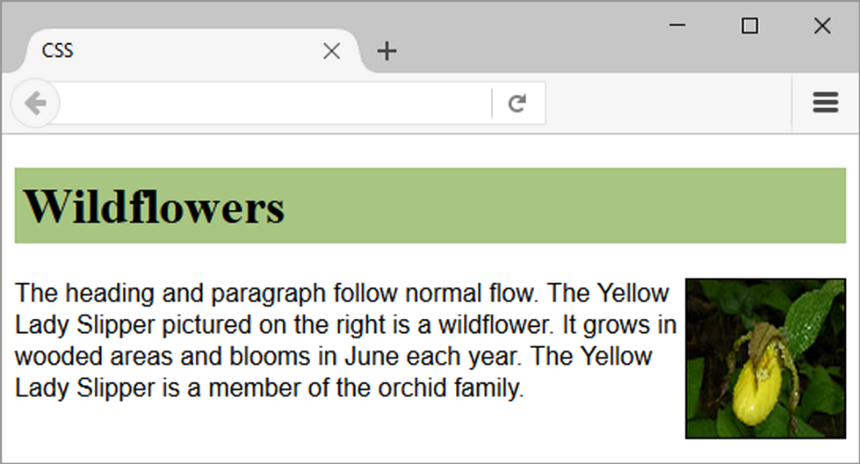
Float Property
Elements that seem to “float” on the right or left side of either the browser window or another element are often configured using the float property.

Slide 10
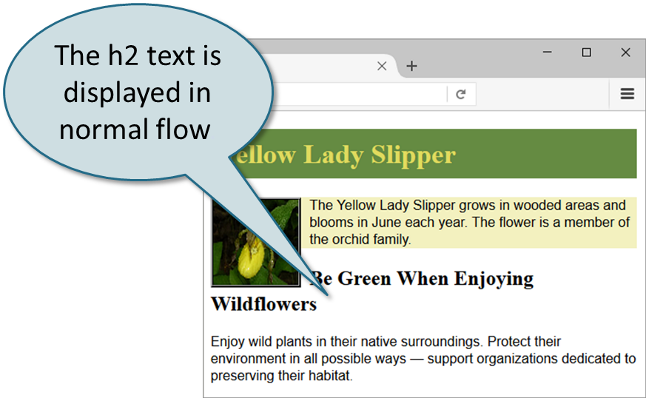
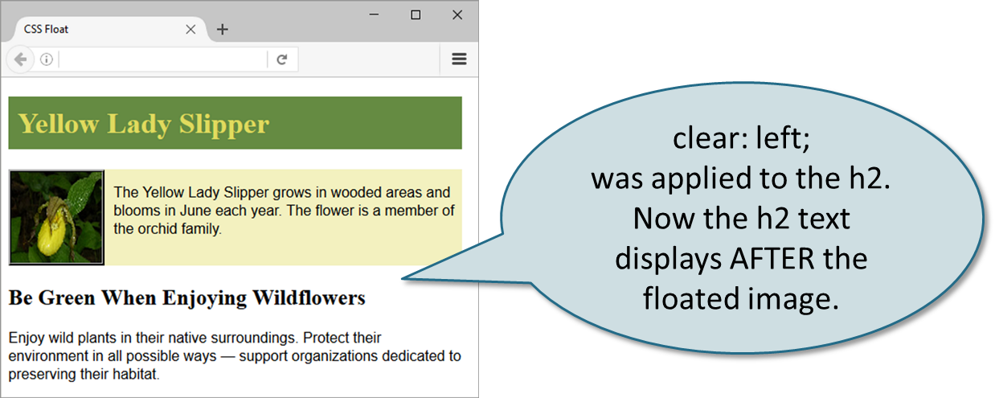
Clear Property
Useful to “clear” or terminate a float
Values are left, right, and both

Slide 11
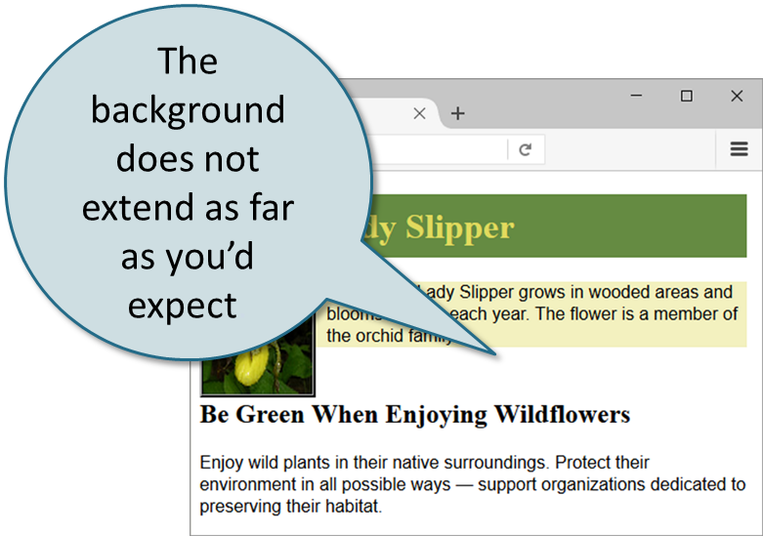
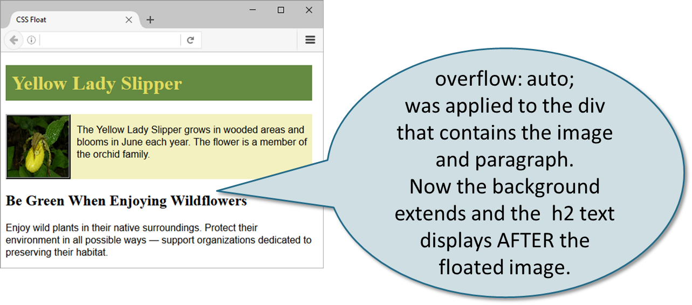
Overflow Property
Intended to configure the display of elements on a Web page.
However, it is useful to “clear” or terminate a float before the end of a container element
Values are auto, hidden, and scroll

Slide 12
Checkpoint 6.1
List the components of the box model from innermost to outermost.
Describe the purpose of the C S S float property.
Which two C S S properties can be used to clear a float?

Slide 13
C S S Display Property (1 of 2)
  Configures how and if an element is displayed
  display: none;
    The element will not be displayed.
  display: block;
    The element is rendered as a block element – even if it is actually an inline element, such as a hyperlink

Slide 14
C S S Display Property (2 of 2)
  display: inline;
    The element will be rendered as an inline element – even if it is actually a block element – such as a <li>.
  display: inline-block;
    The element will display as an inline display element adjacent to other inline display elements but also can be configured with properties of block display elements including width and height.

Slide 15
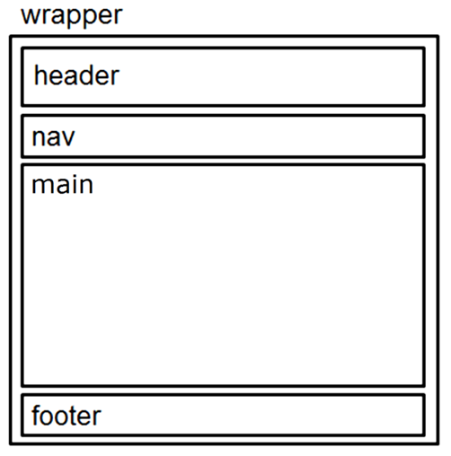
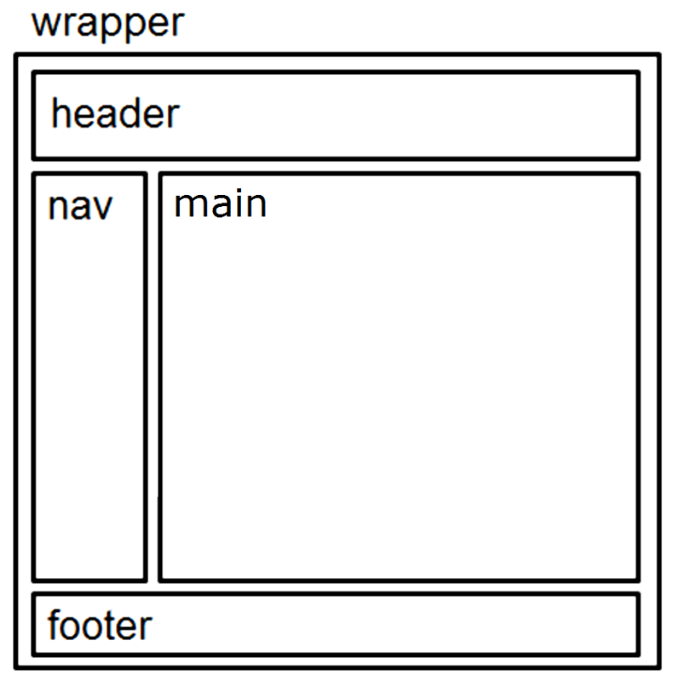
Page Layout Single Column → Two Column
Single Column Wireframe
Two Column Wireframe

Slide 16
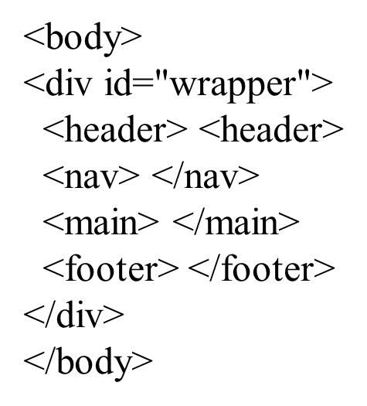
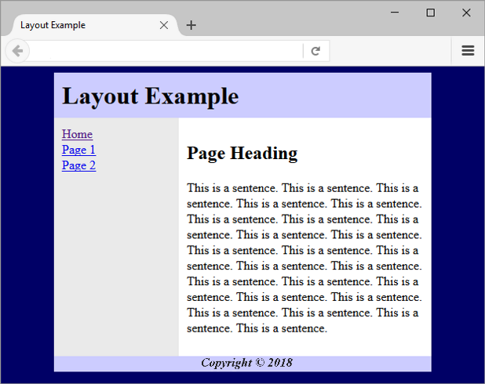
Basic Two-Column Layout (1 of 2)

Slide 17
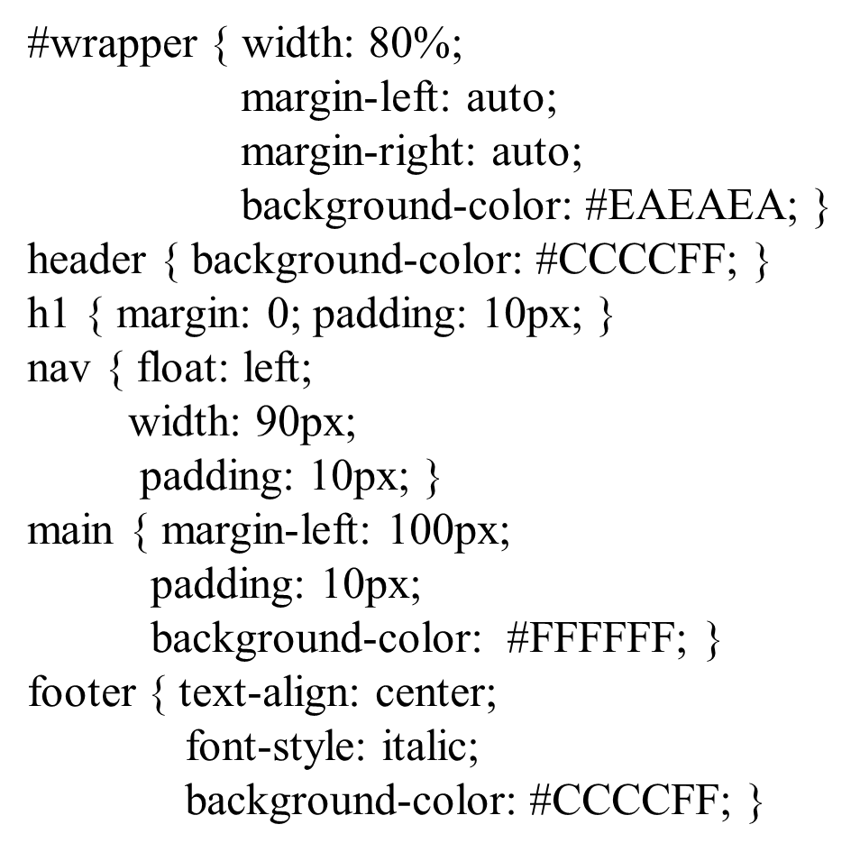
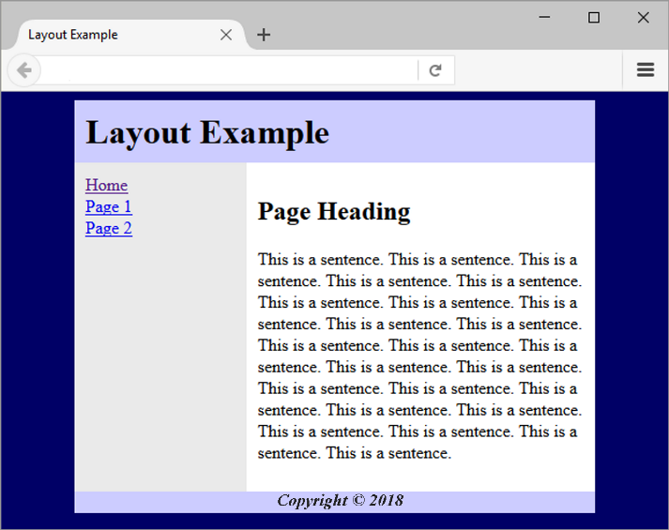
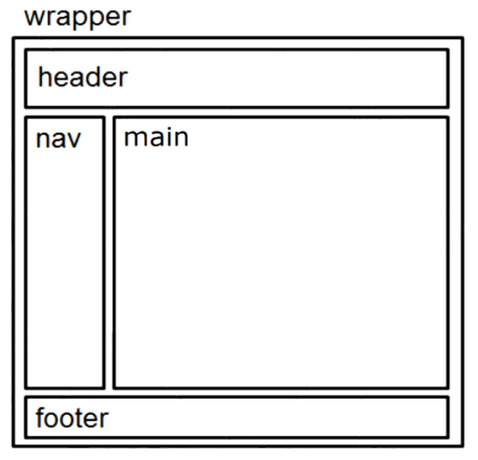
Basic Two-Column Layout (2 of 2)

Slide 18
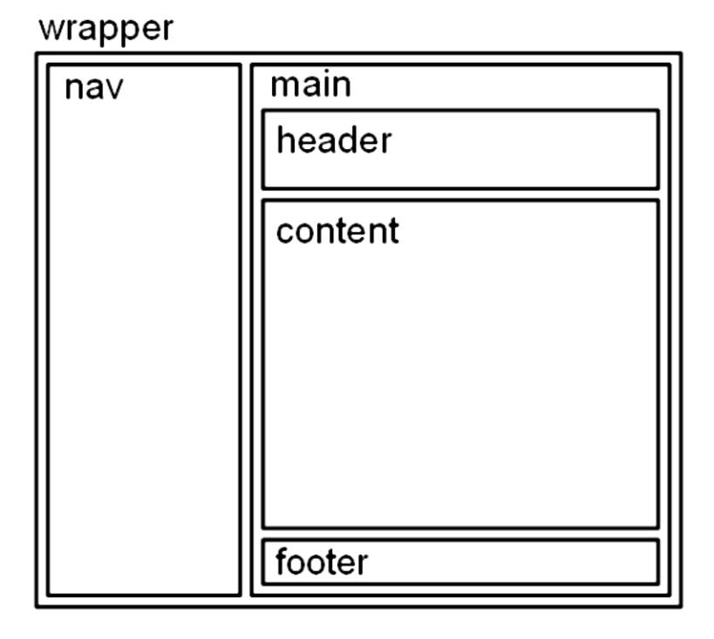
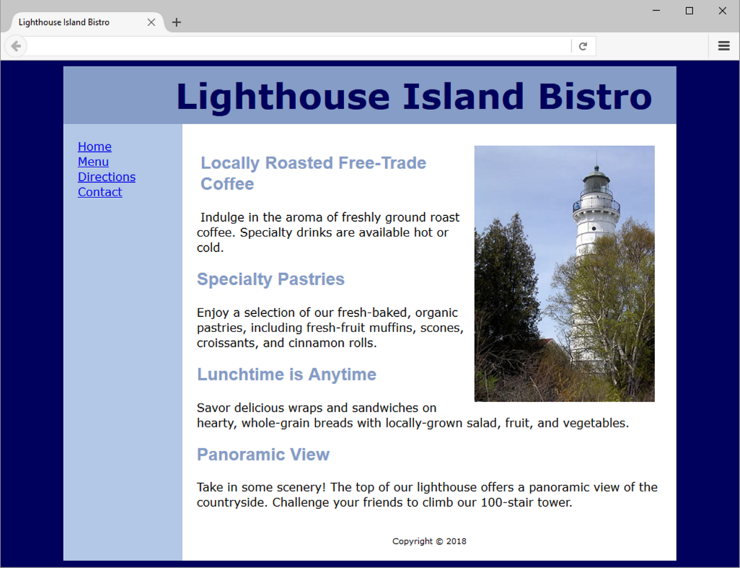
C S S Page Layout Two Columns (Left Nav)

Slide 19
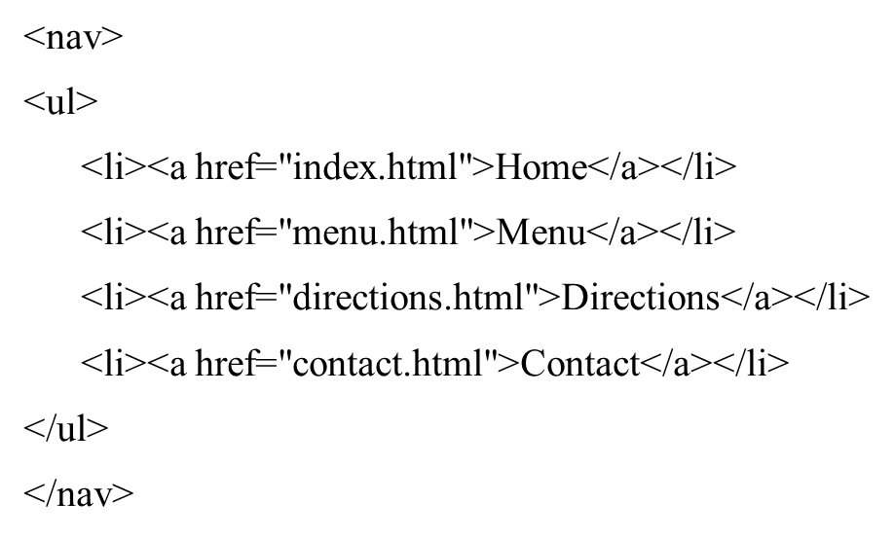
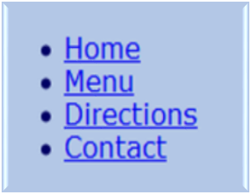
Vertical Navigation (1 of 2)

Slide 20
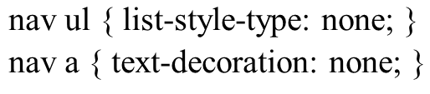
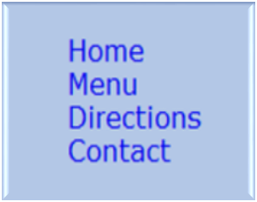
Vertical Navigation (2 of 2)
C S S removes the list marker and underline:

Slide 21
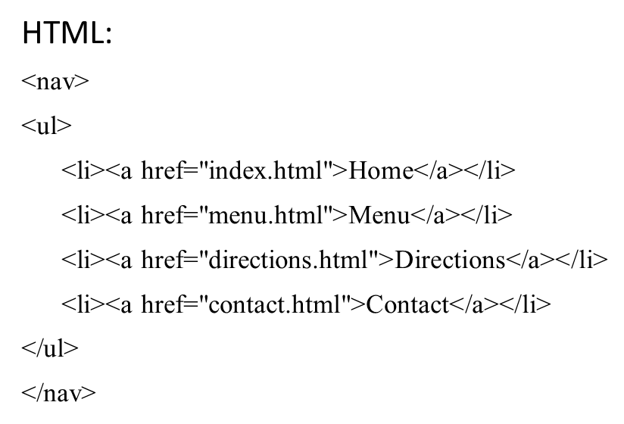
Horizontal Navigation (1 of 2)

Slide 22
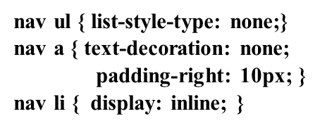

Horizontal Navigation (2 of 2)
C S S removes the list marker, removes the underline, adds padding, and configures the list items for inline display.

Slide 23
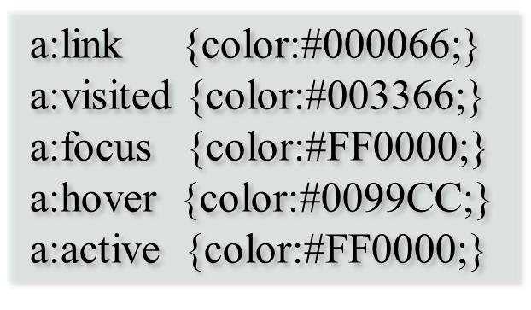
C S S Pseudo-Classes (1 of 2)
Pseudo-classes and the anchor element
  link – default state for a hyperlink
  visited – a hyperlink that has been visited
  focus – triggered when the hyperlink has focus
  hover – triggered when the mouse moves over the hyperlink
  active – triggered when the hyperlink is being licked

Slide 24
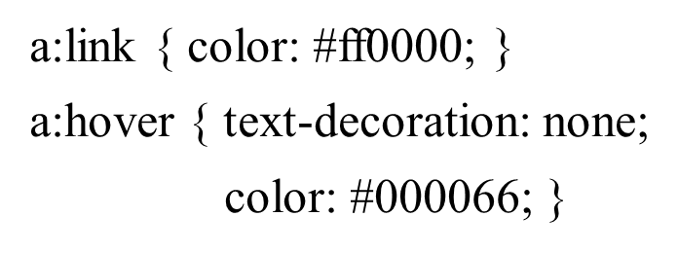
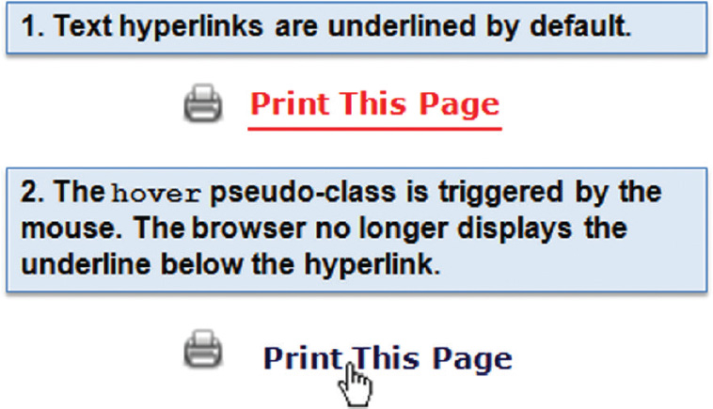
C S S Pseudo-Classes (2 of 2)

Slide 25
Header Text Image Replacement (1 of 2)
Useful when a non web-safe font must be used in the header logo banner area
Display the banner image but also configure text in the h1 for use by search engines and assistive technologies.
Configure styles for the header element set the header banner image as the background of the header or h1 element.
Code the company or website name with the h1 element.
Configure the placement of the h1 text to be beyond the browser viewport:

Slide 26
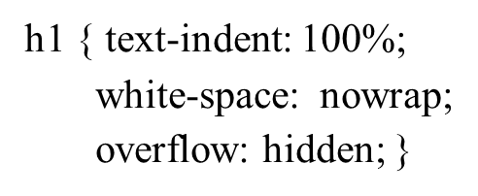

Header Text Image Replacement (2 of 2)
  Source: http://www.zeldman.com/2012/03/01/replacing-the-9999px-hack-new-image-replacement/

Slide 27
Position Property
Value | Purpose
static | Default value; the element is rendered in normal flow
fixed | Configures the location of an element within the browser viewport; the element does not move when the page is scrolled
relative | Configures the location of an element relative to where it would otherwise render in normal flow
absolute | Precisely configures the location of an element outside of normal flow

Slide 28

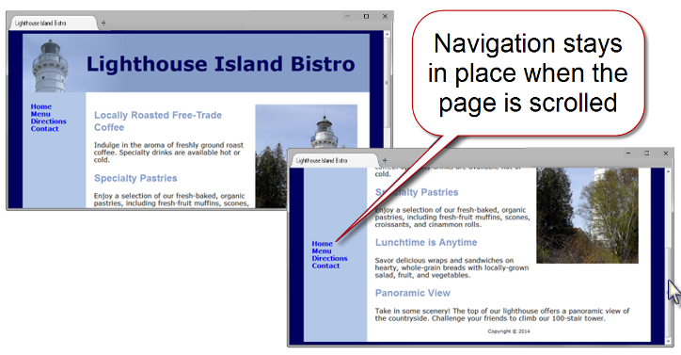
Fixed Positioning

Slide 29
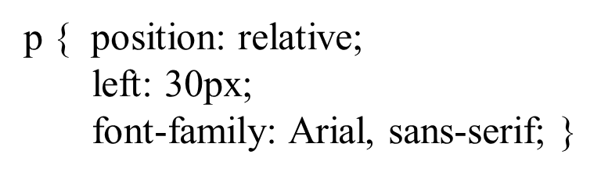
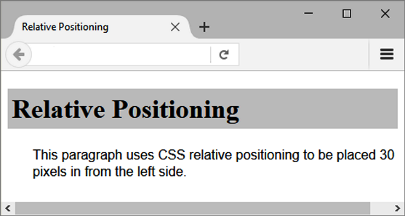
Relative Positioning
Changes the location of an element in relation to where it would otherwise appear in normal flow

Slide 30
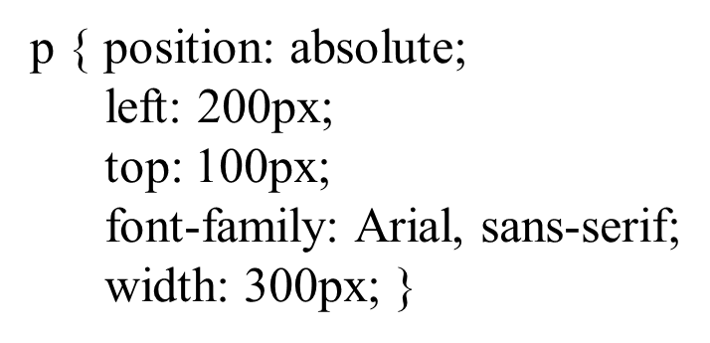
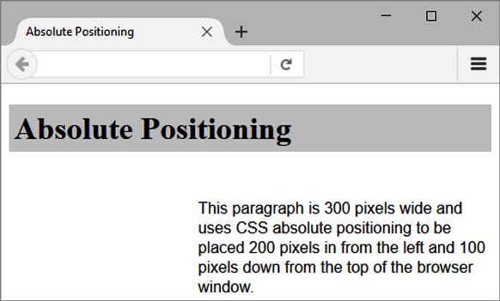
Absolute Positioning
Precisely specifies the location of an element outside of normal flow in in relation to its first parent non-static element

Slide 31
C S S Debugging Tips
Manually check syntax errors
Use W 3 C C S S Validator to check syntax errors
  http://jigsaw.w3.org/css-validator/
Configure temporary background colors
Configure temporary borders
Use C S S comments to find the unexpected
  /* the browser ignores this code */
Don’t expect your pages to look exactly the same in all browsers!
Be patient!

Slide 32
H T M L5 Structural Elements Review (1 of 2)
Header Element
  block display; contains the headings of either a web page document or an area in the document such as a section or article
Nav Element
  block display; contains a section of navigation hyperlinks
Main Element
  block display; contains main page content

Slide 33
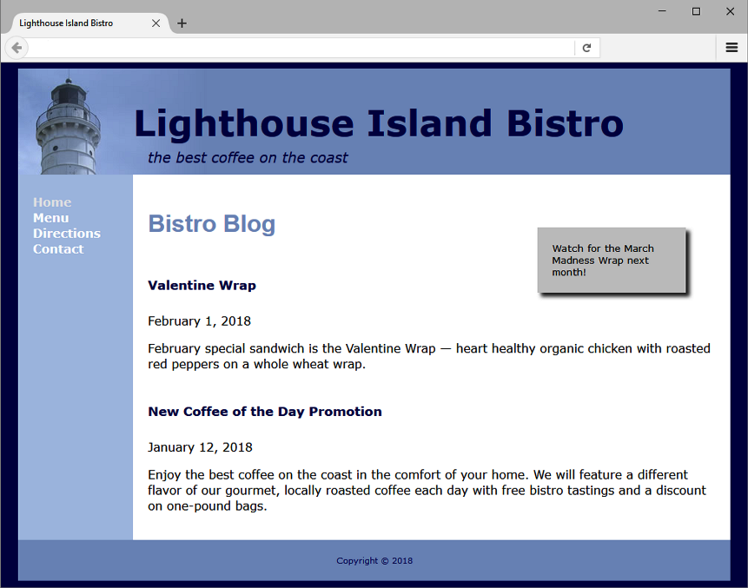
H T M L5 Structural Elements Review (2 of 2)
Footer Element
  block display; contains the footer content of a web page or specific area (such as a section or article) on a web page

Slide 34
More H T M L5 Elements (1 of 2)
Aside Element
  block display; contains a sidebar, a note, or other tangential content
Section Element
  contains a “section” of a document, such as a chapter or topic
  block display
Article Element
  contains an independent entry, such as a blog posting, comment, or e-zine article that could stand on its own
  block display

Slide 35

More H T M L5 Elements (2 of 2)
Time Element
  represents a date or a time
  could be useful to date articles or blog posts
  inline display

Slide 36
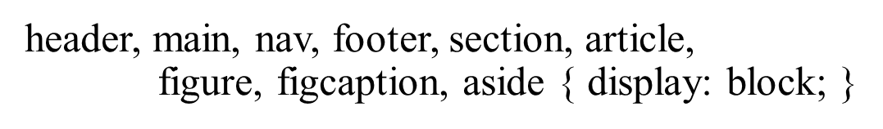
H T M L 5 Compatibility with Older Browsers
Configure Block Display with C S S

Slide 37
Deciding to Configure a Class or Id
Configure a class:
  If the style may apply to more than one element on a page
  Use the . (dot) notation in the style sheet.
  Use the class attribute in the H T M L.
Configure an id:
  If the style is specific to only one element on a page
  Use the # notation in the style sheet.
  Use the id attribute in the H T M L.

Slide 38
Checkpoint 6.2
Describe a reason to use H T M L5 structural elements instead of div elements for some page areas.
Describe one C S S debugging tip that you have found to be helpful.
Describe how to choose whether to configure an H T M L element selector, create a class, or create an id when working with C S S.

Slide 39
Summary
This chapter introduced you to the box model, C S S pseudo-classes, configuring two-column page layouts with C S S, and additional H T M L5 structural elements.

Slide 40
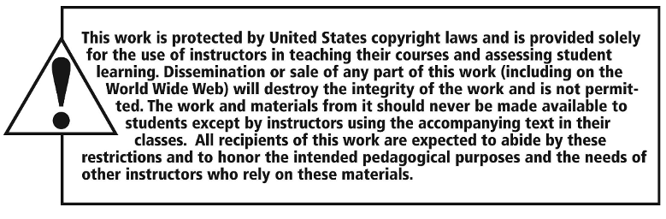
Copyright

