Slide 1
Web Development & Design Foundations with H T M L 5
Ninth Edition
Chapter 9
Forms
Slides in this presentation contain hyperlinks. JAWS users should be able to get a list of links by using INSERT+F7
Copyright © 2019, 2017, 2015 Pearson Education, Inc. All Rights Reserved
Notes:
If this PowerPoint presentation contains mathematical equations, you may need to check that your computer has the following installed:
1) MathType Plugin
2) Math Player (free versions available)
3) NVDA Reader (free versions available)

Slide 2
Learning Objectives (1 of 2)
9.1 Describe common uses of forms on web pages
9.2 Create forms on web pages using the form, input, textarea, and select elements
9.3 Create forms that provide additional accessibility features using the accesskey and tabindex attributes
9.4 Associate form controls and groups using the label, fieldset, and legend elements
9.5 Create custom image buttons and use the button element

Slide 3
Learning Objectives (2 of 2)
9.6 Use C S S to style a form
9.7 Configure new H T M L 5 form controls including the email, U R L, datalist, range, spinner, calendar, and color controls
9.8 Describe the features and common uses of server-side processing
9.9 Invoke server-side processing to handle form data
9.10 Find free server-side processing resources on the Web

Slide 4
Overview of Forms (1 of 2)
Forms are used all over the Web to
Accept information
Provide interactivity
Types of forms:
Search form, Order form, Newsletter sign-up form, Survey form, Add to Cart form, and so on…

Slide 5
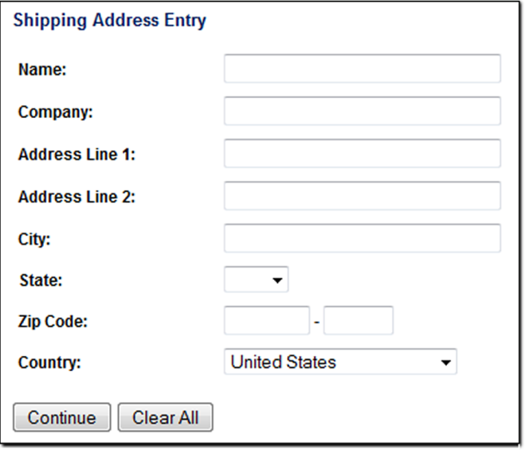
Overview of Forms (2 of 2)
Form
An H T M L element that contains and organizes
form controls such as text boxes, check boxes, and buttons that can accept information from website visitors.

Slide 6
Two Components of Using Forms
The H T M L form the web page user interface and
The server-side processing Server-side processing works with the form data and sends e-mail, writes to a text file, updates a database, or performs some other type of processing on the server.

Slide 7
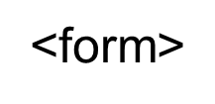
H T M L Using Forms (1 of 2)
Configures a scrolling text box
Container tag
Configures a variety of form elements including text boxes, radio buttons, check boxes, and buttons
Stand alone tag
Contains the form elements on a web page
Container tag

Slide 8
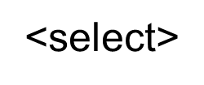
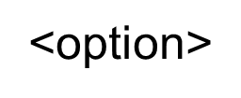
H T M L Using Forms (2 of 2)
Configures a select box (drop down list)
Container tag
Configures an option in the select box
Container tag

Slide 9
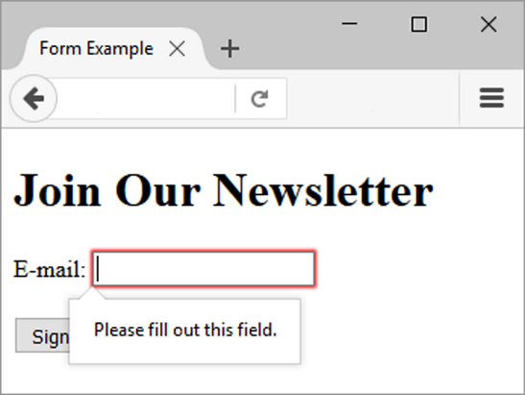
Sample Form H T M L

Slide 10
H T M L Form Element
The form element attributes:
action
Specifies the server-side program or script that will process your form data
method
get – default value, form data passed in U R L
post – more secure, form data passed in H T T P Entity Body
name
Identifies the form
i d
Identifies the form

Slide 11
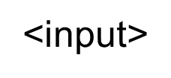
Input Text Box
Accepts text information
Attributes:
type="text”
name
i d
size
maxlength
value

Slide 12
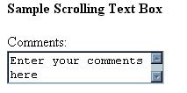
Textarea Scrolling Text Box
Configures a scrolling text box
Attributes:
name
i d
cols
rows

Slide 13
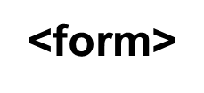
Input Submit Button (1 of 2)
Submits the form information
When clicked:
Triggers the action method on the
tag
Sends the form data (the name = value pair for each form element) to the web server.

Slide 14
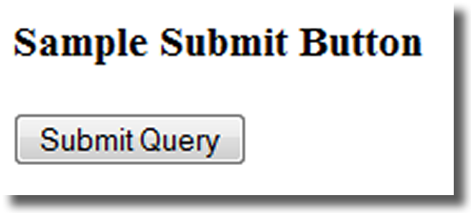
Input Submit Button (2 of 2)
Attributes:
type=“submit”
name
i d
value

Slide 15
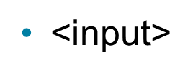
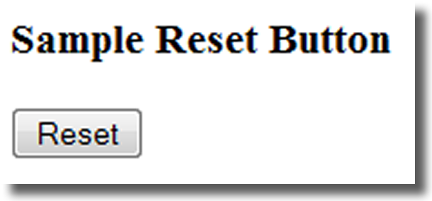
Input Reset Button
Resets the form fields to their initial values
Attributes:
type=“reset”
name
i d
value

Slide 16
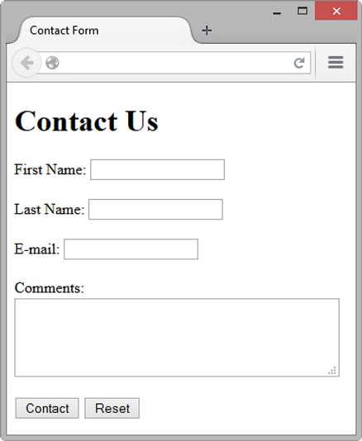
Hands-On Practice

Slide 17
Input Password Box
Accepts text information that needs to be hidden as it is entered
Attributes:
type=“password”
name
i d
size
maxlength
value

Slide 18
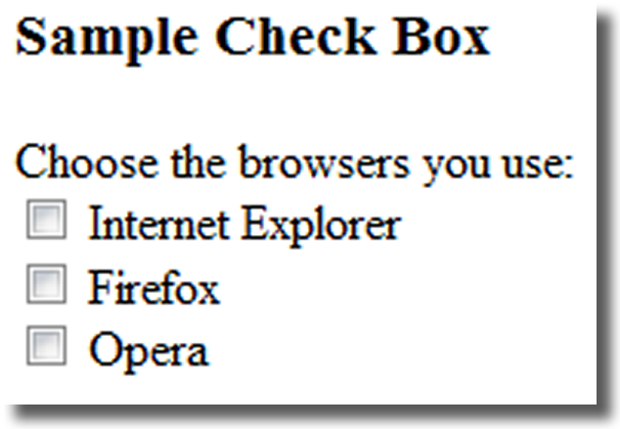
Input Check Box
Allows the user to select one or more of a group of predetermined items
Attributes:
type="checkbox“
name
i d
checked
value

Slide 19
Input Radio Button (1 of 2)
Allows the user to select exactly one from a group of predetermined items
Each radio button in a group is given the same name and a unique value

Slide 20
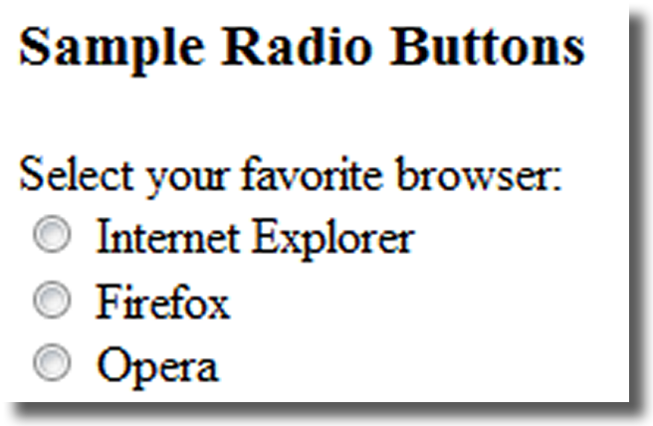
Input Radio Button (2 of 2)
Attributes:
type="radio“
name
i d
checked
value

Slide 21
Input Hidden Form Data
This form control is not displayed on the web page.
Hidden form fields
Can be accessed by both client-side and server-side scripting
Sometimes used to contain information needed as the visitor moves from page to page.
Attributes:
type="hidden“
name
i d
value

Slide 22
Select List (1 of 2)
Configures a select list (along with option elements)
Also known as: Select Box, Drop-Down List, Drop-Down Box, and Option Box.
Allows the user to select one or more items from a list of predetermined choices.

Slide 23
Select List (2 of 2)
Attributes:
name
i d
size
multiple

Slide 24
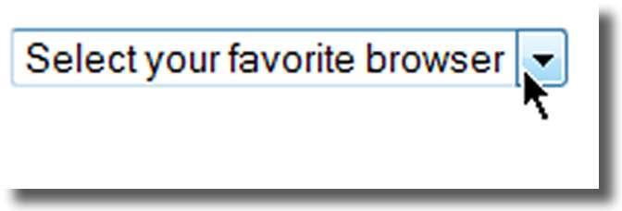
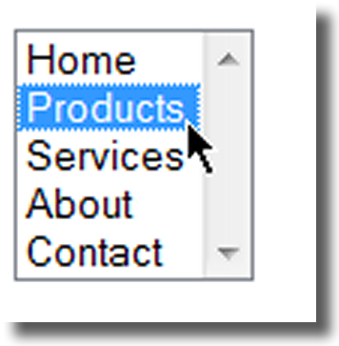
Options in a Select List
Configures the options in a Select List
Attributes:
value
selected

Slide 25
Checkpoint 9.1 (1 of 2)
You are designing a web site for a client who sells items in a retail store.
They want to create a customer list for e-mail marketing purposes. Your client sells to consumers and needs a form that accepts their customer’s name and e-mail address.
Would you recommend using two input boxes (one for the name and one for the e-mail) or three input boxes (for the first name, last name, and email address)? Explain your answer.

Slide 26
Checkpoint 9.1 (2 of 2)
You are designing a survey form for a client. One of the questions has 10 possible responses.
Only one response can be selected per question.
What type of form control would you use to configure this question on the web page?
True or False.
In a radio button group, the value attribute is used by the browser to process the radio buttons as a group.

Slide 27
Input Image Button (1 of 2)
Submits the form
When clicked:
Triggers the action method on the form tag
Sends the form data (the name=value pair for each form element) to the web server.

Slide 28
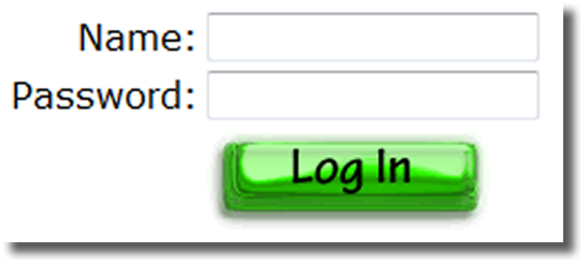
Input Image Button (2 of 2)
Attributes:
type=“image”
name
i d
s r c

Slide 29
Button Element (1 of 2)
A container tag
When clicked, its function depends on the value of the type attribute.
Can contain a combination of text, images, and media

Slide 30
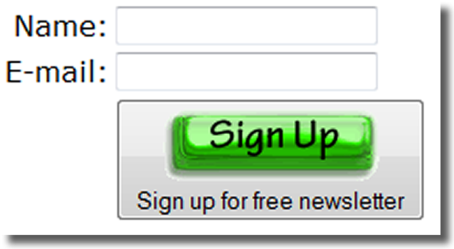
Button Element (2 of 2)
Attributes:
type="submit", type="reset", type="button“
name
i d
alt
value

Slide 31
Accessibility & Forms
Label Element
Fieldset Element
Legend Element
Tabindex Attribute
Accesskey Attribute

Slide 32
Label Element
Associates a text label with a form control
Two Different Formats:
Or

Slide 33
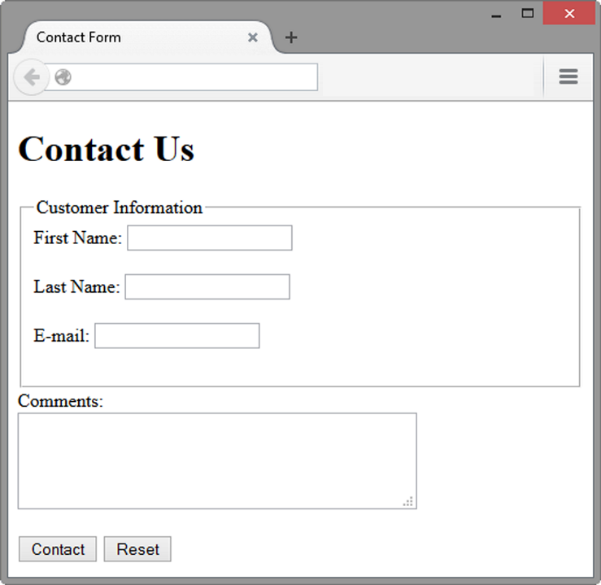
Fieldset and Legend Elements (1 of 2)
The Fieldset Element
Container tag
Creates a visual group of form elements on a web page
The Legend Element
Container tag
Creates a text label within the fieldset

Slide 34
Fieldset and Legend Elements (2 of 2)

Slide 35
Tabindex Attribute
Attribute that can be used on form controls and anchor tags
Modifies the default tab order
Assign a numeric value

Slide 36
Accesskey Attribute
Attribute that can be used on form controls and anchor tags
Create a “hot-key” combination to place the focus on the component
Assign a value of a keyboard letter
On Windows use the C T R L and the “hot-key” to move the cursor

Slide 37
Checkpoint 9.2
Describe the purpose of the fieldset and legend elements.
Describe the purpose of the accesskey attribute and how it supports accessibility.
When designing a form, should you use the standard submit button, an image button, or a button tag? Are these different in the way that they provide for accessibility? Explain your answer.

Slide 38
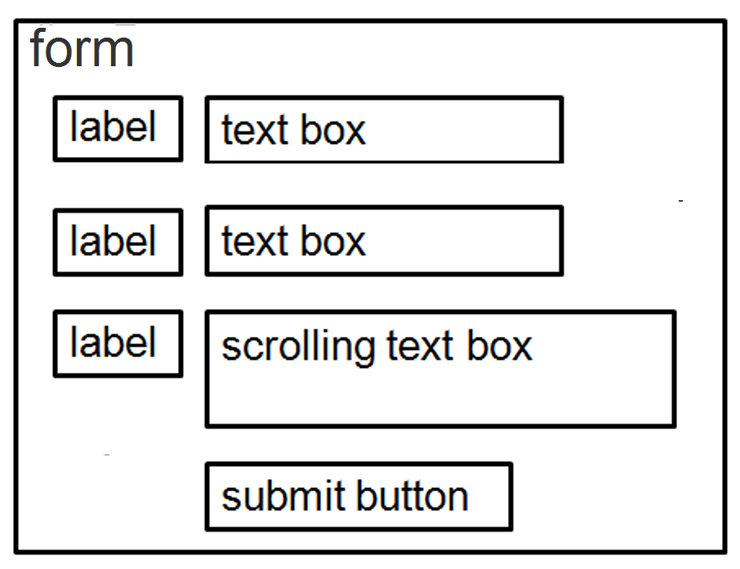
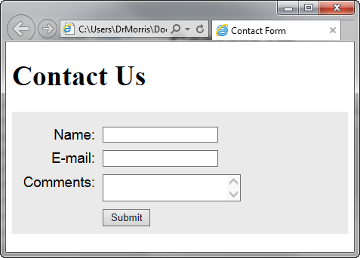
Using C S S to Style a Form
Student Files: form c s s.h t m l

Slide 39
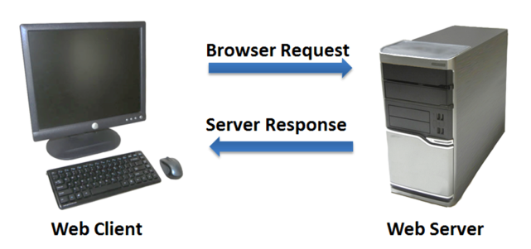
Server-Side Processing
Your web browser requests web pages and their related files from a web server.
The web server locates the files and sends them to your web browser.
The web browser then renders the returned files and displays the requested web pages for you to use.

Slide 40
C G I Common Gateway Interface
A protocol for a web server to pass a web page user’s request to an application program and accept information to send to the user.

Slide 41
Server-Side Scripting
One of many technologies in which a server-side script is embedded within a Web page document saved with a file extension such as:
.p h p (P H P)
.a s p (Active Server Pages)
.c f m (Adobe ColdFusion)
.j s p (Sun JavaServer Pages)
.a s p x (A S P.Net).
Uses direct execution — the script is run either by the web server itself or by an extension module to the web server.

Slide 42
Steps in Utilizing Server-Side Processing
Web page invokes server-side processing by a form or hyperlink.
Web server executes a server-side script.
Server-side script accesses requested database, file, or process.
Web server returns web page with requested information or confirmation of action.

Slide 43
Common Uses of Server-Side Scripting
Search a database
Place an order at an online store
Send a web page to a friend
Subscribe to a newsletter

Slide 44
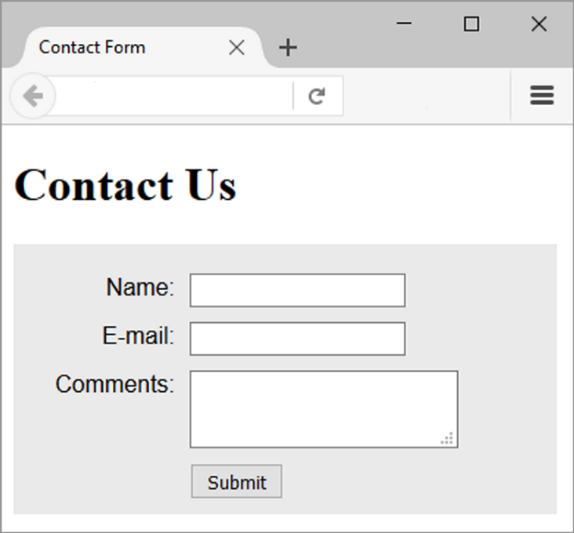
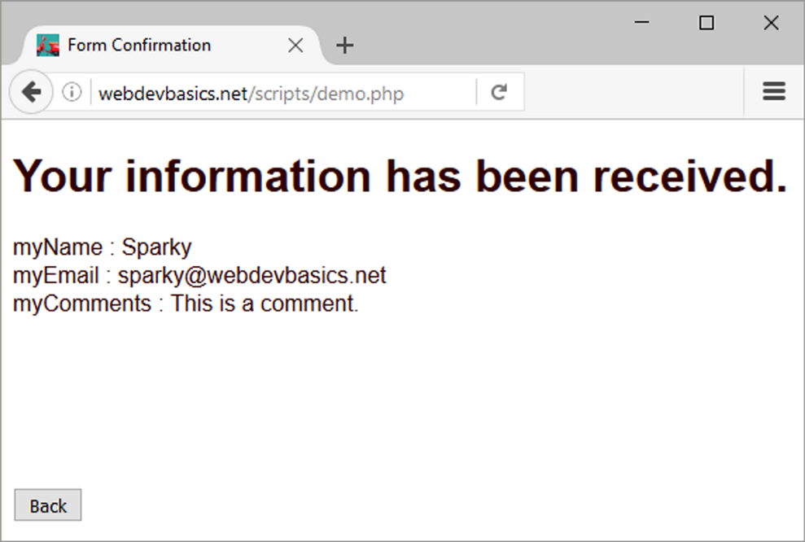
Sending Information to a Server-Side Script

Slide 45
Sources of Free Server-Side Processing
Many web host providers offer free scripts for their clients. Contact their support area or F A Q to learn more about their services.
Some web sites that offer Free remotely hosted scripts (in return for displaying an ad).
http://formbuddy.com
http://response-o-matic.com
http://master.com
http://www.formmail.com
http://wufoo.com
http://formassembly.com

Slide 46
Server-Side Scripting Technologies
JavaServer Pages http://www.oracle.com/technetwork/java/javaee/jsp
ColdFusion http://www.adobe.com/products/coldfusion
P H P http://www.php.net
Ruby on Rails http://www.rubyonrails.org
Microsoft’s .NET Framework http://www.microsoft.com/net
Microsoft Active Server Pages http://msdn.microsoft.com/en-us/library/ms972337.aspx

Slide 47
Checkpoint 9.3
Describe server-side processing.
Describe why communication is needed between the developer of a server-side script and the web page designer.

Slide 48
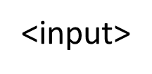
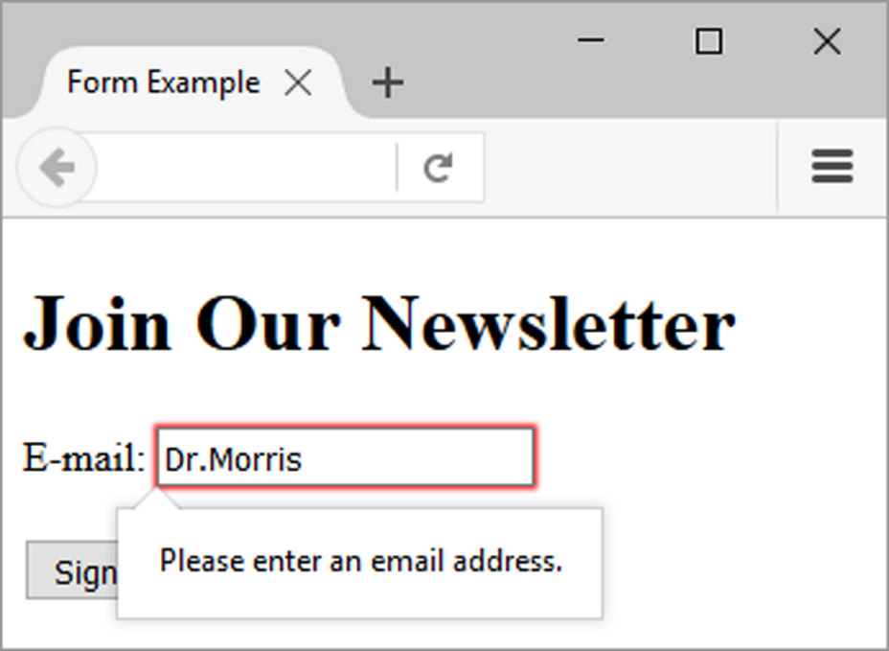
H T M L 5: Email Text Box
Accepts text information in e-mail address format
Common Attributes:
type="email"
name
i d
size
maxlength
value
placeholder
required

Slide 49
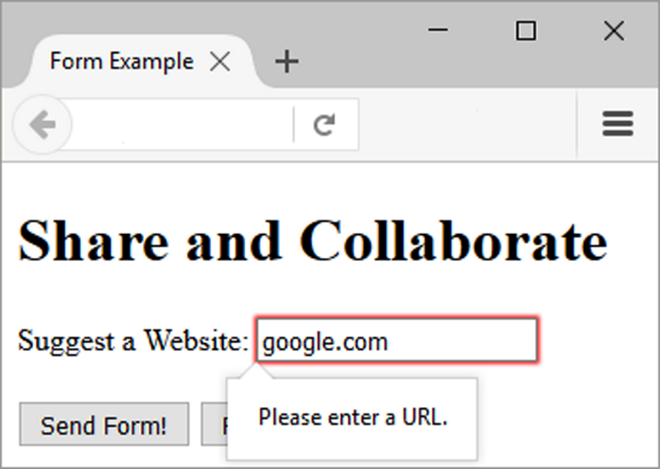
H T M L 5: Telephone Number Text Box
Accepts text information in telephone number format
Common Attributes:
type="tel“
name
i d
size
maxlength
value
placeholder
required

Slide 50
H T M L 5: Search Text Box
Accepts search terms
Common Attributes:
type="search"
name
i d
size
maxlength
value
placeholder
required

Slide 51
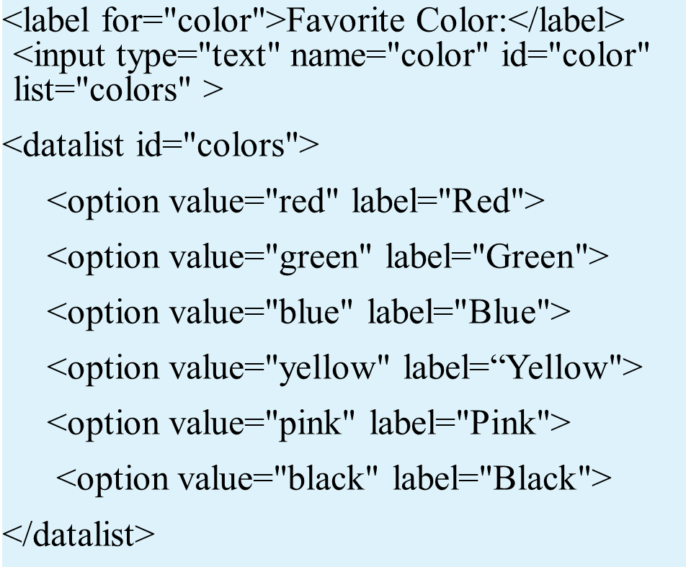
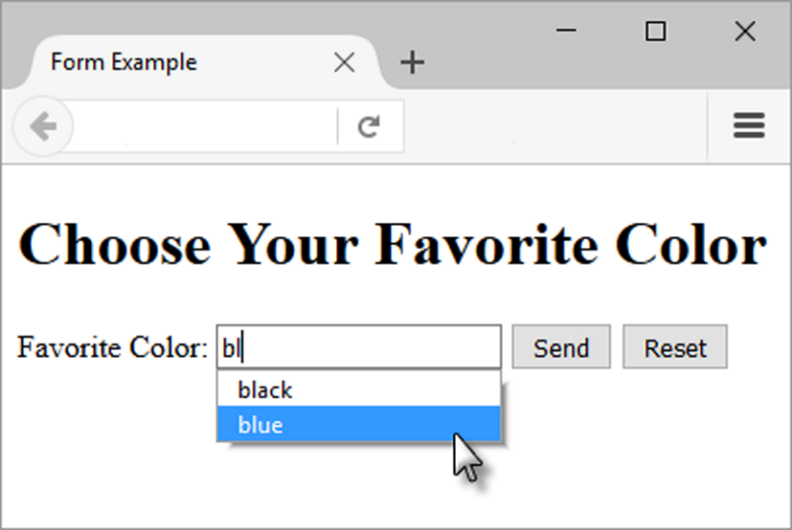
H T M L 5: Datalist Control

Slide 52
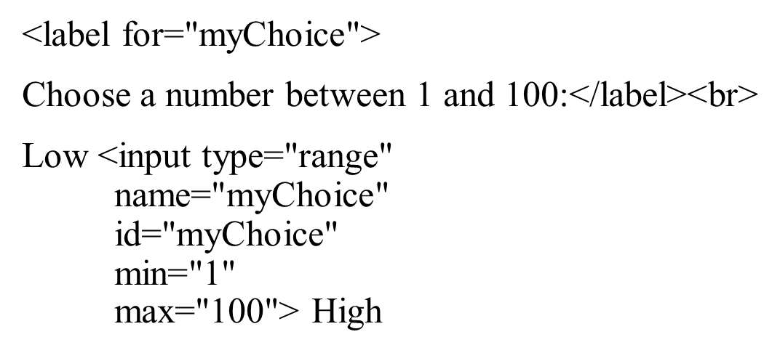
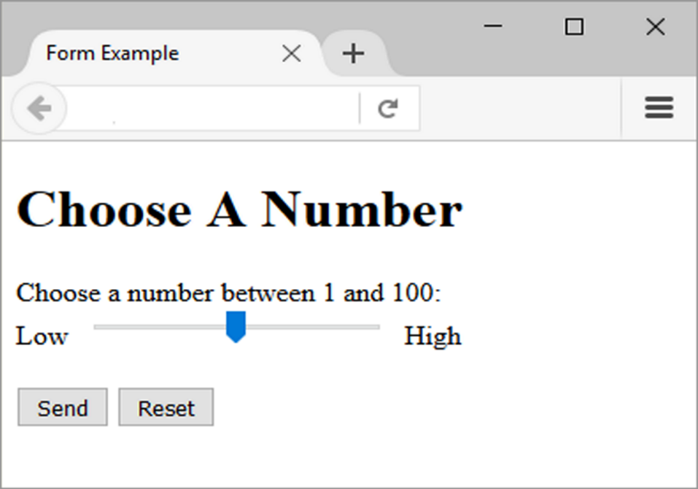
H T M L 5: Slider Control

Slide 53
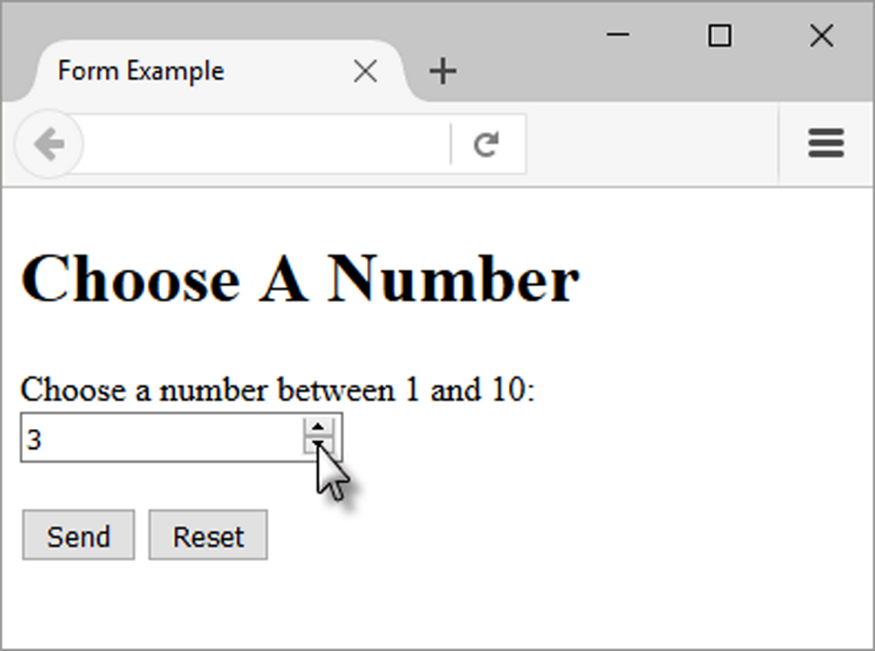
H T M L 5: Spinner Control

Slide 54
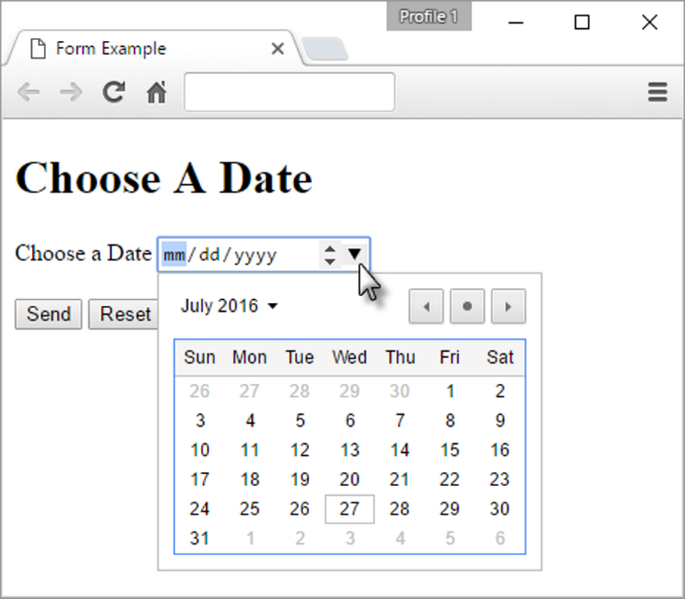
H T M L 5: Calendar Control

Slide 55
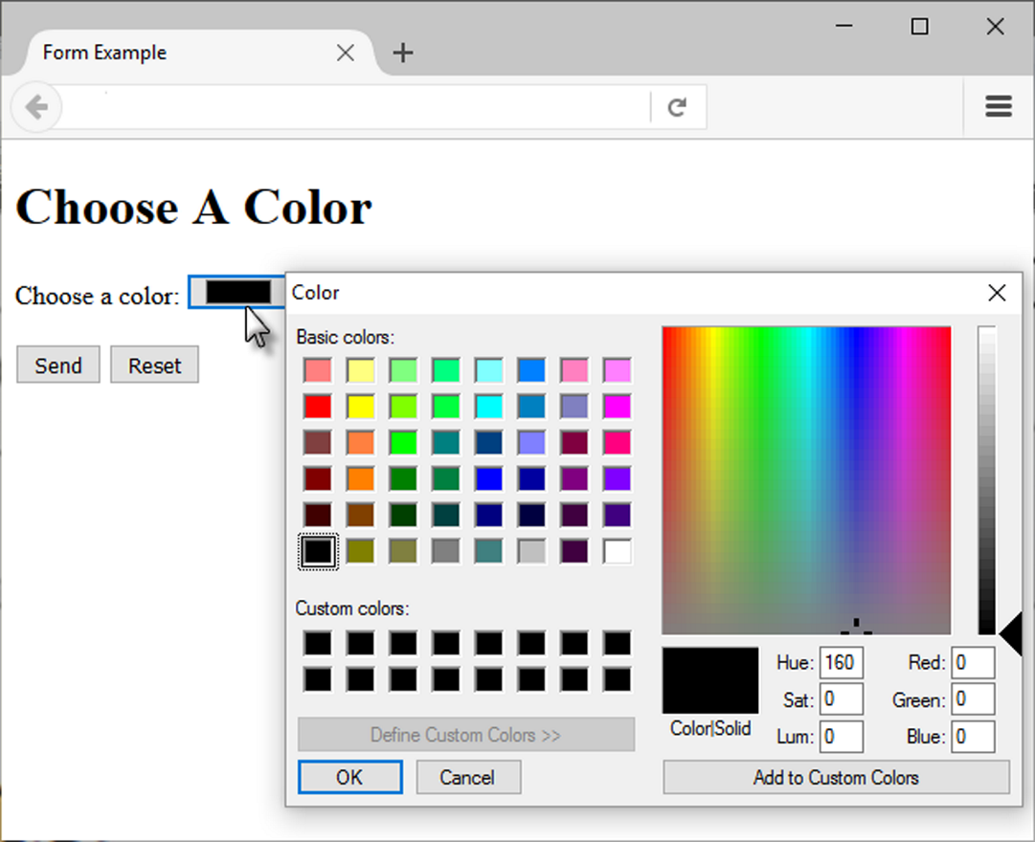
H T M L 5: Color Well Control

Slide 56
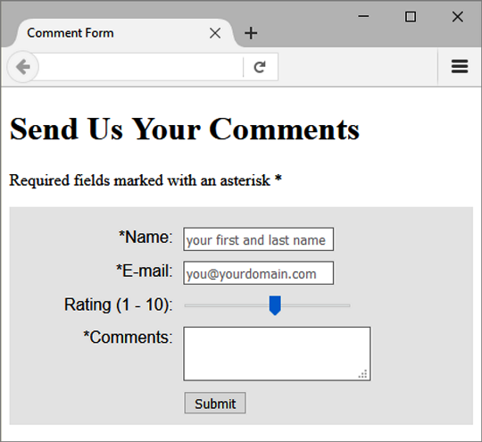
Practice with an H T M L 5 Form
The form display and functioning varies with browser support.

Slide 57
Summary
This chapter introduced the use of forms on web pages.
You learned about how to configure form elements and provide for accessibility.
You also learned how to configure a form to access server-side processing.
In addition, you learned about new H T M L 5 form controls.

Slide 58
Copyright

