Slide 1
Chapter 1

Slide 2
Objectives

Slide 3
Objectives (continued)

Slide 4
Objectives (continued)

Slide 5
The architecture of a web application

Slide 6
The architecture of the Internet

Slide 7
Key terms

Slide 8
How static web pages are processed

Slide 9
A simple HTTP request

Slide 10
Two protocols that web applications depend upon

Slide 11
How dynamic web pages are processed with PHP

Slide 12
Key terms

Slide 13
Web browsers

Slide 14
Server-side languages

Slide 15
Highlights in the history of PHP

Slide 16
Highlights in the history of MySQL

Slide 17
MySQL notes

Slide 18
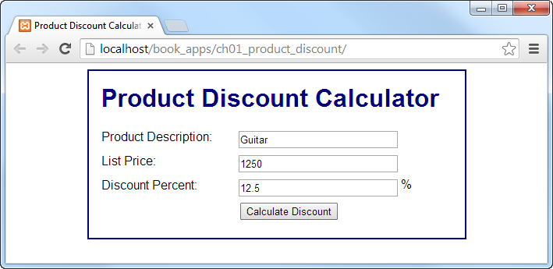
The first page of an application

Slide 19
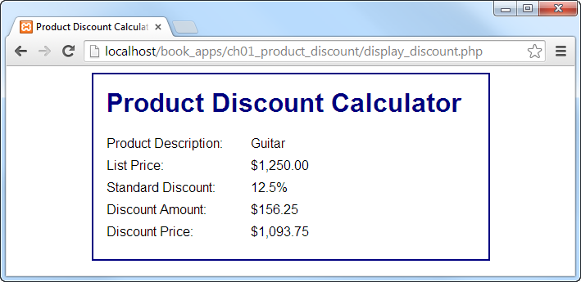
The second page (display_discount.php)

Slide 20
The HTML file (index.html)

Slide 21
The HTML file (index.html) (continued)

Slide 22
The CSS file (main.css)

Slide 23
The CSS file (main.css) (continued)

Slide 24
The PHP file (display_discount.php)

Slide 25
The PHP file (display_discount.php) (continued)

Slide 26
The PHP file (display_discount.php) (continued)

Slide 27
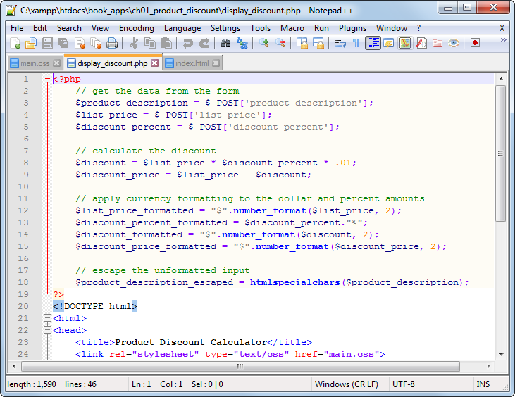
Notepad++ with three tabs open

Slide 28
How to open files in Notepad++

Slide 29
How to close the current file in Notepad++

Slide 30
How to change the Notepad++ style for comments

Slide 31
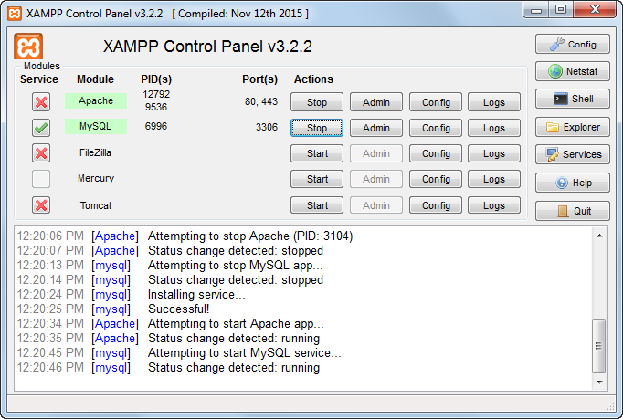
The XAMPP control panel

Slide 32
How to start the XAMPP control panel

Slide 33
About XAMPP

Slide 34
The directories for a PHP app on a local server

Slide 35
The structure for book_apps and ex_starts

Slide 36
How to deploy a PHP application on a local server

Slide 37

The components of an HTTP URL

Slide 38
Requesting pages from an Internet web server

Slide 39
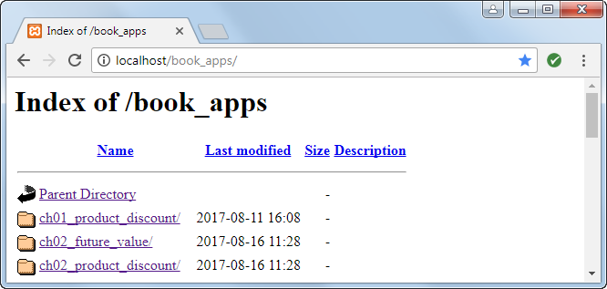
An index of the apps in the book_apps directory

Slide 40
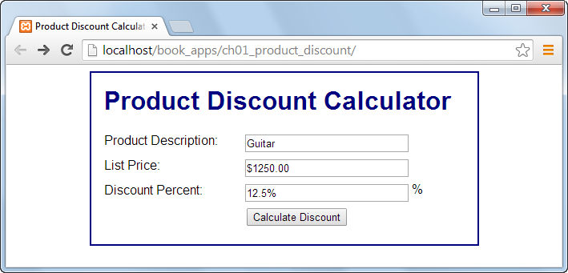
The Product Discount application in Chrome

Slide 41
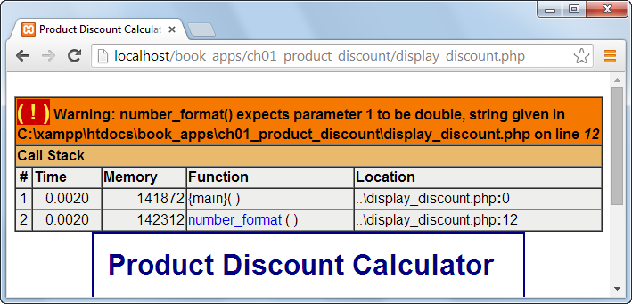
An error displayed in Chrome

Slide 42
How to test a PHP page for the first time

Slide 43
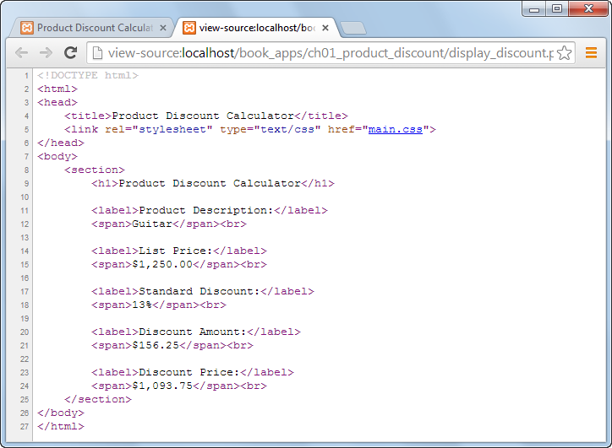
The source code for a PHP page

Slide 44
How to view the source code for a page in Chrome and Firefox

Slide 45
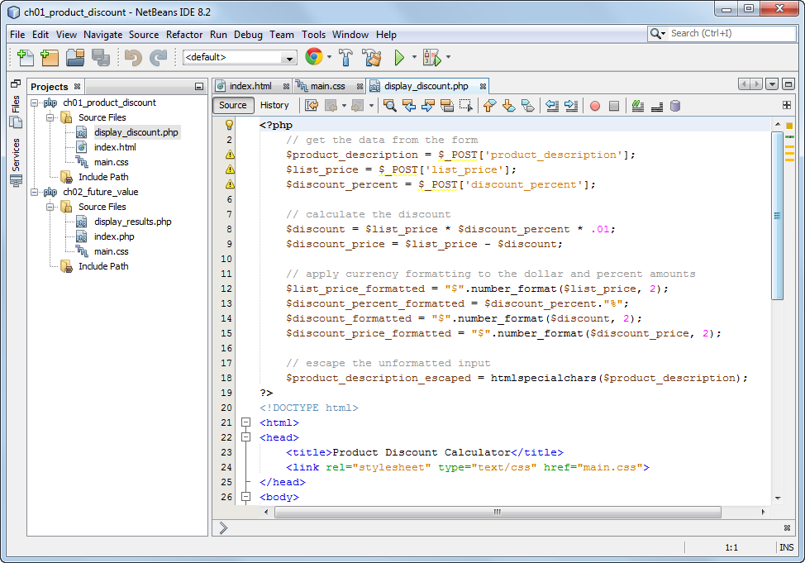
NetBeans with three files in a project open

Slide 46
How to work with NetBeans projects

Slide 47
About NetBeans

Slide 48
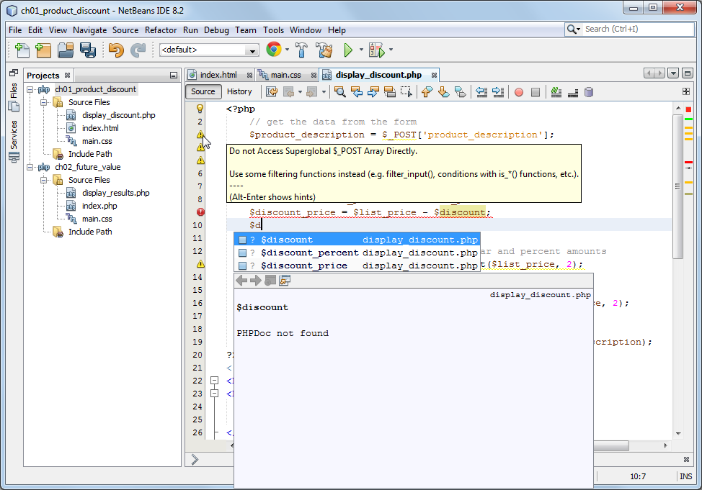
Auto-completion and error marking in NetBeans

Slide 49
How to edit a PHP file with NetBeans

Slide 50
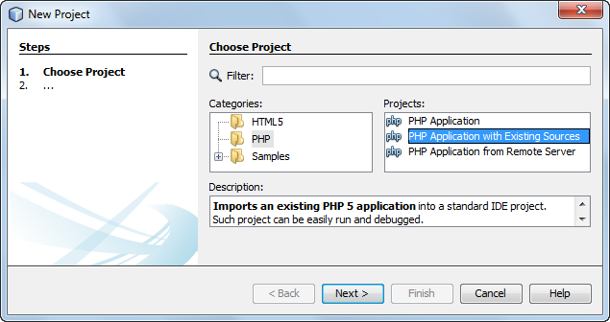
The dialog box for starting a new project

Slide 51
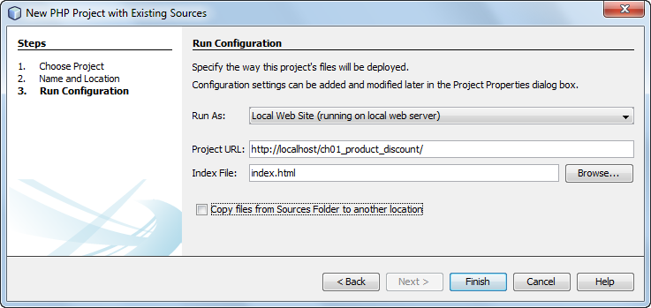
The dialog box for configuring a project

Slide 52
How to check the run configuration for a project

