Slide 1
Chapter 2

Slide 2
Objectives

Slide 3
Objectives (continued)

Slide 4
Objectives (continued)

Slide 5
Objectives (continued)

Slide 6
A PHP file that includes HTML and embedded PHP

Slide 7
The PHP file displayed in a browser

Slide 8
PHP code: comments and statements

Slide 9
Syntax rules

Slide 10
The six PHP data types

Slide 11
Integer values (whole numbers)

Slide 12
Double values that use scientific notation

Slide 13
Using the assignment operator (=) as you declare a variable and assign it a value

Slide 14
Rules for creating variable names

Slide 15
How to declare a constant

Slide 16
An HTML form that does an HTTP GET request

Slide 17
An <a> tag that performs an HTTP GET request

Slide 18
A PHP page for an HTTP POST request

Slide 19
When to use the HTTP GET method

Slide 20
When to use the HTTP POST method

Slide 21
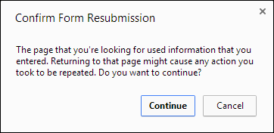
The Chrome dialog box that’s displayed if the user tries to refresh a post

Slide 22
How to assign string expressions

Slide 23
How to use the concatenation operator (.)

Slide 24
The syntax for the echo statement

Slide 25
Common arithmetic operators

Slide 26
Some simple numeric expressions

Slide 27
Statements that calculate a discount

Slide 28
The order of precedence

Slide 29
The compound assignment operators

Slide 30
Two ways to append string data to a variable

Slide 31
Three ways to increment a counter variable

Slide 32
More examples

Slide 33
A function for formatting numbers

Slide 34
A function for getting the current date

Slide 35
Three functions for checking variable values

Slide 36
Two functions for converting user-entered data for display

Slide 37
The filter_input() function

Slide 38
Common constants for filters

Slide 39
Statements that retrieve values from the superglobal variables

Slide 40
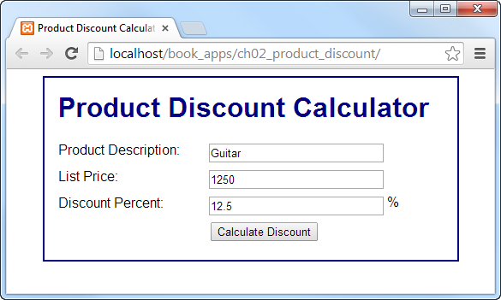
The first page (index.html)

Slide 41
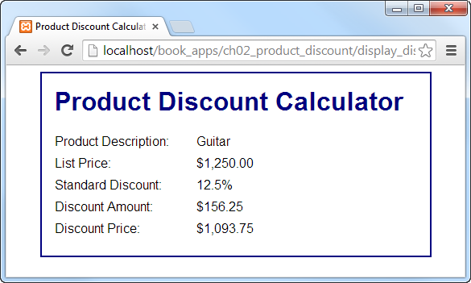
The second page (product_discount.php)

Slide 42
The code for the form on the first page

Slide 43
The PHP file (display_discount.php)

Slide 44
The PHP file (display_discount.php) (continued)

Slide 45
The PHP file (display_discount.php) (continued)

Slide 46
The relational operators

Slide 47
The logical operators in order of precedence

Slide 48
An if statement with no other clauses

Slide 49
An if statement with else if and else clauses

Slide 50
A compound conditional expression

Slide 51
A while loop that stores the numbers 1 through 5

Slide 52
A for loop that stores the numbers 1 through 5

Slide 53
A while loop that calculates the future value of a one-time investment

Slide 54
A for loop that calculates the future value of a one-time investment

Slide 55
Built-in functions that pass control

Slide 56
The include function

Slide 57
How to pass control to another PHP file in the current directory

Slide 58
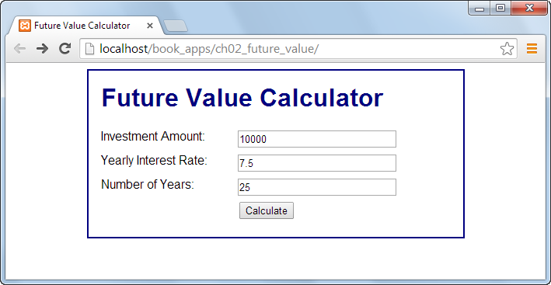
The first page

Slide 59
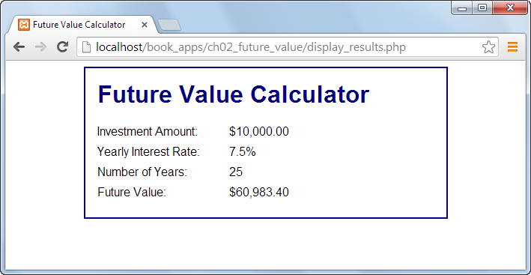
The second page

Slide 60
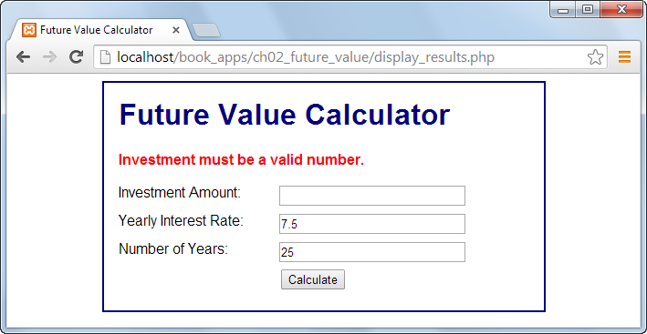
The first page with an error message

Slide 61
The index.php file

Slide 62
The index.php file (continued)

Slide 63
The display_results.php file

Slide 64
The display_results.php file (continued)

Slide 65
The display_results.php file (continued)

Slide 66
The display_results.php file (continued)

Slide 67
The URL for the PHP documentation

Slide 68
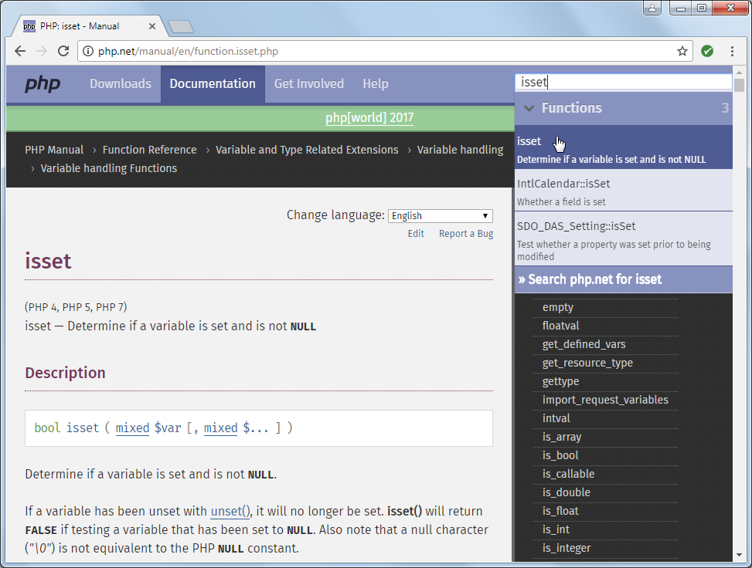
Documentation for the isset() function

Slide 69
How to access the PHP manual

