Slide 1
Chapter 3

Slide 2
Objectives

Slide 3
Objectives (continued)

Slide 4
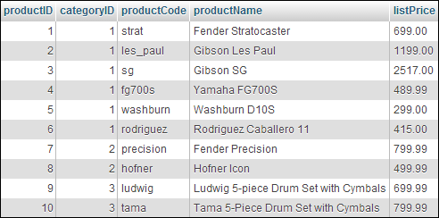
A products table
Columns

Slide 5
Key terms

Slide 6
The relationship between two tables in a database

Slide 7
Key terms

Slide 8
The columns of the products table

Slide 9
Common MySQL data types

Slide 10
The SELECT statement syntax for all columns

Slide 11
The syntax for selected columns

Slide 12
The syntax that joins two tables

Slide 13
A statement that gets data from two related tables

Slide 14
Key terms

Slide 15
The syntax for the INSERT statement

Slide 16
The syntax for the UPDATE statement

Slide 17
The syntax for the DELETE statement

Slide 18
MySQL is…

Slide 19
MySQL provides…

Slide 20
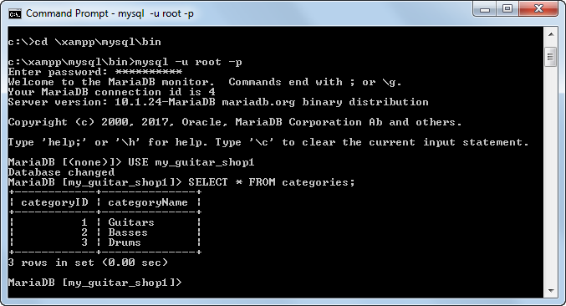
A command-line client

Slide 21
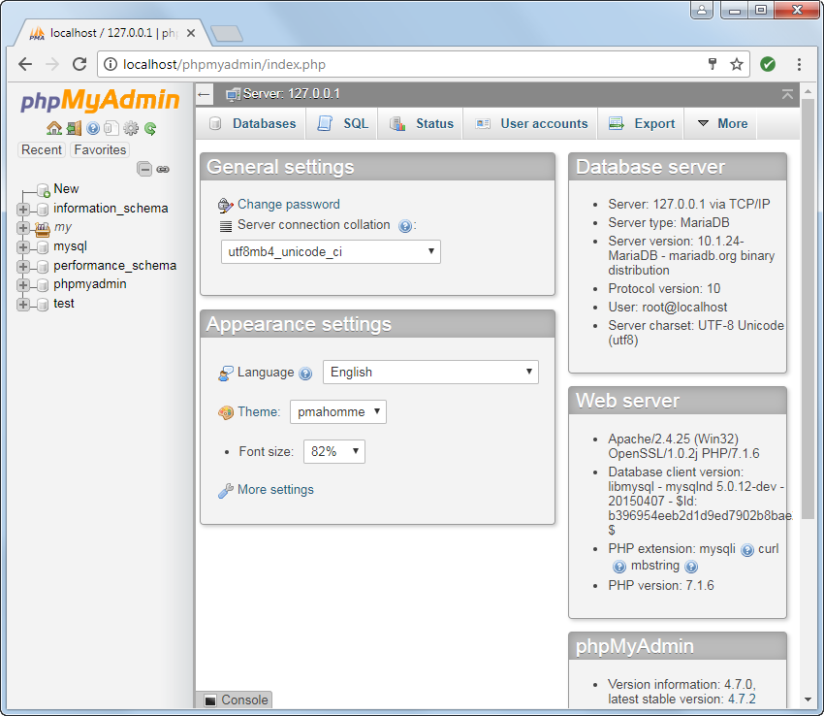
A web-based client

Slide 22
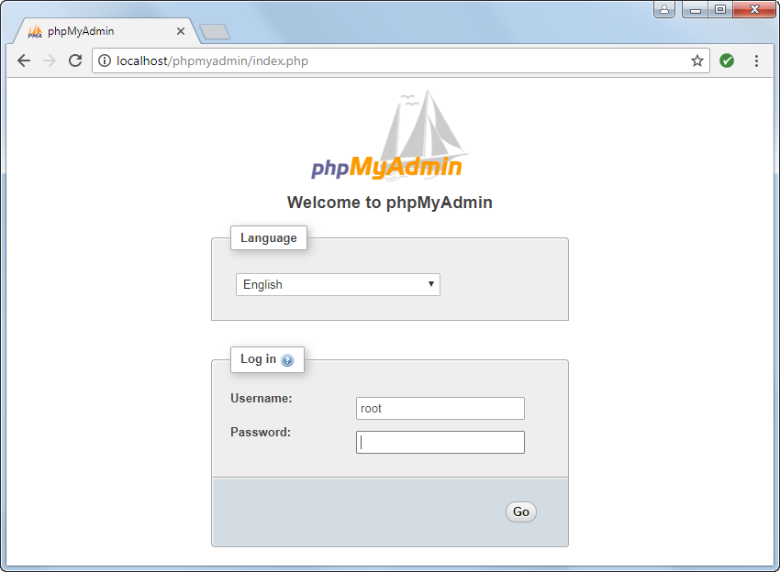
The Welcome page

Slide 23
The Home and Logout buttons at the top of the sidebar on most pages

Slide 24
How to start phpMyAdmin on a local computer

Slide 25
How to change your password

Slide 26
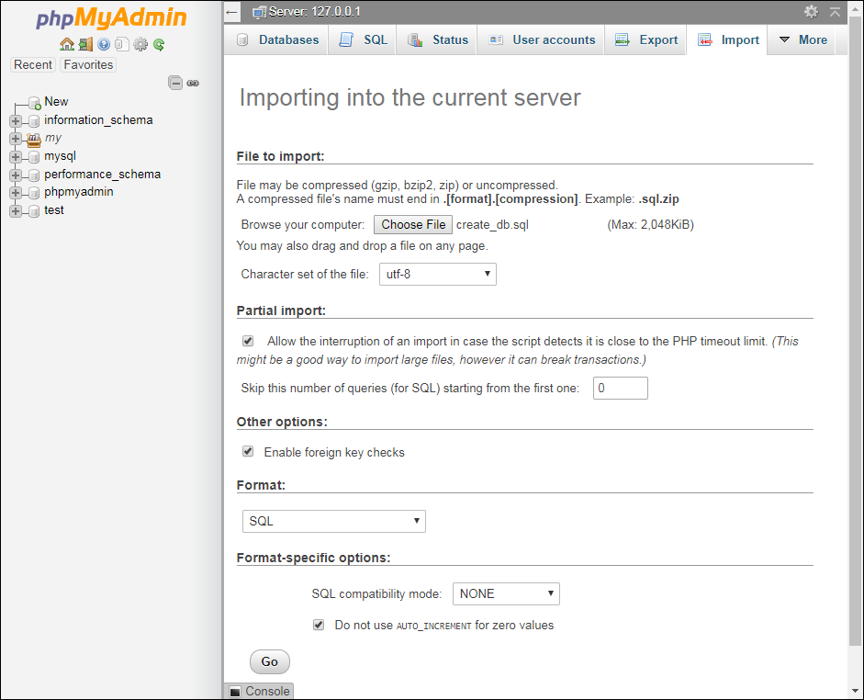
Running a SQL script that creates a database

Slide 27
How to import and run a SQL script

Slide 28
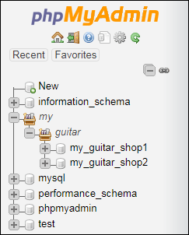
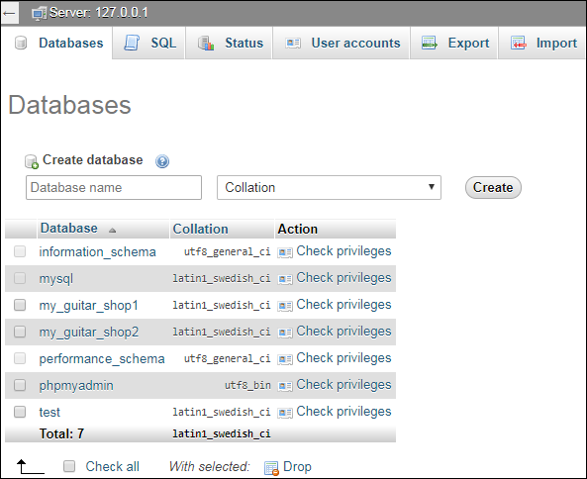
The databases tree and the Databases tab

Slide 29
The Structure tab for the my_guitar_shop1 database

Slide 30
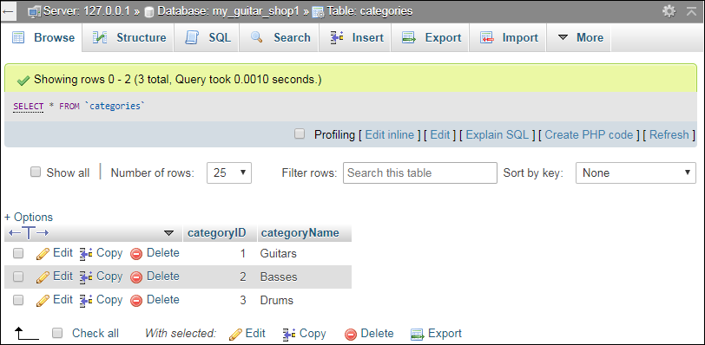
The Browse tab for the categories table

Slide 31
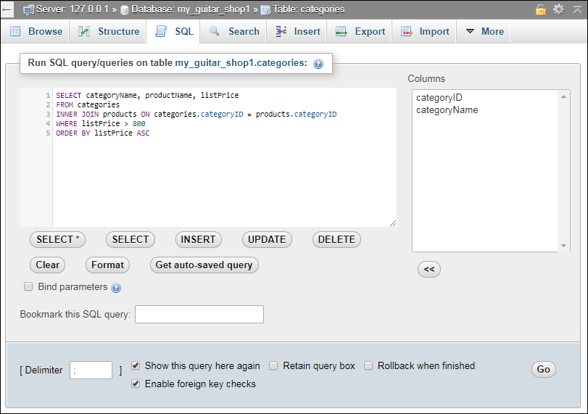
The SQL tab with a statement ready to run

Slide 32
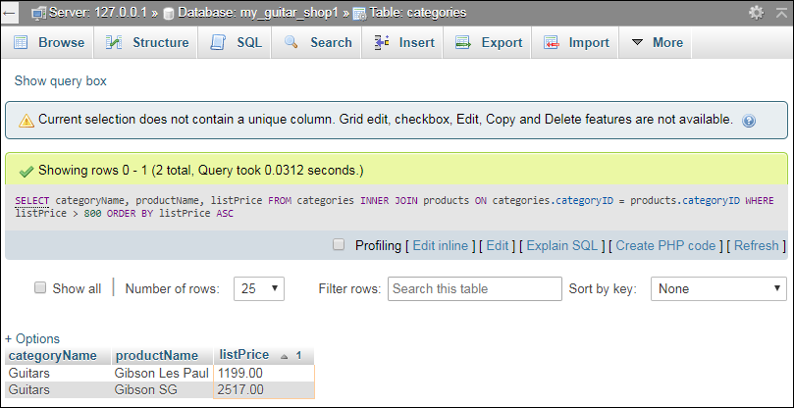
The result of the SQL statement

Slide 33
Creating a user with limited privileges on one table

Slide 34
Common privileges

Slide 35
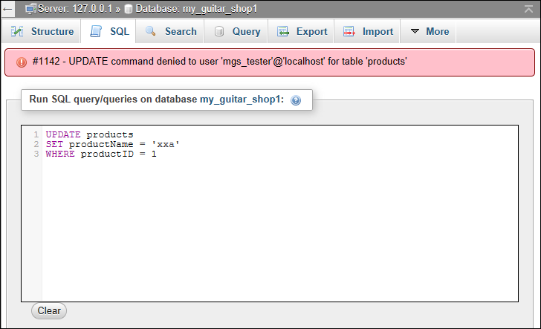
The error message that’s displayed after an UPDATE statement failed

