Slide 1
Chapter 4

Slide 2
Objectives

Slide 3
Objectives (continued)

Slide 4
The syntax for creating an object from any class

Slide 5
How to connect to a MySQL database

Slide 6
Key terms

Slide 7
The syntax for a try/catch statement

Slide 8
How to handle a PDO exception

Slide 9
Key terms

Slide 10
A method of the PDO class for preparing a SQL statement

Slide 11
How to execute a SQL statement that doesn’t have parameters

Slide 12
Two more methods of the PDOStatement class

Slide 13
Code that uses a string index to access each column

Slide 14
Key terms

Slide 15
Another method of the PDOStatement class

Slide 16
How to use a foreach statement to display the result set in an HTML table

Slide 17
Key terms

Slide 18
How to execute an INSERT statement

Slide 19
How to execute an UPDATE statement

Slide 20
How to execute a DELETE statement

Slide 21
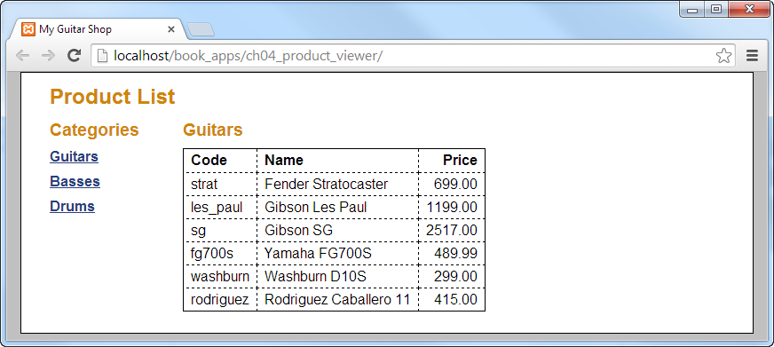
The user interface

Slide 22
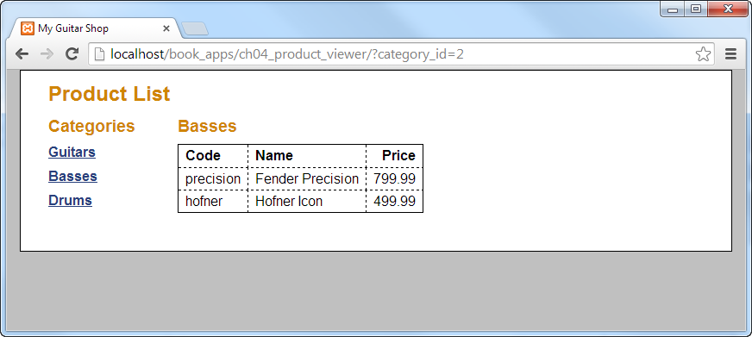
The user interface after the user selects a new category

Slide 23
The database.php file

Slide 24
The database_error.php file

Slide 25
The index.php file

Slide 26
The index.php file (continued)

Slide 27
The index.php file (continued)

Slide 28
The index.php file (continued)

Slide 29
The index.php file (continued)

Slide 30
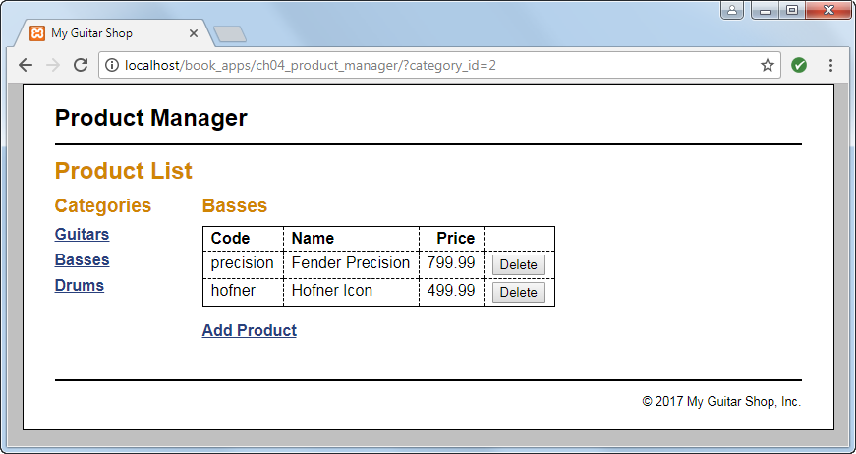
The Product List page

Slide 31
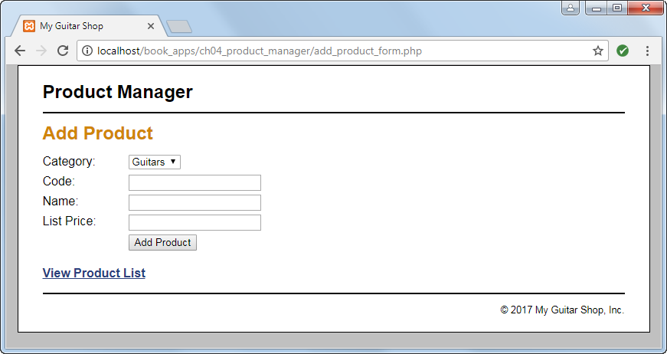
The Add Product page

Slide 32
The index.php file

Slide 33
The index.php file (continued)

Slide 34
The index.php file (continued)

Slide 35
The index.php file (continued)

Slide 36
The index.php file (continued)

Slide 37
The index.php file (continued)

Slide 38
The delete_product.php file

Slide 39
The add_product_form.php file

Slide 40
The add_product_form.php file (continued)

Slide 41
The add_product_form.php file (continued)

Slide 42
The add_product.php file

Slide 43
The add_product.php file (continued)

