Slide 1
Chapter 5

Slide 2
Objectives

Slide 3
Objectives (continued)

Slide 4
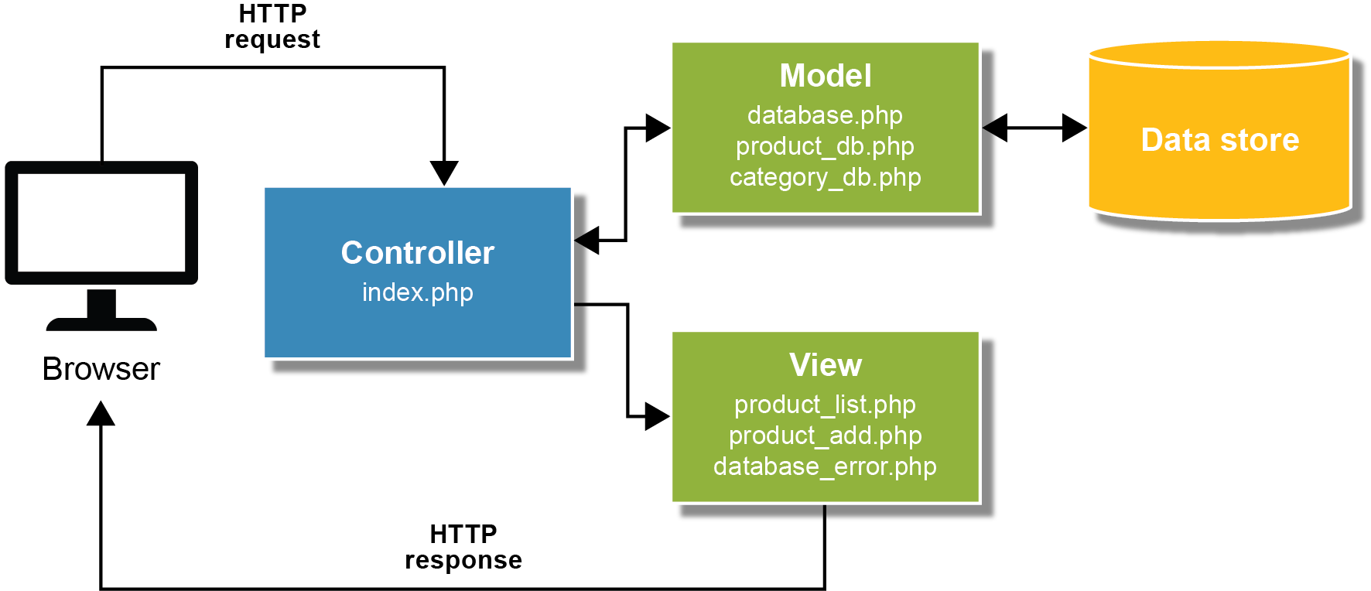
The MVC pattern

Slide 5
Key terms

Slide 6
The syntax for coding a function

Slide 7
A function with four parameters that adds a product

Slide 8
A function call with one argument and a returned array

Slide 9
Key terms

Slide 10
A built-in function for redirecting a request

Slide 11
How to redirect a request that includes a parameter

Slide 12
Key terms

Slide 13
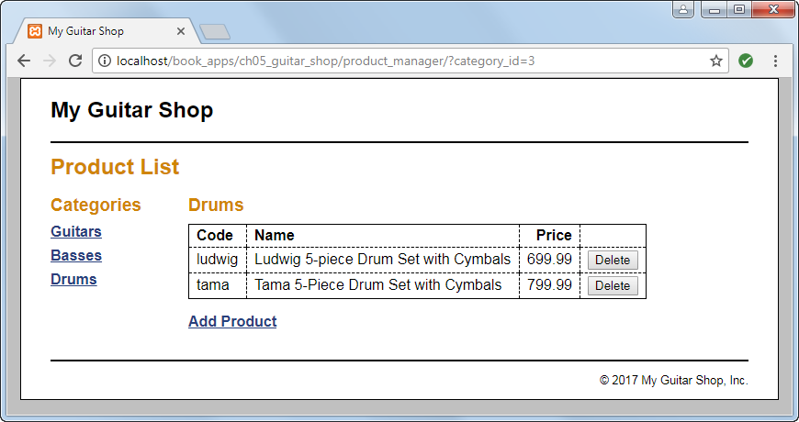
The Product List page

Slide 14
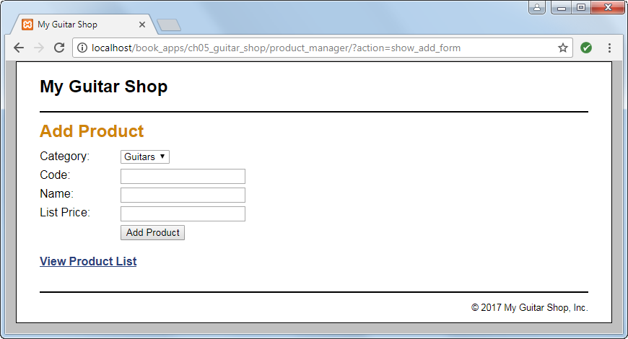
The Add Product page

Slide 15
The model/category_db.php file

Slide 16
The model/product_db.php file

Slide 17
The model/product_db.php file (continued)

Slide 18
product_manager/index.php (the controller)

Slide 19
The controller (continued)

Slide 20
The controller (continued)

Slide 21
The view/header.php file

Slide 22
The view/footer.php file

Slide 23
product_manager/product_list.php (a view)

Slide 24
product_manager/product_list.php (continued)

Slide 25
product_manager/product_list.php (continued)

Slide 26
product_manager/product_add.php (another view)

Slide 27
product_manager/product_add.php (continued)

Slide 28
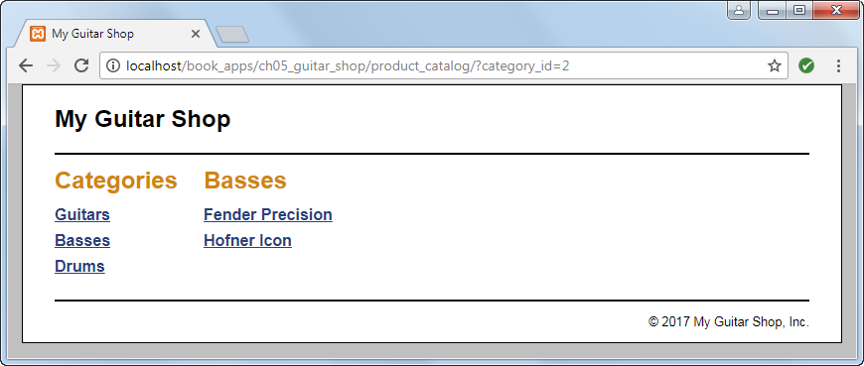
The Product List page

Slide 29
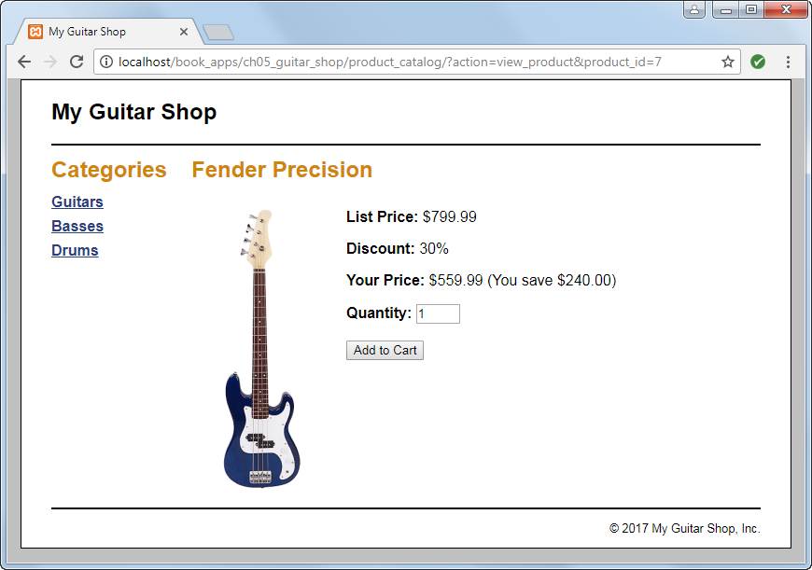
The Product page

Slide 30
The product_catalog/index.php file (the controller)

Slide 31
The controller (continued)

Slide 32
The controller (continued)

Slide 33
The controller (continued)

Slide 34
The product_catalog/product_list.php file (a view)

Slide 35
The product_catalog/product_list.php file (cont.)

Slide 36
The product_catalog/product_view.php file (another view)

Slide 37
The product_catalog/product_view.php file (cont.)

Slide 38
The product_catalog/product_view.php file (cont.)

