Slide 1
Chapter 6

Slide 2
Objectives

Slide 3
Objectives (continued)

Slide 4
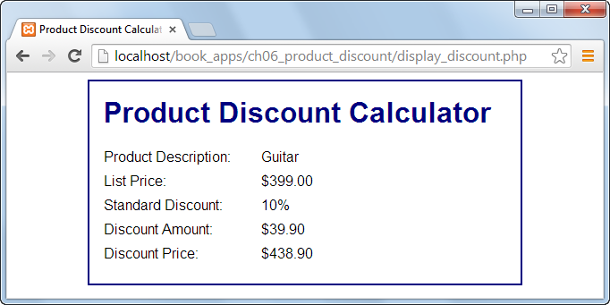
The Discount application with a logic error

Slide 5
The goal of testing

Slide 6
The three types of errors that can occur

Slide 7
PHP code that contains errors

Slide 8
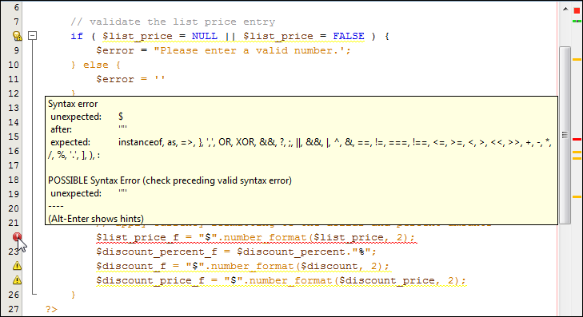
The PHP code that contains errors in NetBeans

Slide 9
Common syntax errors

Slide 10
Problems with values

Slide 11
PHP with echo statements that trace the execution of the code

Slide 12
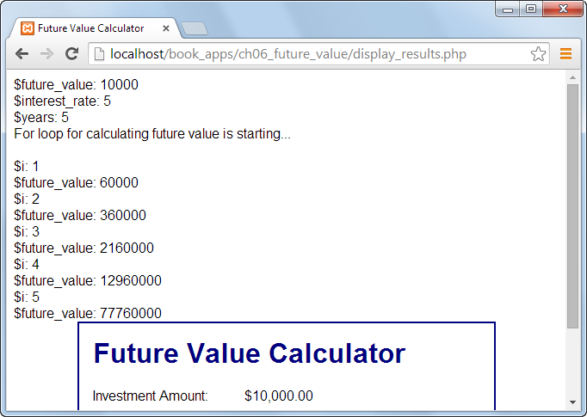
The data displayed in a browser

Slide 13
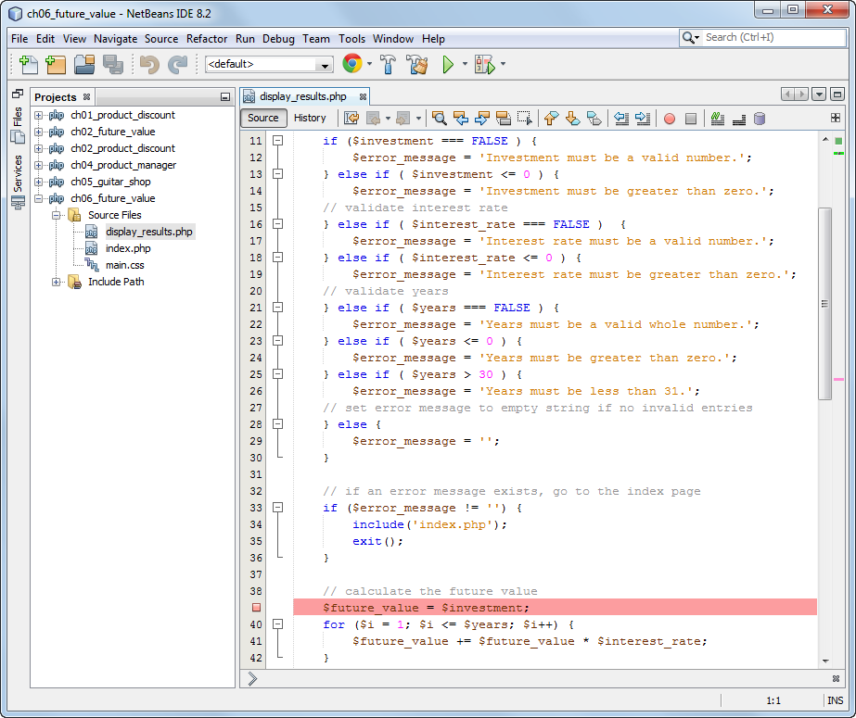
A code editor window with a breakpoint

Slide 14
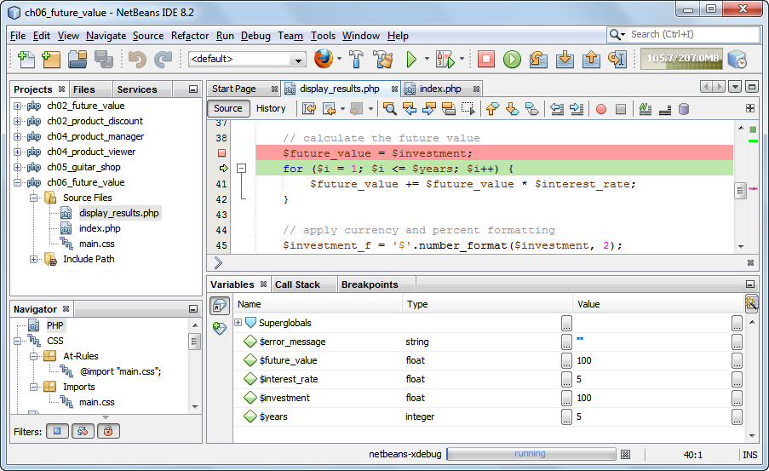
A debugging session with variables displayed

Slide 15
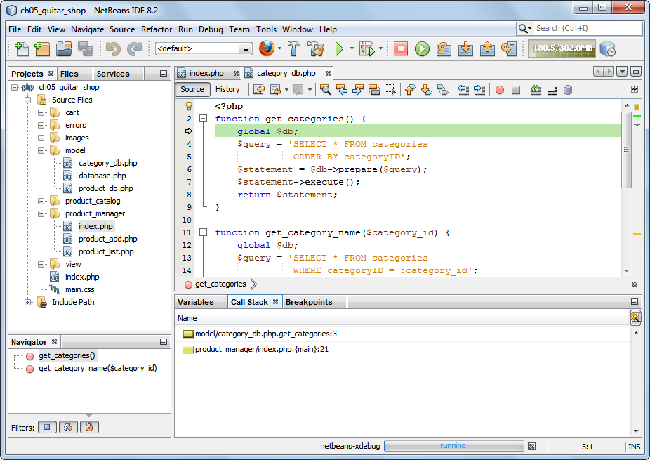
A debugging session with a stack trace displayed

