Slide 1
Chapter 11

Slide 2
Objectives

Slide 3
Objectives (continued)

Slide 4
The syntax for creating an array

Slide 5
How to create an array of discounts

Slide 6
How to use the print_r() function to view the contents of an array

Slide 7
How to define a constant for an array (PHP 7.0 or later)

Slide 8
Key terms

Slide 9
The syntax for adding an element to an array

Slide 10
Functions for removing the values from elements

Slide 11
Functions for loops that work with arrays

Slide 12
Computing the sum and average of an array

Slide 13
How to skip gaps in an array

Slide 14
The syntax for creating an associative array

Slide 15
How to create an associative array of codes

Slide 16
How to create an associative array of extensions

Slide 17
How to set a value with a specific key

Slide 18
How to delete values from an array

Slide 19
The syntax of a foreach loop

Slide 20
A foreach loop that displays the keys and values

Slide 21
A foreach loop that displays the values in a regular array

Slide 22
Key terms

Slide 23
Functions for creating arrays

Slide 24
How to create an array with a range of values

Slide 25
How to slice one array from another

Slide 26
Functions for working with queues and stacks

Slide 27
Key terms

Slide 28
Functions for performing math calculations

Slide 29
Functions for searching arrays

Slide 30
How to search an array

Slide 31
How to count the number of occurrences of a value in an array

Slide 32
Functions for sorting arrays

Slide 33
How to sort strings in ascending order

Slide 34
Functions for modifying arrays

Slide 35
How to modify an array

Slide 36
How to shuffle and deal a deck of cards

Slide 37
A simple array

Slide 38
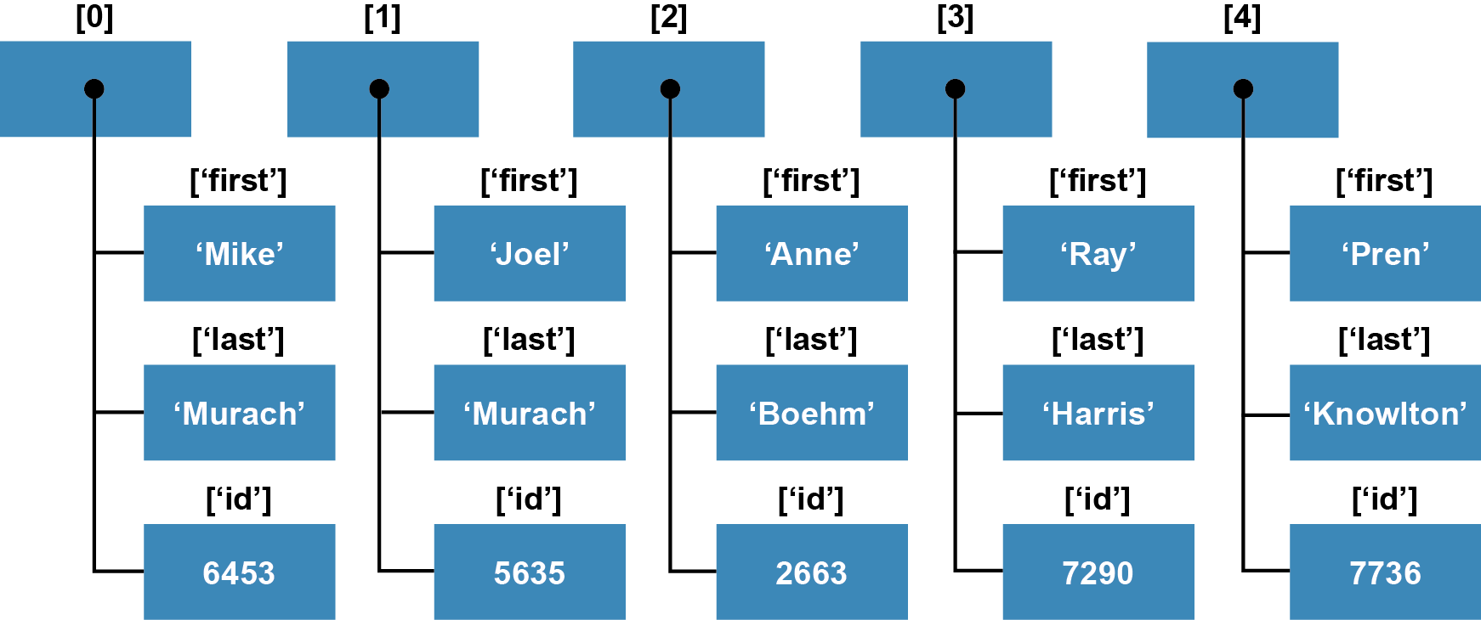
A rectangular array of arrays

Slide 39
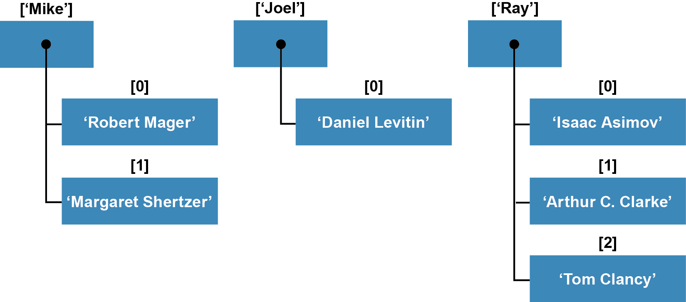
A jagged array of arrays

Slide 40
Key terms

Slide 41
Code that creates an array of arrays

Slide 42
Code that creates a cart array

Slide 43
Referring to the elements in the array of arrays

Slide 44
A more concise way to create an array of arrays

Slide 45
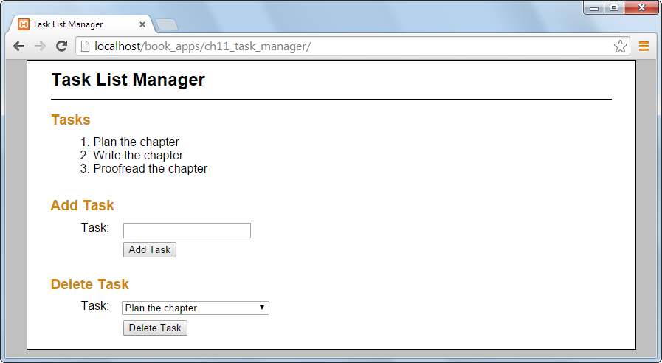
The Task List Manager application

Slide 46
The index.php file

Slide 47
The index.php file (continued)

Slide 48
The task_list.php file

Slide 49
The task_list.php file (continued)

Slide 50
The task_list.php file (continued)

Slide 51
The task_list.php file (continued)

