Slide 1
Chapter 12

Slide 2
Objectives

Slide 3
Examples of cookies

Slide 4
How cookies work

Slide 5
The syntax of the setcookie() function

Slide 6
Key terms

Slide 7
How to enable or disable cookies in Chrome 59

Slide 8
How to enable or disable cookies in IE 11

Slide 9
How to reset default security settings in IE 11

Slide 10
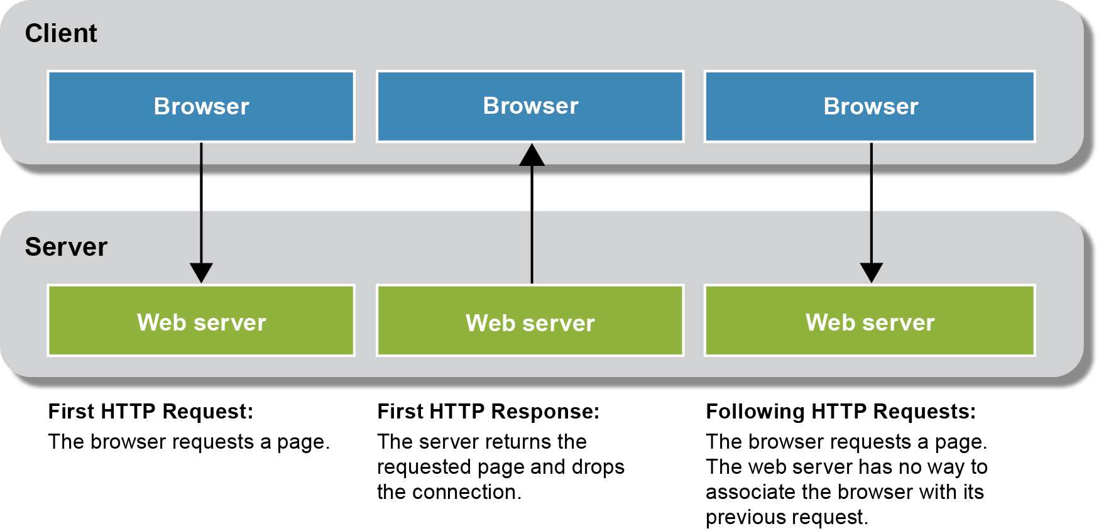
Why session tracking is difficult with HTTP

Slide 11
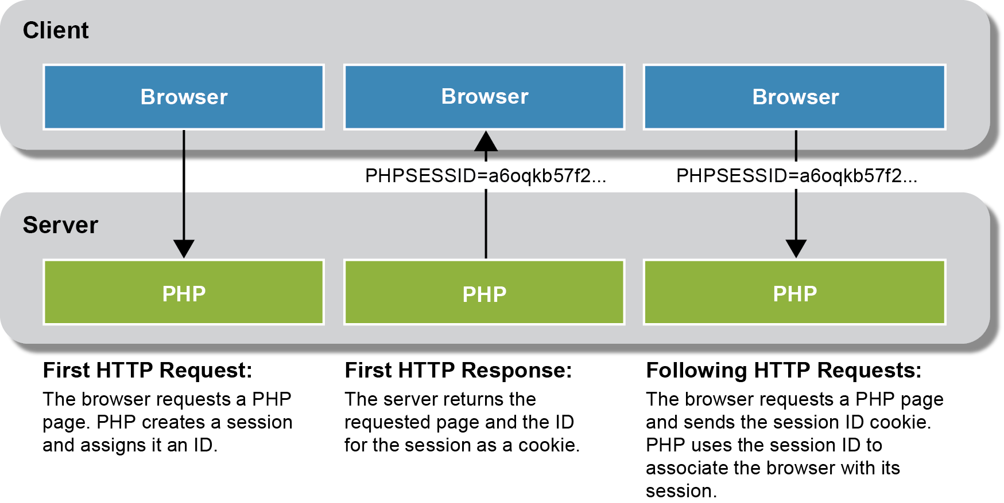
How PHP keeps track of sessions

Slide 12
Key terms

Slide 13
A function to start a session

Slide 14
The session_set_cookie_params() function

Slide 15
How to set and get scalar variables

Slide 16
How to set and get arrays

Slide 17
How to remove variables from a session

Slide 18
Functions to manage sessions

Slide 19
A function to end a session

Slide 20
Delete the session cookie from the browser

Slide 21
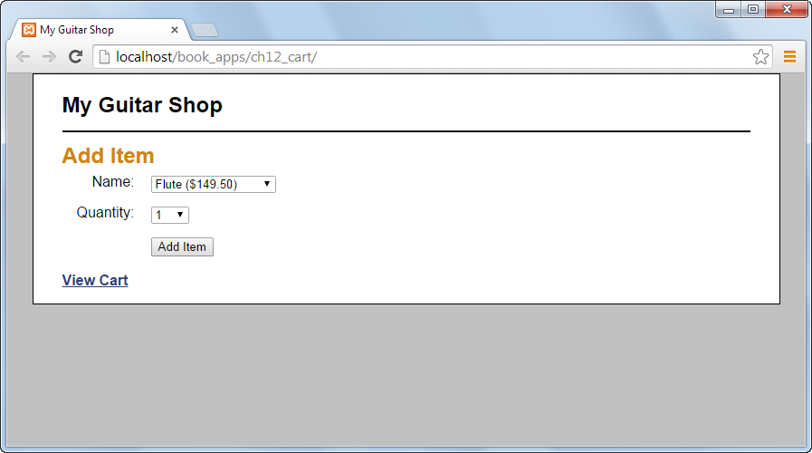
The Add Item page

Slide 22
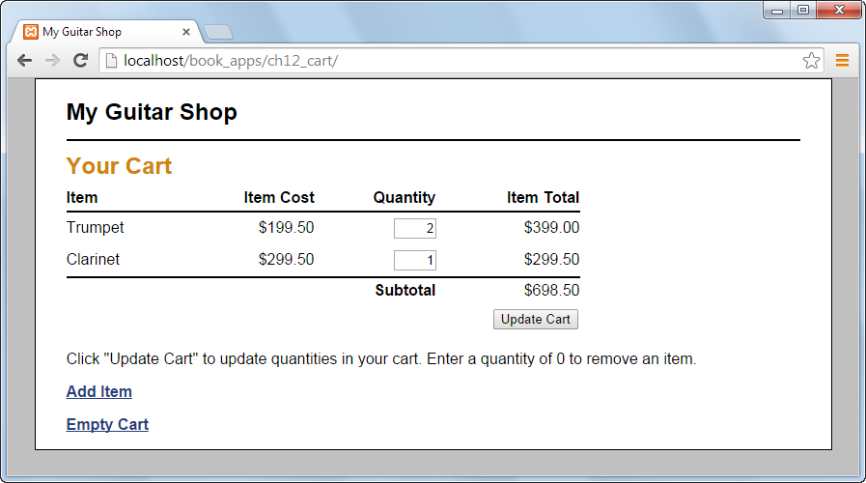
The Cart page

Slide 23
The index.php file

Slide 24
The index.php file (continued)

Slide 25
The index.php file (continued)

Slide 26
The cart.php file

Slide 27
The cart.php file (continued)

Slide 28
The cart.php file (continued)

Slide 29
The cart.php file (continued)

Slide 30
The add_item_view.php file

Slide 31
The add_item_view.php file (continued)

Slide 32
The add_item_view.php file (continued)

Slide 33
The cart_view.php file

Slide 34
The cart_view.php file (continued)

Slide 35
The cart_view.php file (continued)

Slide 36
The cart_view.php file (continued)

