Slide 1
Chapter 13

Slide 2
Objectives

Slide 3
Objectives (continued)

Slide 4
The syntax for a function

Slide 5
A function with one parameter

Slide 6
A function call that doesn’t return a value

Slide 7
Key terms

Slide 8
An argument passed by value

Slide 9
How to modify a string that’s passed by reference

Slide 10
How to return multiple values

Slide 11
A variable with global scope

Slide 12
Another way to access a global variable

Slide 13
Key terms

Slide 14
A function with one default parameter

Slide 15
A function with an optional parameter

Slide 16
A function with one required and two default parameters

Slide 17
Calling a function with a default parameter value

Slide 18
The syntax for type declarations

Slide 19
A function with one parameter type declaration

Slide 20
Function calls without strict typing

Slide 21
How to enable strict types mode

Slide 22
Key terms

Slide 23
Functions for working with variable-length parameter lists

Slide 24
A function that averages one or more numbers

Slide 25
Using required parameters with a variable parameter list

Slide 26
A library of functions (the cart.php file)

Slide 27
A library of functions (the cart.php file) (cont.)

Slide 28
A library of functions (the cart.php file) (cont.)

Slide 29
Code that uses the library

Slide 30
Functions for working with the include path

Slide 31
How to set the include path

Slide 32
How to create a namespace in a file

Slide 33
How to use the functions in a namespace

Slide 34
A variable function

Slide 35
A function that uses a callback

Slide 36
Language constructs that can’t be use in variable functions

Slide 37
How variable functions and callbacks work

Slide 38
A function for sorting an array with a custom comparison function

Slide 39
How to create and use an anonymous function

Slide 40
The spaceship operator

Slide 41
An array of arrays

Slide 42
A function to sort the array by any column

Slide 43
Code that sorts the array by the name column

Slide 44
How closures work

Slide 45
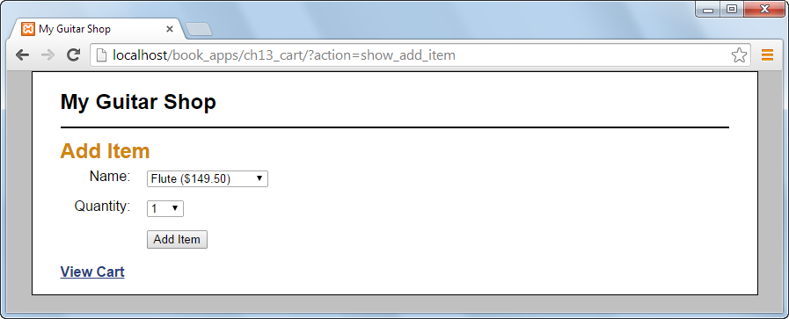
The Add Item page

Slide 46
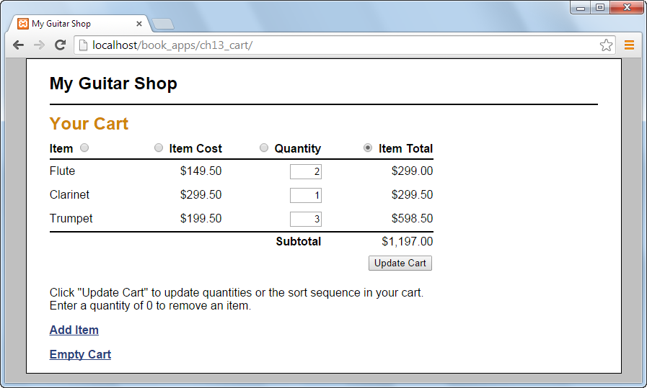
The Cart page

Slide 47
The cart.php file

Slide 48
The cart.php file (continued)

Slide 49
The index.php file

Slide 50
The index.php file (continued)

Slide 51
The index.php file (continued)

Slide 52
The index.php file (continued)

Slide 53
The cart_view.php file

Slide 54
The cart_view.php file

Slide 55
The cart_view.php file (continued)

Slide 56
The cart_view.php file (continued)

Slide 57
The cart_view.php file

