Slide 1
Chapter 14

Slide 2
Objectives

Slide 3
Objectives (continued)

Slide 4
The Category class

Slide 5
Key terms

Slide 6
The Product class

Slide 7
The Product class (continued)

Slide 8
The Product class (continued)

Slide 9
The Product class (continued)

Slide 10
The Product class (continued)

Slide 11
The Product class (continued)

Slide 12
The Product class (continued)

Slide 13
The syntax for coding a property

Slide 14
Key terms

Slide 15
The syntax for coding a constructor method

Slide 16
How to code a destructor method

Slide 17
Key terms

Slide 18
The syntax for coding a method

Slide 19
A private method

Slide 20
A method that accesses a property of the current object

Slide 21
The syntax for creating an object

Slide 22
The syntax for setting a public property value

Slide 23
The syntax for calling an object’s methods

Slide 24
Key terms

Slide 25
A class with three class constants

Slide 26
Using a constant outside the class

Slide 27
A class with a static property and method

Slide 28
Using a public static method

Slide 29
Key terms

Slide 30
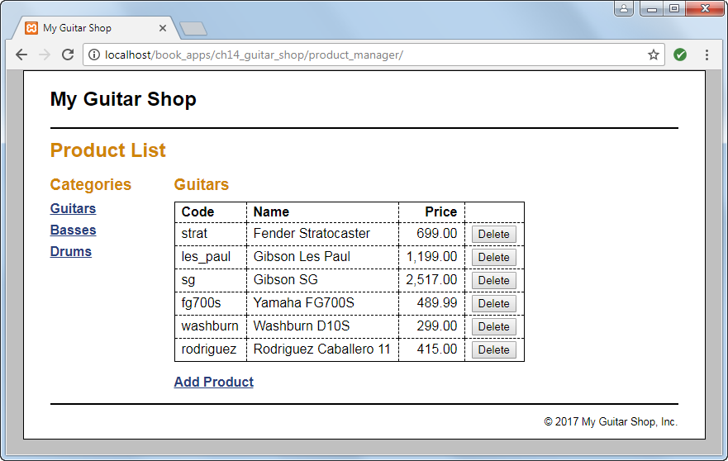
The Product List page

Slide 31
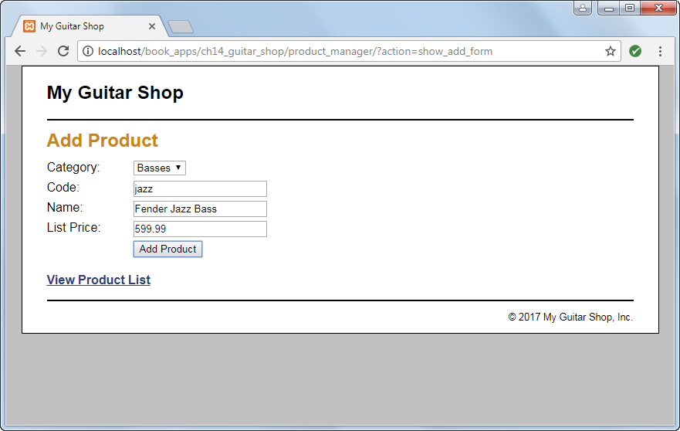
The Add Product page

Slide 32
The database.php file

Slide 33
The database.php file (continued)

Slide 34
The product_db.php file

Slide 35
The product_db.php file (continued)

Slide 36
The product_db.php file (continued)

Slide 37
The product_db.php file (continued)

Slide 38
The index.php file

Slide 39
The index.php file (continued)

Slide 40
The index.php file (continued)

Slide 41
The product_list.php file

Slide 42
The product_list.php file (continued)

Slide 43
The product_list.php file (continued)

Slide 44
The product_list.php file (continued)

Slide 45
The syntax for looping through an object’s properties

Slide 46
An Employee class

Slide 47
An Employee object with four properties

Slide 48
The syntax for cloning an object

Slide 49
Create a clone of the object

Slide 50
Using the == operator to compare objects

Slide 51
Key terms

Slide 52
Functions for inspecting an object

Slide 53
Determine if an object is an instance of a class

Slide 54
Key terms

Slide 55
A superclass

Slide 56
A superclass (continued)

Slide 57
A subclass

Slide 58
Code that uses the subclass

Slide 59
Key terms

Slide 60
How the access modifiers work

Slide 61
A superclass

Slide 62
An abstract class with an abstract method

Slide 63
Implementing an abstract class

Slide 64
Implementing an abstract (continued)

Slide 65
Code that attempts to create an object from the abstract class

Slide 66
Key terms

Slide 67
A class with a final method

Slide 68
A final class that can’t be inherited

Slide 69
The syntax for creating an interface

Slide 70
An interface that provides three constants

Slide 71
A class that inherits a class and implements an interface

Slide 72
A class declaration that implements three interfaces

Slide 73
Key terms

