Slide 1
Chapter 15

Slide 2
Objectives

Slide 3
Objectives (continued)

Slide 4
A function for matching a regular expression

Slide 5
How to test for errors in a regular expression

Slide 6
A case-insensitive regular expression

Slide 7
Key terms

Slide 8
Patterns for special characters

Slide 9
Matching special characters

Slide 10
Patterns for character types

Slide 11
Matching character types

Slide 12
Using the character class

Slide 13
Using metacharacters

Slide 14
Using bracket expressions

Slide 15
Patterns for string positions

Slide 16
Matching string positions

Slide 17
Matching subpatterns

Slide 18
Matching repeating patterns

Slide 19
Look-ahead assertions

Slide 20
A negative look-ahead assertion

Slide 21
A pattern to enforce password complexity

Slide 22
How to work with a multiline regular expression

Slide 23
How to work with a global regular expression

Slide 24
How to use the preg_replace() function to replace a pattern with a string

Slide 25
How to use the preg_split() function to split a string on a pattern

Slide 26
Regular expressions for testing validity

Slide 27
Testing a phone number for validity

Slide 28
Testing a date for a valid format, but not for a valid month, day, and year

Slide 29
Complete email address validation

Slide 30
Complete email address validation (continued)

Slide 31
The syntax for creating a new Exception object

Slide 32
A function that may throw an exception

Slide 33
Methods of Exception objects

Slide 34
The syntax for a try/catch statement

Slide 35
A statement that rethrows an Exception object

Slide 36
Code that catches all errors and exceptions (PHP 7 and later)

Slide 37
Code that catches a ParseError (PHP 7 and later)

Slide 38
Code that catches a TypeError (PHP 7 and later)

Slide 39
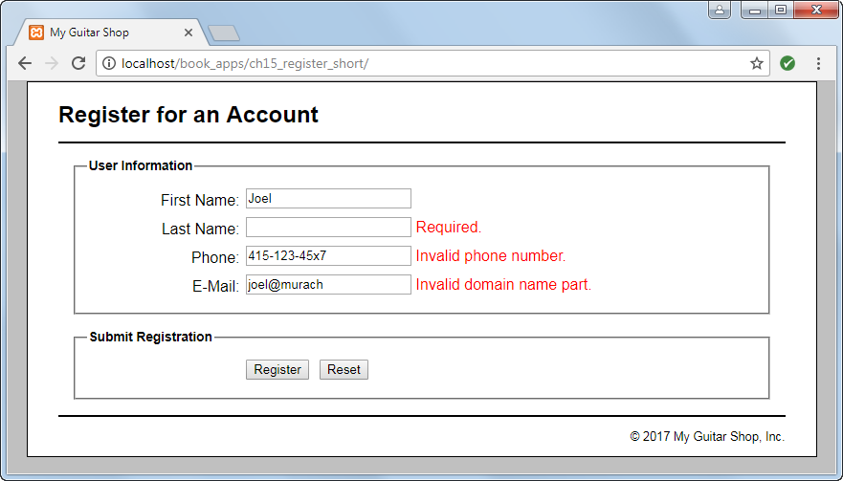
The user interface for the Registration application

Slide 40
The file structure

Slide 41
model/fields.php

Slide 42
model/fields.php (continued)

Slide 43
model/fields.php (continued)

Slide 44
model/validate.php

Slide 45
model/validate.php (continued)

Slide 46
model/validate.php (continued)

Slide 47
model/validate.php (continued)

Slide 48
model/validate.php

Slide 49
model/validate.php (continued)

Slide 50
model/validate.php (continued)

Slide 51
model/validate.php (continued)

Slide 52
model/validate.php (continued)

Slide 53
The controller (index.php)

Slide 54
The controller (index.php) (continued)

Slide 55
The controller (index.php) (continued)

Slide 56
The controller (index.php) (continued)

Slide 57
The view (view/register.php)

Slide 58
The view (view/register.php) (continued)

Slide 59
The view (view/register.php) (continued)

Slide 60
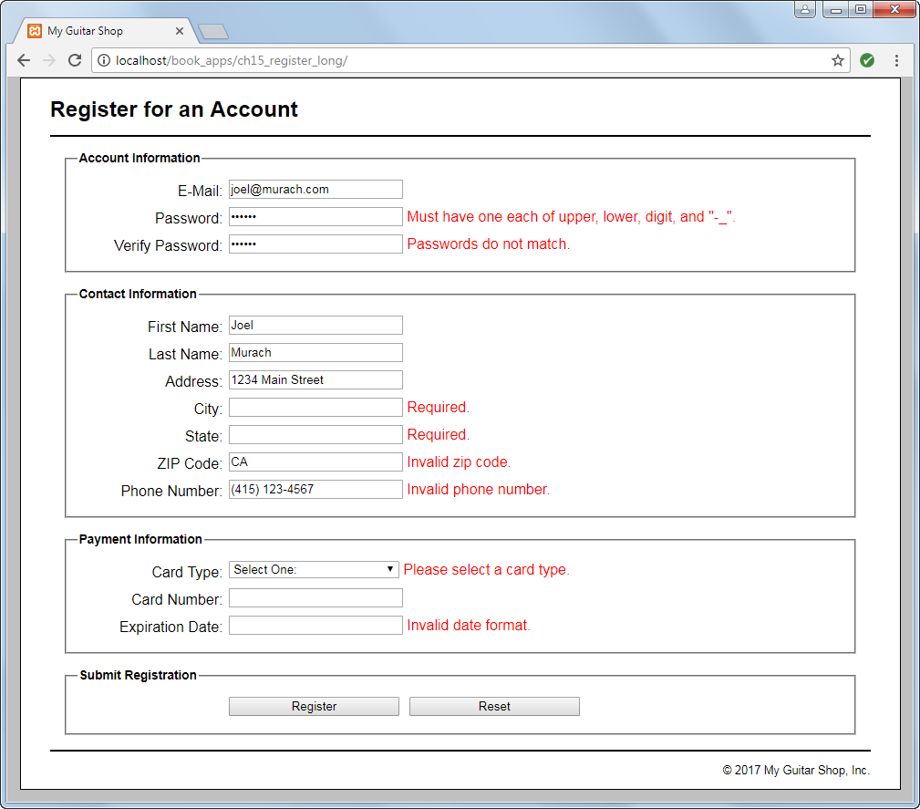
A long version of the Registration application

