Slide 1
Chapter 16

Slide 2
Objectives

Slide 3
Objectives (continued)

Slide 4
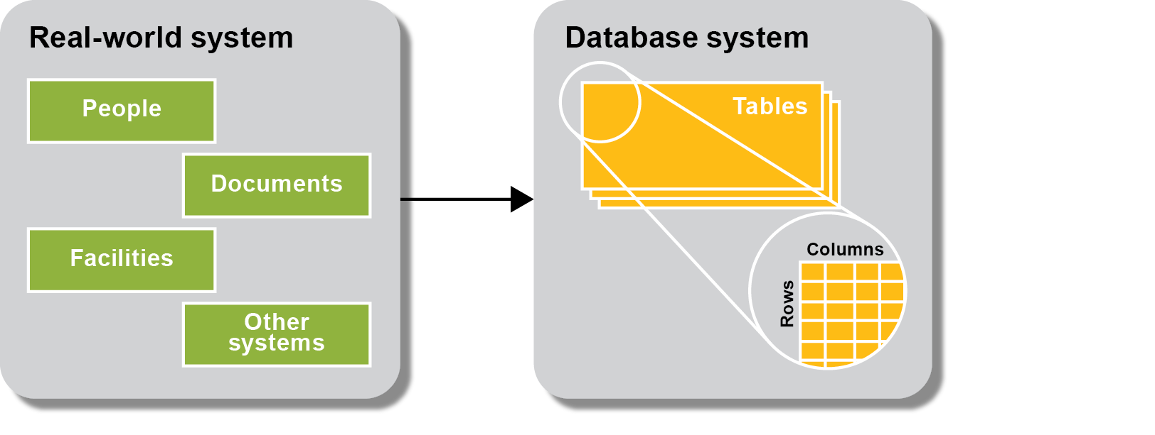
A database system is modeled after a real-word system

Slide 5
The six basic steps for designing a data structure

Slide 6
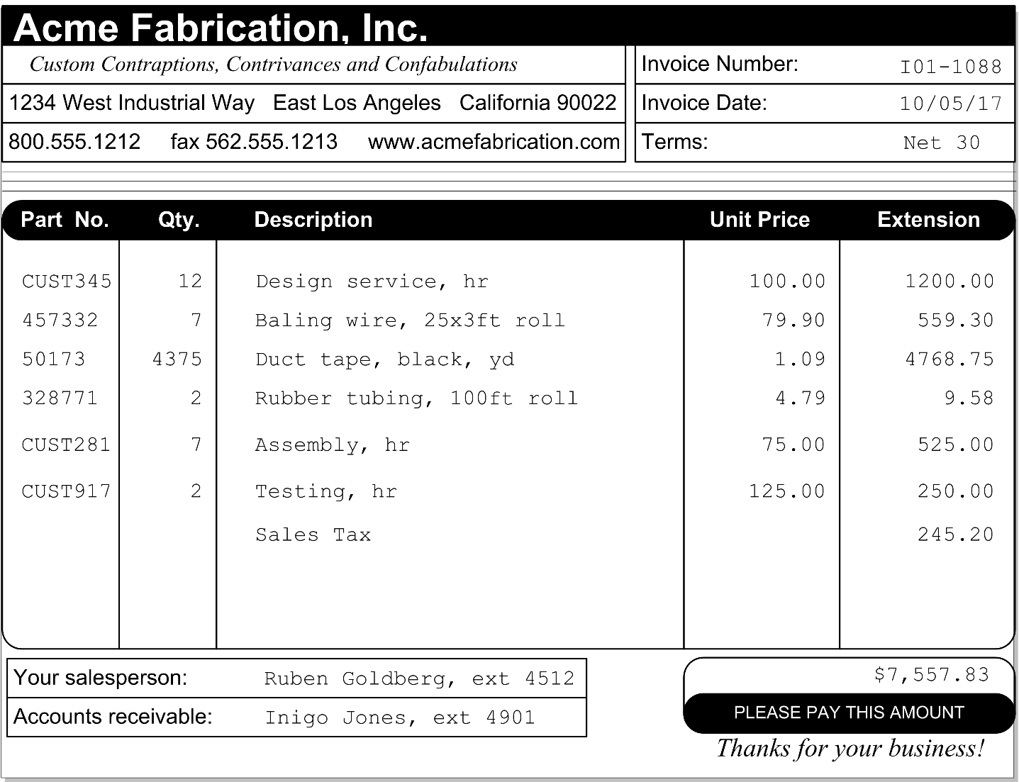
An invoice that can be used to identify data elements

Slide 7
The data elements identified on the invoice

Slide 8
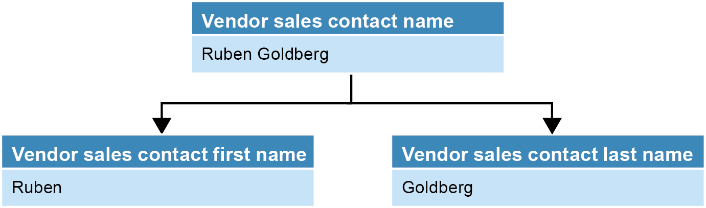
A name that’s divided into first and last names

Slide 9
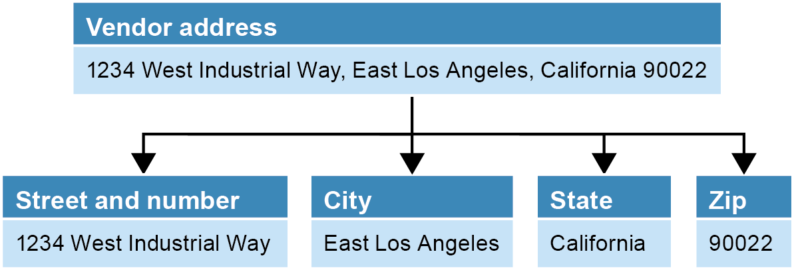
An address that’s divided into street address, city, state, and zip code

Slide 10
Possible tables and columns for an A/P system

Slide 11
Possible tables and columns for an A/P system
(continued)

Slide 12
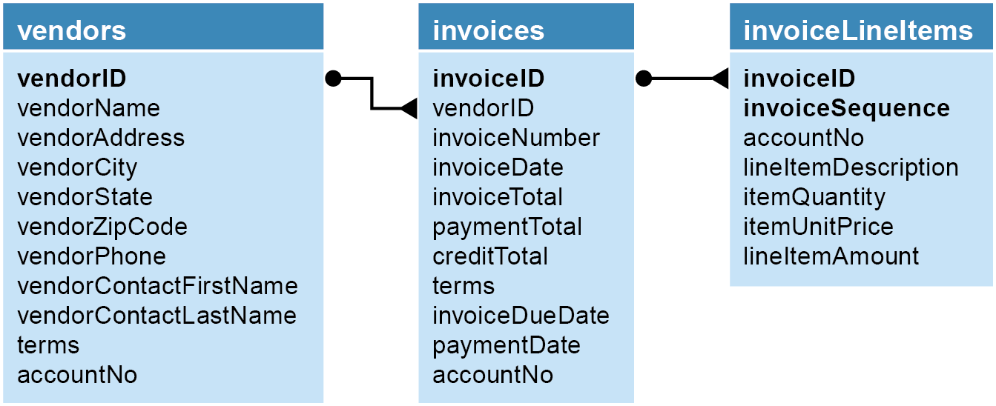
The relationships between the tables in the accounts payable system

Slide 13
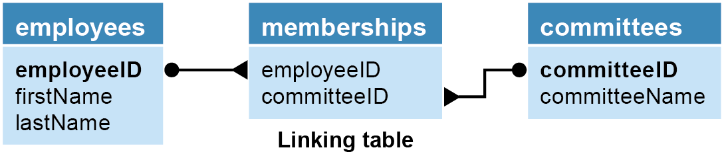
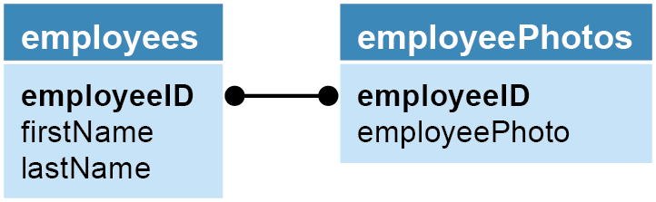
Two tables with a many-to-many relationship

Slide 14
Operations that can violate referential integrity

Slide 15

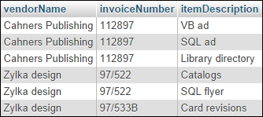
A table that contains repeating columns

Slide 16
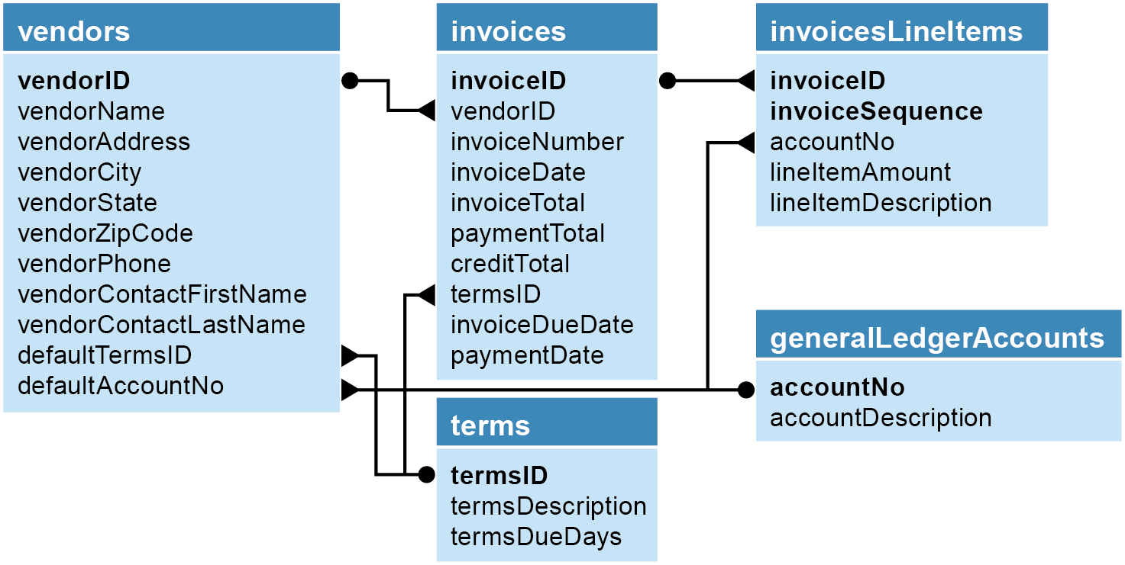
The accounts payable system in third normal form

Slide 17
About indexes

Slide 18
The seven normal forms

Slide 19
The benefits of normalization

Slide 20

The invoice data with a column that contains repeating values

Slide 21
The invoice data in first normal form

Slide 22
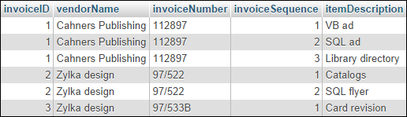
The invoice data in first normal form with keys added

Slide 23

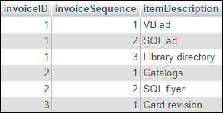
The invoice data in second normal form

Slide 24
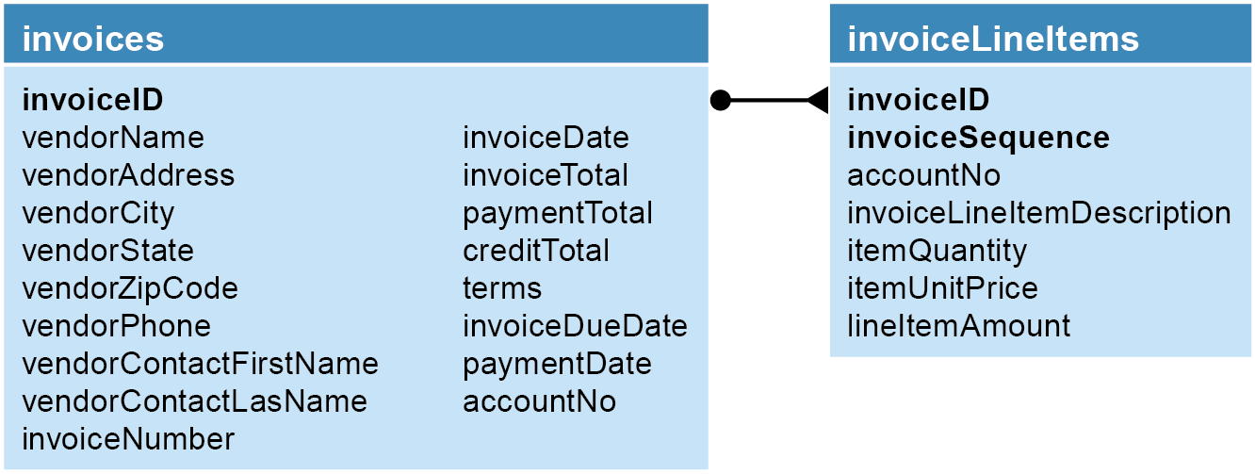
The A/P system in second normal form

Slide 25

The A/P system in third normal form

Slide 26
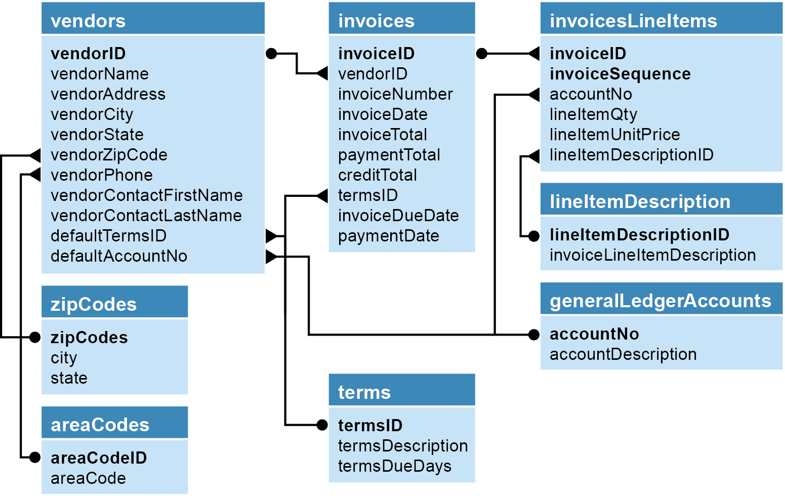
The accounts payable system in fifth normal form

Slide 27
When to denormalize

Slide 28
MySQL Workbench…

Slide 29
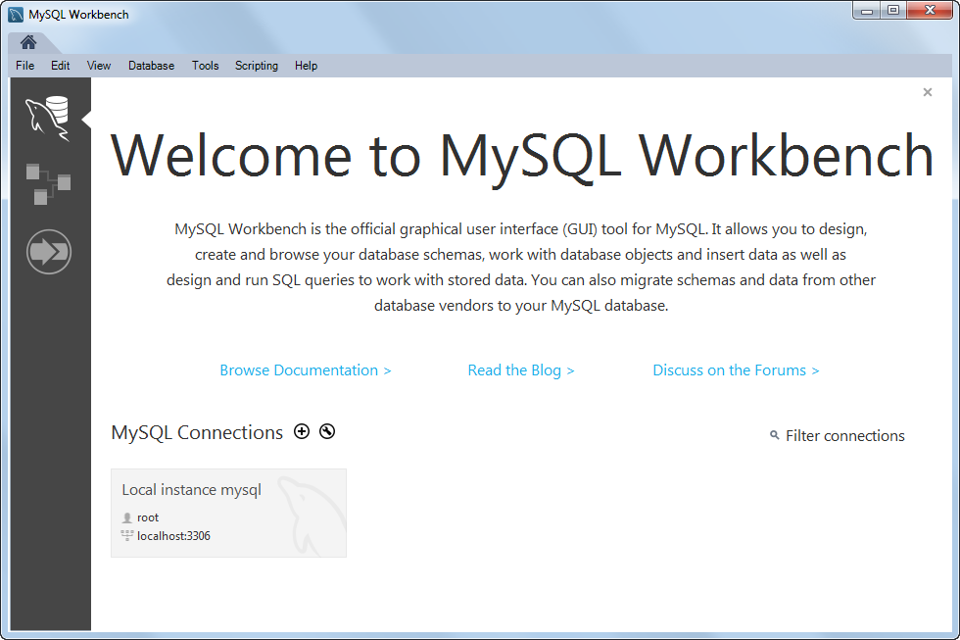
The Welcome tab of the Home page

Slide 30
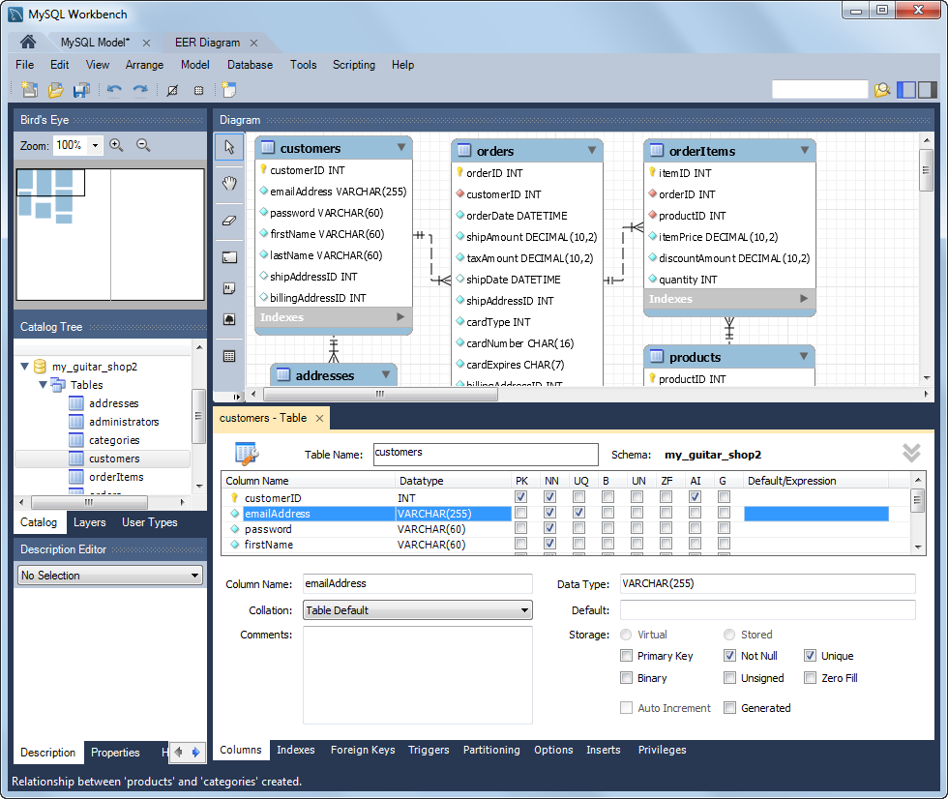
MySQL Workbench

