Slide 1
Chapter 17

Slide 2
Objectives

Slide 3
Objectives (continued)

Slide 4
How to create a database

Slide 5
Common numeric data types

Slide 6
The syntax of the CREATE TABLE statement

Slide 7
A table without column attributes

Slide 8
Another table with column attributes

Slide 9
Two column attributes for working with a primary key

Slide 10
A table with a two-column primary key

Slide 11
Three attributes for working with a foreign key

Slide 12
A table with a table-level foreign key constraint

Slide 13
An insert statement that fails because a related row doesn’t exist

Slide 14
A statement that renames a table

Slide 15
A statement that changes a column definition

Slide 16
A statement that drops a table

Slide 17
The syntax of the CREATE INDEX statement

Slide 18
A CREATE TABLE statement that creates indexes

Slide 19
Privileges for working with data

Slide 20
Other privileges

Slide 21
The four privilege levels

Slide 22
How to create a user from a specific host

Slide 23
The syntax of the GRANT statement

Slide 24
A statement that creates a user with no privileges

Slide 25
A statement that grants table privileges to a user

Slide 26
The syntax of the REVOKE statement for all privileges

Slide 27
The syntax of the REVOKE statement for specific privileges

Slide 28
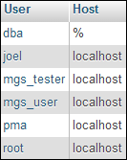
A statement that lists all users

Slide 29
The syntax of the SHOW GRANTS statement

Slide 30
A statement that shows the privileges for a user from a specific host

Slide 31
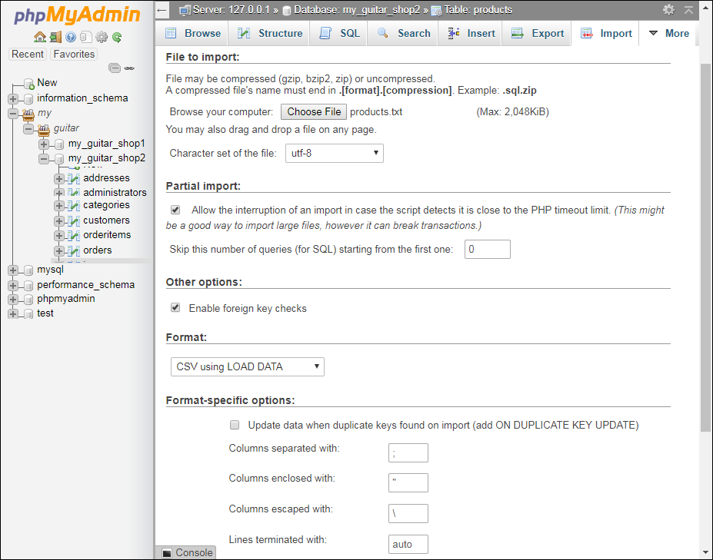
The Import tab for a table named products

Slide 32
A tab-delimited text file that’s stored in users.txt

Slide 33
How to use the Windows command prompt to load data from a text file

Slide 34
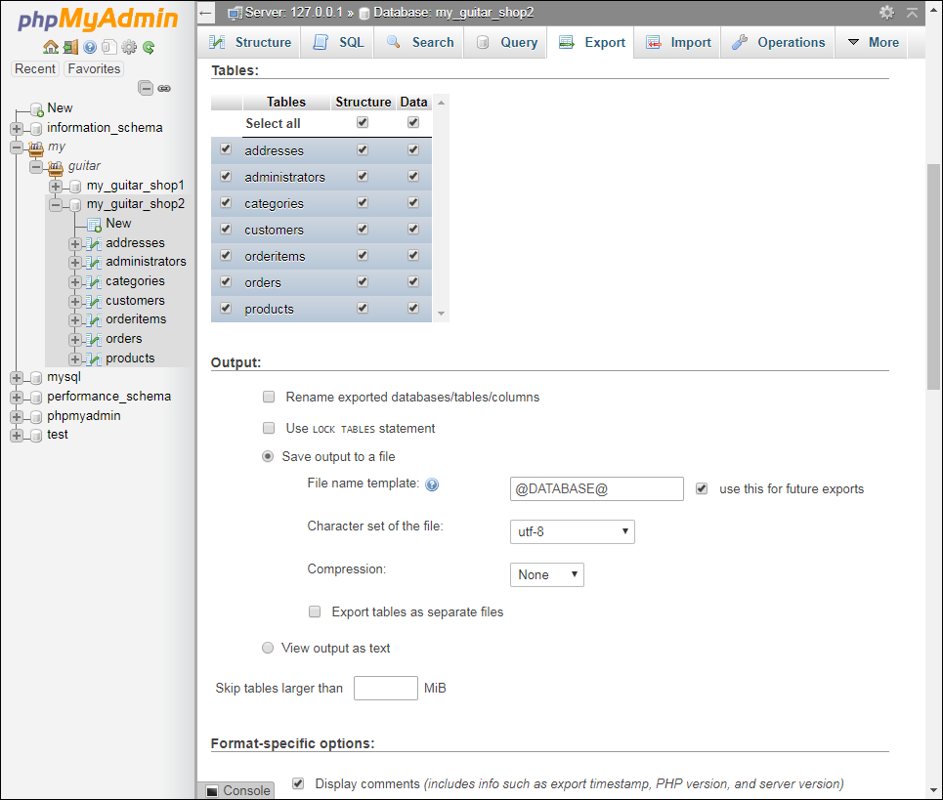
The Export tab for my_guitar_shop2

Slide 35
How to use phpMyAdmin to dump a database

Slide 36
The SQL script that creates the my_guitar_shop2 database

Slide 37
The SQL script that creates the database (cont.)

Slide 38
The SQL script that creates the database (cont.)

Slide 39
The SQL script that creates the database (cont.)

Slide 40
The SQL script that creates the database (cont.)

Slide 41
The SQL script that creates the database (cont.)

