Slide 1
Chapter 18

Slide 2
Objectives

Slide 3
Objectives (continued)

Slide 4
Objectives (continued)

Slide 5
The simplified syntax of the SELECT statement

Slide 6
Retrieve all rows and columns from a table

Slide 7
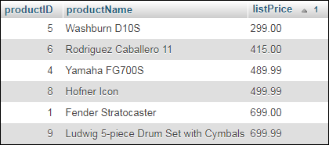
Retrieve three columns and sort them by price

Slide 8
Retrieve rows in the specified price range

Slide 9
Retrieve an empty result set

Slide 10
Use the AS keyword to specify an alias

Slide 11
Omitting the AS keyword works too

Slide 12
Use quotes to include spaces

Slide 13
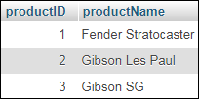
The syntax of the LIMIT clause

Slide 14
Another way to retrieve the first three rows

Slide 15
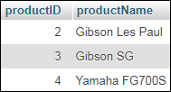
Retrieve three rows starting at the second row

Slide 16
The syntax of the WHERE clause with comparison operators

Slide 17
A WHERE clause that selects products where the product…

Slide 18
A WHERE clause that selects products where the product…

Slide 19
The syntax of the WHERE clause with logical operators

Slide 20
A compound condition without parentheses

Slide 21
The same compound condition with parentheses

Slide 22
The syntax of the WHERE clause with the IS NULL operator

Slide 23
Retrieve rows for orders that haven’t been shipped

Slide 24
Retrieve rows for orders that have been shipped

Slide 25
The syntax of the WHERE clause with the LIKE operator

Slide 26
WHERE clauses that use the LIKE operator

Slide 27
The syntax of the ORDER BY clause

Slide 28
Sort by one column in descending sequence

Slide 29
Sort by two columns

Slide 30
The explicit syntax for an inner join

Slide 31
Joining the customers and orders tables

Slide 32
The syntax for an inner join that uses table aliases

Slide 33
An inner join with aliases for four tables

Slide 34
The syntax of the aggregate functions

Slide 35
Count all orders and shipped orders

Slide 36
Find lowest, highest, and average prices

Slide 37
Get the total of the calculated values for all orders

Slide 38
The syntax of the GROUP BY and HAVING clauses

Slide 39
Use columns from multiple tables

Slide 40
Use a WHERE clause to filter rows before grouping them

Slide 41
Four ways to introduce a subquery in a SELECT statement

Slide 42
Use a subquery in the WHERE clause

Slide 43
Use another subquery in the WHERE clause

Slide 44
A correlated subquery in the SELECT clause

Slide 45
The syntax of a subquery that uses the EXISTS clause

Slide 46
The syntax of the INSERT statement

Slide 47
Add a single row without using a column list

Slide 48
The syntax of the UPDATE statement

Slide 49
Update one column of multiple rows

Slide 50
The syntax of the DELETE statement

Slide 51
Another way to delete multiple rows

