Slide 1
Chapter 20

Slide 2
Objectives

Slide 3
The text that’s entered by the user

Slide 4
The HTML that’s generated by the system

Slide 5
The rules for this content management system

Slide 6
The util/tags.php file

Slide 7
The util/tags.php file (continued)

Slide 8
Code that uses the add_tags() function

Slide 9
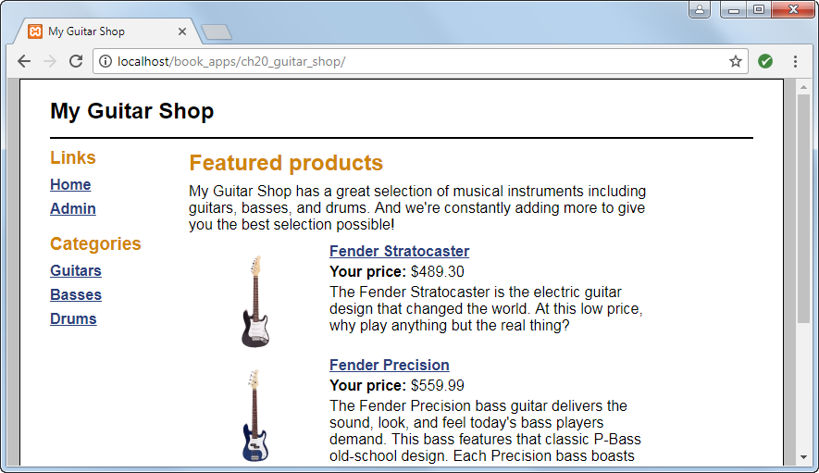
The home page for the Guitar Shop website

Slide 10
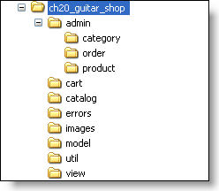
The directory structure for the website starting from htdocs/book_apps

Slide 11
Files in the application’s root directory

Slide 12
The util/main.php file

Slide 13
The view/header.php file

Slide 14
The view/sidebar.php file

Slide 15
The view/sidebar.php file (continued)

Slide 16
The view/sidebar_admin.php file

Slide 17
The view/sidebar_admin.php file (continued)

Slide 18
The view/product.php file

Slide 19
The view/product.php file (continued)

Slide 20
The view/product_php file (continued)

Slide 21
The view/product.php file (continued)

Slide 22
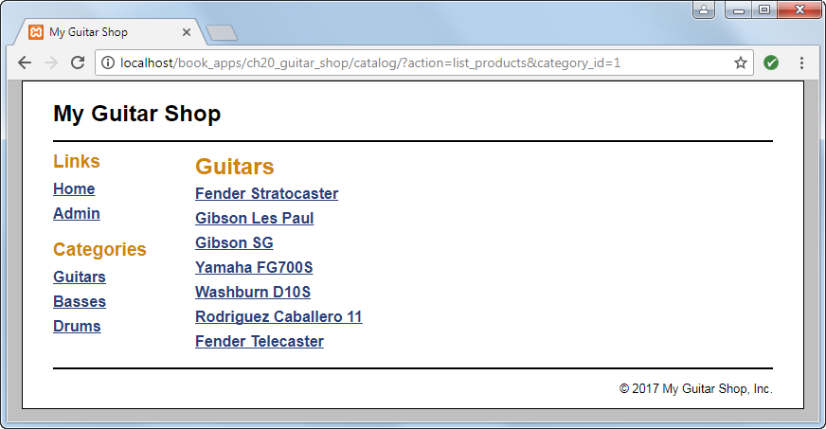
The Product List page

Slide 23
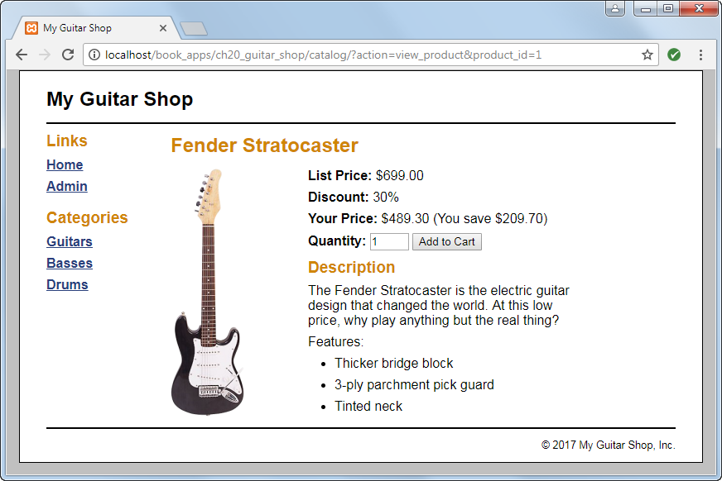
The Product View page

Slide 24
The catalog/index.php file

Slide 25
The catalog/index.php file (continued)

Slide 26
The catalog/index.php file (continued)

Slide 27
The catalog/product_list.php fle

Slide 28
The catalog/product_view.php file

Slide 29
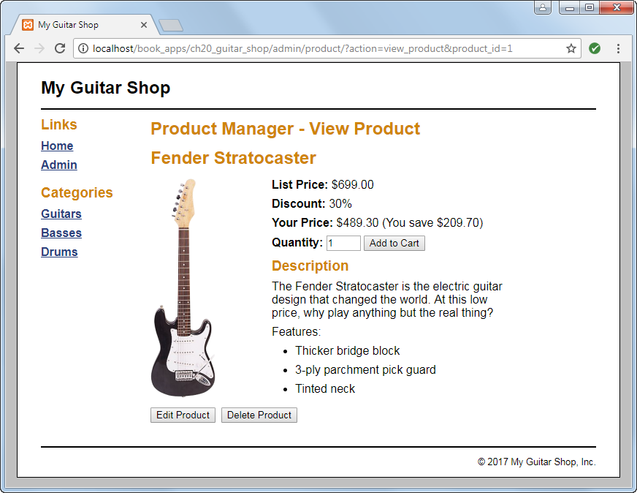
The Product View page

Slide 30
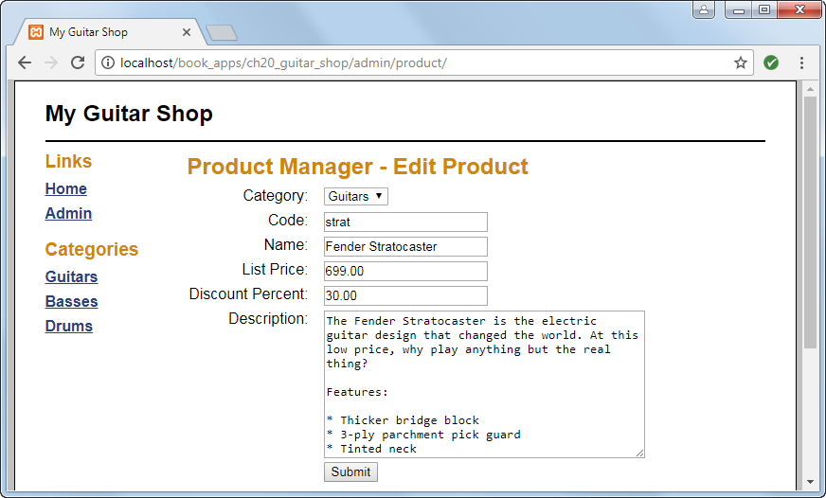
The Product Add/Edit page

Slide 31
The admin/product/index.php file

Slide 32
The admin/product/index.php file (continued)

Slide 33
The admin/product/index.php file (continued)

Slide 34
The admin/product/index.php file (continued)

Slide 35
The admin/product/index.php file (continued)

Slide 36
The admin/product/index.php file (continued)

Slide 37
The admin/product/index.php file (continued)

Slide 38
The admin/product/index.php file (continued)

Slide 39
The admin/product/product_view.php file

Slide 40
The admin/product/product_view.php file (cont.)

Slide 41
The admin/product/product_add_edit.php file

Slide 42
The product_add_edit.php file (continued)

Slide 43
The product_add_edit.php file (continued)

Slide 44
The product_add_edit.php file (continued)

Slide 45
The product_add_edit.php file (continued)

