Slide 1
Chapter 21

Slide 2
Objectives

Slide 3
Objectives (continued)

Slide 4
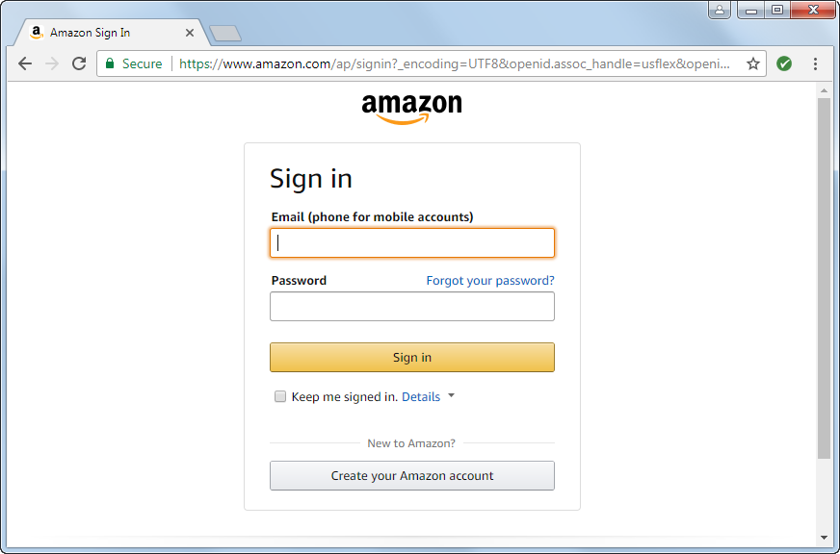
A request made with a secure connection
The URL starts with https
A lock icon is displayed

Slide 5
Key terms

Slide 6
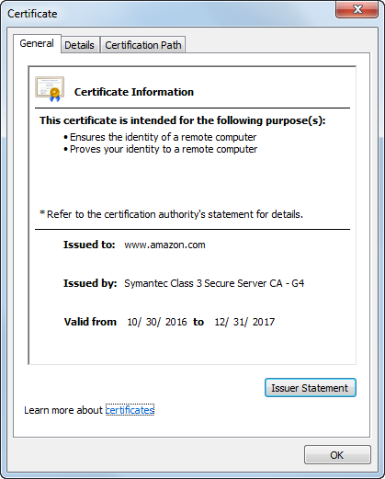
A digital secure certificate

Slide 7
Types of digital secure certificates

Slide 8
How authentication works

Slide 9
Authorities that issue digital secure certificates

Slide 10
Key terms

Slide 11
URLs for secure connections on a local system

Slide 12
URLs for secure connections over the Internet

Slide 13
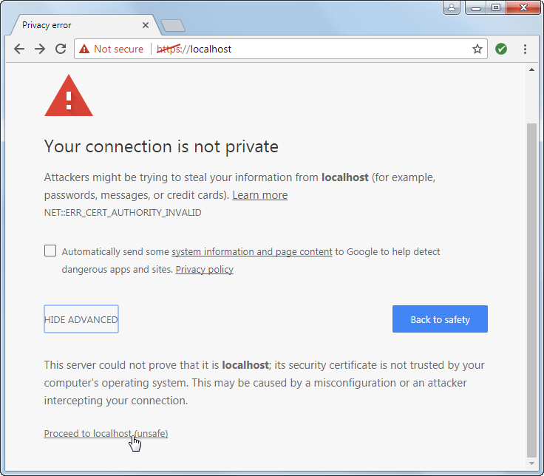
A warning page for the security certificate

Slide 14
The $_SERVER array

Slide 15
A utility file that redirects to a secure connection

Slide 16
Form-based authentication

Slide 17
Digest authentication

Slide 18
Two functions for working with passwords

Slide 19
Code that hashes a password using the default algorithm

Slide 20
A script that creates a table for storing usernames and passwords

Slide 21
The admin_db.php file

Slide 22
The admin_db.php file (continued)

Slide 23
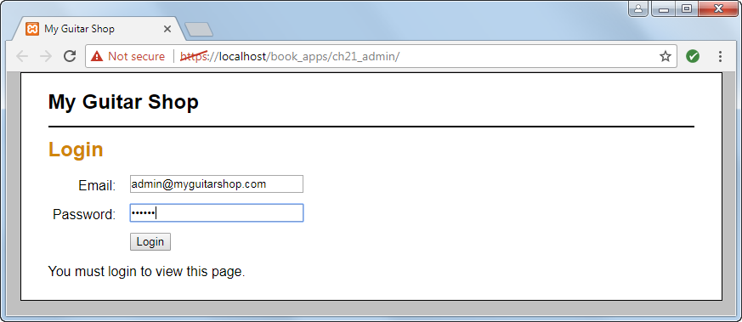
A login form

Slide 24
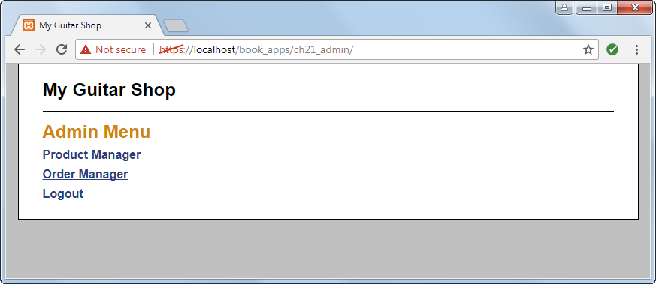
A protected page

Slide 25
The controller for the protected pages

Slide 26
The controller for the protected pages (continued)

Slide 27
The controller for the protected pages (continued)

Slide 28
A utility file that forces a valid admin user

Slide 29
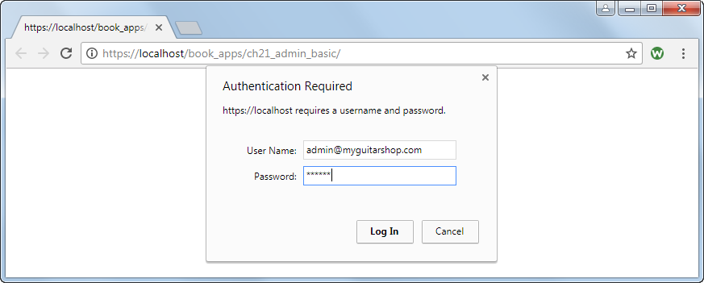
A login dialog box for basic authentication

Slide 30
A protected page

Slide 31
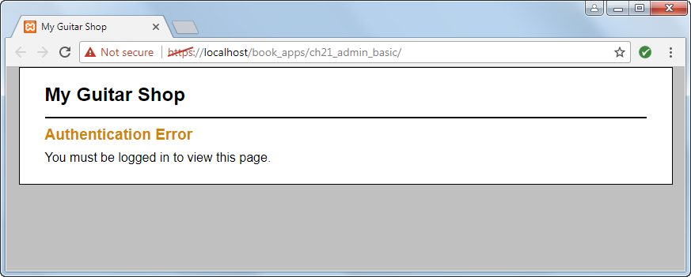
The unauthorized page

Slide 32
The $_SERVER array for basic authentication

Slide 33
Code that forces a valid admin user

Slide 34
Code at the top of each protected page

Slide 35
Four cryptography libraries

Slide 36
The URL for the Defuse Crypto library

Slide 37
Some methods of the Key class

Slide 38
Code that creates an encryption key and saves it to a file

Slide 39
Code that encrypts and decrypts data

Slide 40
The Crypt class (crypt.php)

Slide 41
The Crypt class (crypt.php) (continued)

Slide 42
Code that uses the Crypt class to encrypt and decrypt data

