Slide 1
Chapter 22

Slide 2
Objectives

Slide 3
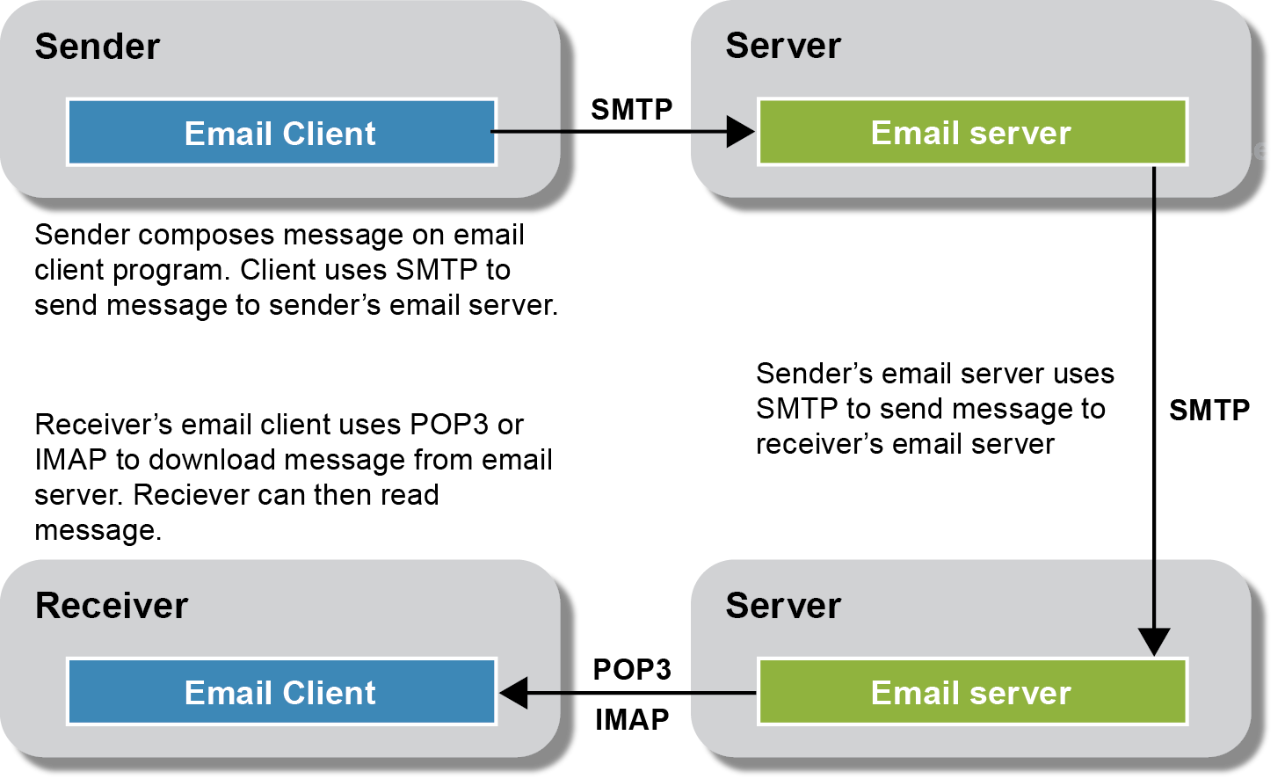
How email is sent

Slide 4
Protocols used in sending email

Slide 5
How to create a Gmail account for email testing

Slide 6
The PHPMailer 5.2 directory that’s included with this book’s download

Slide 7
How to use PHPMailer to send an email

Slide 8
How to use PHPMailer to send an email (cont.)

Slide 9
How to use PHPMailer to send an email (cont.)

Slide 10
A helper function for sending an email

Slide 11
A helper function for sending an email (continued)

Slide 12
How to use the helper function

Slide 13
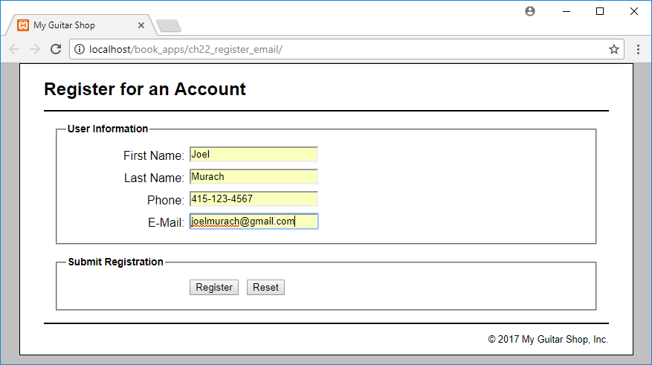
Register view of the Registration application

Slide 14
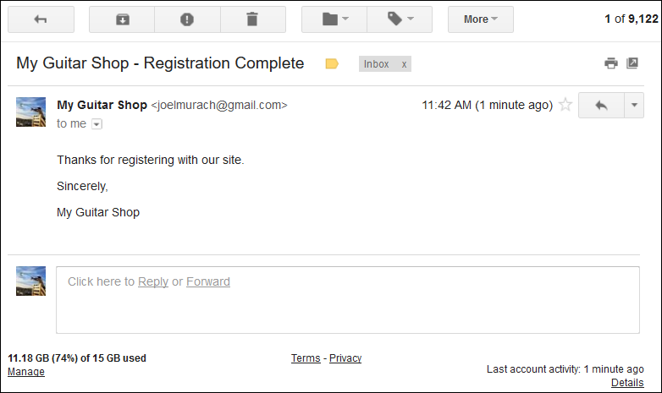
The email sent by the Registration application

Slide 15
The controller (index.php)

Slide 16
The controller (index.php) (continued)

Slide 17
The controller (index.php) (continued)

Slide 18
Register view (view/register.php)

Slide 19
Register view (view/register.php) (continued)

Slide 20
Success view (view/success.php)

