Slide 1
Chapter 23

Slide 2
Objectives

Slide 3
Three functions to test if a file or directory exists

Slide 4
Display a directory listing

Slide 5
Display the files from a directory listing

Slide 6
Three functions to read an entire file

Slide 7
How to read and write text

Slide 8
How to read and write arrays

Slide 9
Modes for opening a file with the fopen() function

Slide 10
Functions that open and close a file

Slide 11
Read from a file

Slide 12
Write to a file

Slide 13
Functions that read and write CSV files

Slide 14
Write tabular data to a CSV file

Slide 15
Functions to copy, rename, and delete files

Slide 16
Rename a file

Slide 17
An HTML form for uploading a file

Slide 18
Elements in the $_FILES array

Slide 19
PHP for working with an uploaded file

Slide 20
A function that gets information about an image

Slide 21
Code that gets information about an image

Slide 22
Code that gets image information (continued)

Slide 23
Functions that work with images

Slide 24
Code that reads and writes an image

Slide 25
Code that reads and writes an image (continued)

Slide 26
Code that reads and writes an image (continued)

Slide 27
Functions that can resize an image

Slide 28
Resizing an image to 100 by 100 pixels maximum

Slide 29
Resizing an image (continued)

Slide 30
Resizing an image (continued)

Slide 31
Functions that work with image transparency

Slide 32
Code that works with image transparency

Slide 33
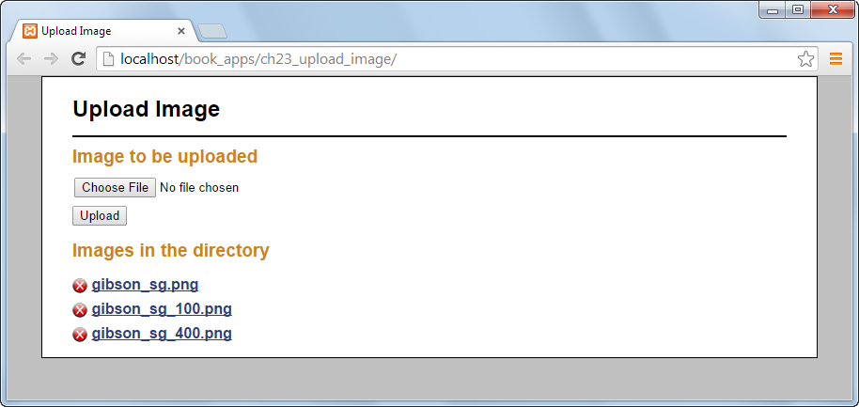
The user interface

Slide 34
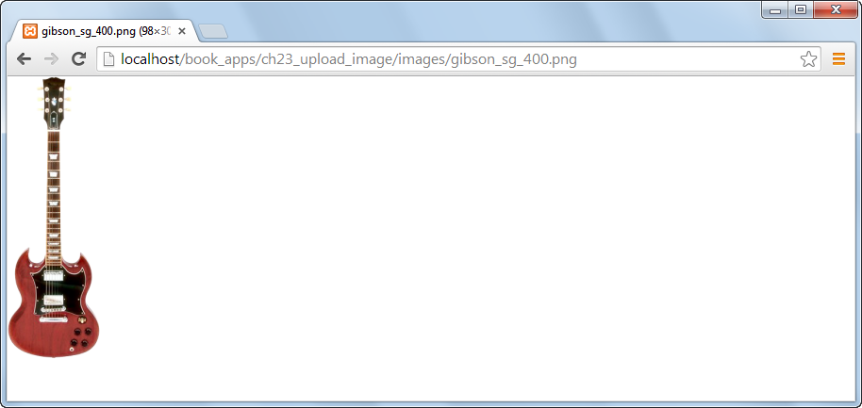
An image displayed in the browser

Slide 35
The file_util.php file

Slide 36
The image_util.php file

Slide 37
The image_util.php file (continued)

Slide 38
The image_util.php file (continued)

Slide 39
The image_util.php file (continued)

Slide 40
The image_util.php file (continued)

Slide 41
The image_util.php file (continued)

Slide 42
The controller (index.php)

Slide 43
The controller (continued)

Slide 44
The controller (continued)

Slide 45
The view (uploadform.php)

Slide 46
The view (uploadform.php) (continued)

Slide 47
The view (uploadform.php) (continued)

