Slide 1
Chapter 24

Slide 2
Objectives

Slide 3
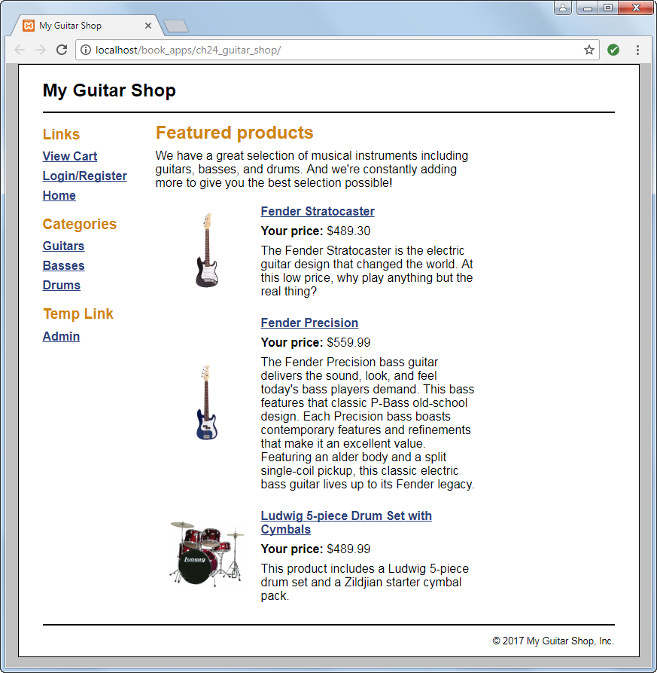
The Home page for the Guitar Shop prototype

Slide 4
Key terms

Slide 5
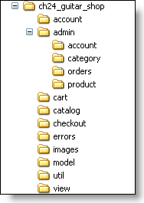
The directory structure of the website

Slide 6
The files in the application root directory

Slide 7
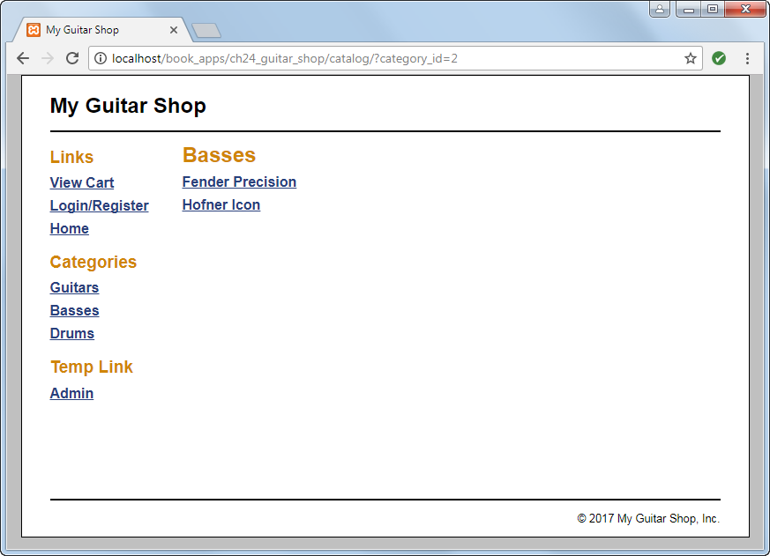
The catalog/category_view.php page

Slide 8
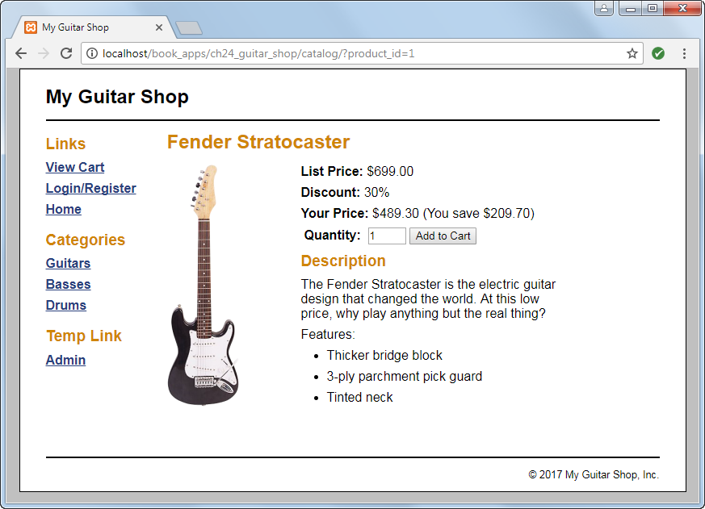
The catalog/product_view.php page

Slide 9
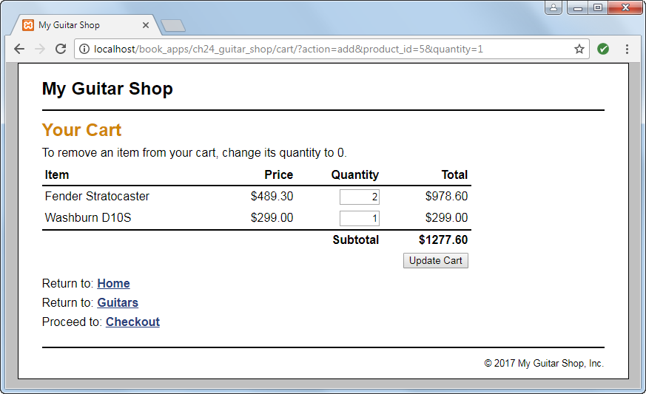
The cart/cart_view.php page

Slide 10
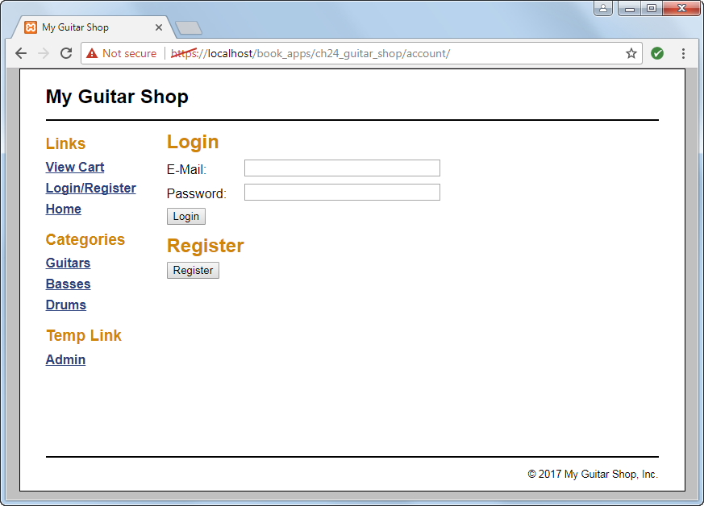
The account/account_login_register.php page

Slide 11
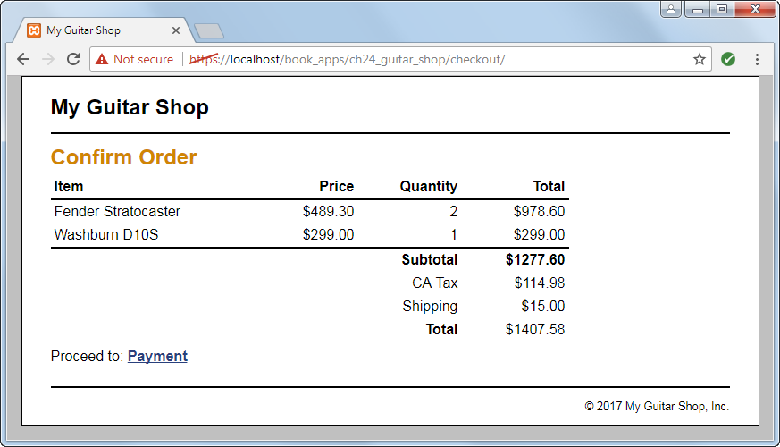
The checkout/checkout_confirm.php page

Slide 12
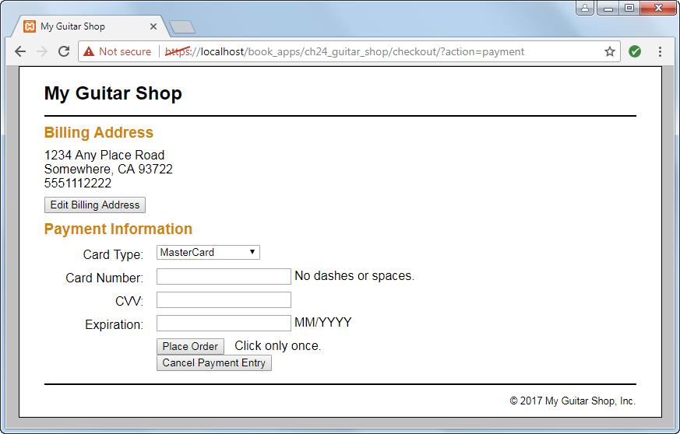
The checkout/checkout_payment.php page

Slide 13
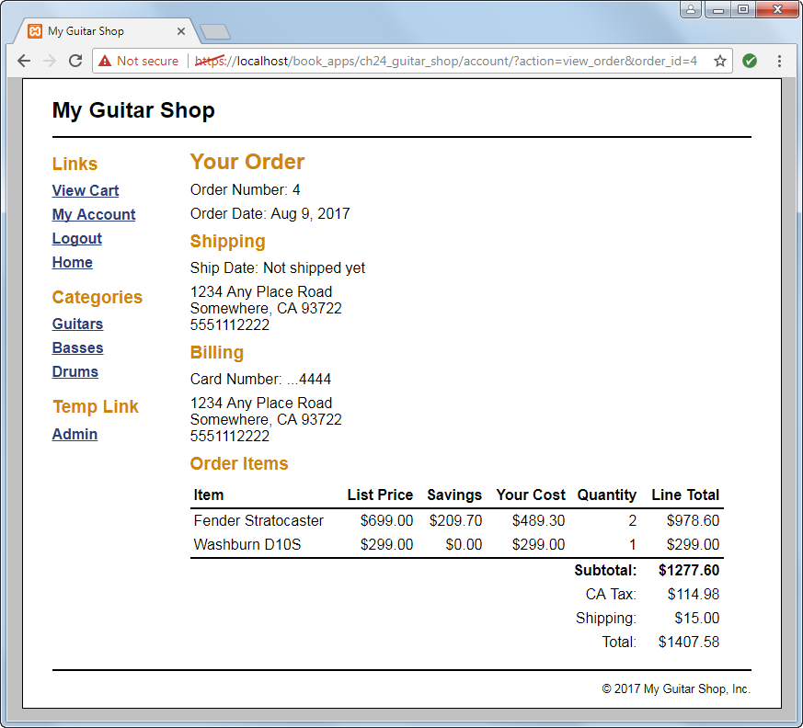
The account/account_view_order.php page

Slide 14
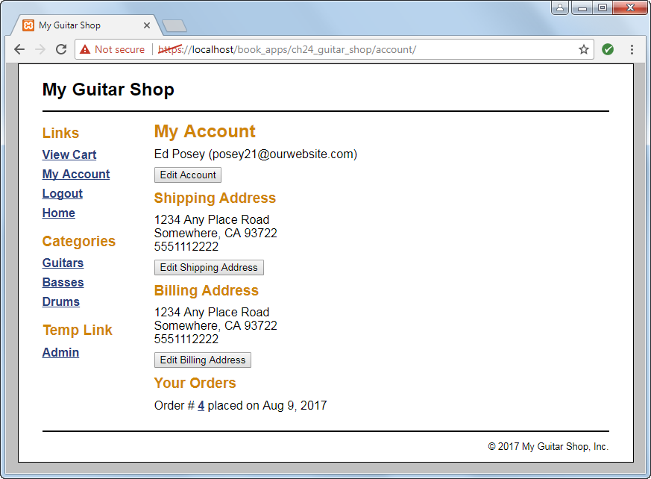
The account/account_view.php page

Slide 15
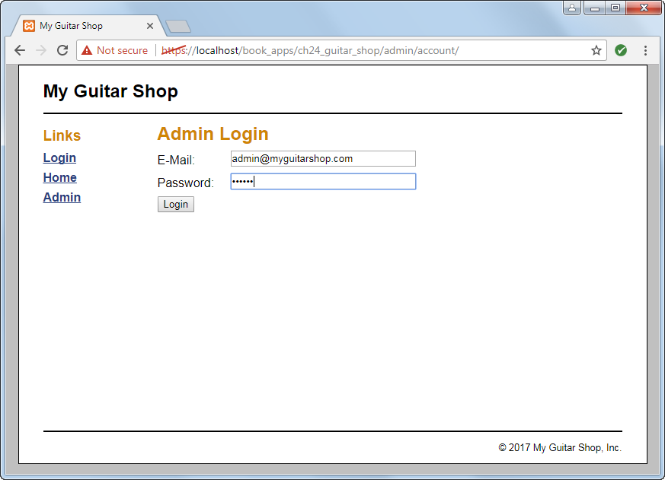
The admin/account/account_login.php page

Slide 16
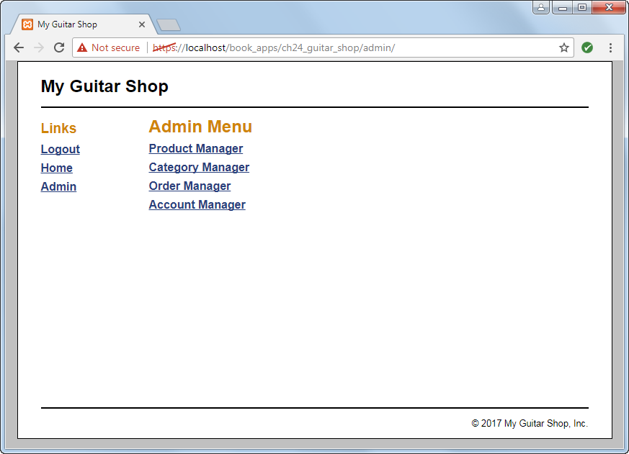
The admin/index.php page

Slide 17
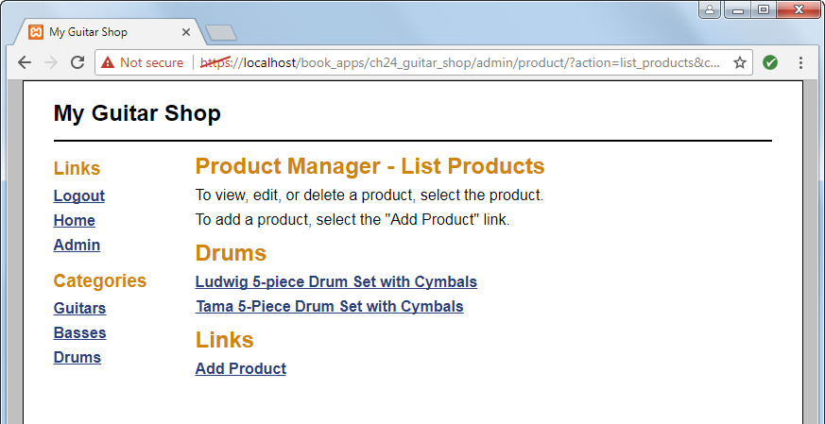
The admin/product/product_list.php page

Slide 18
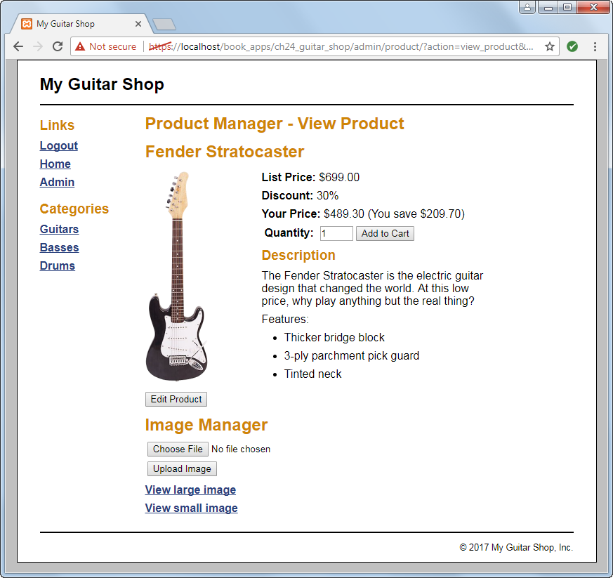
The admin/product/product_view.php page

Slide 19
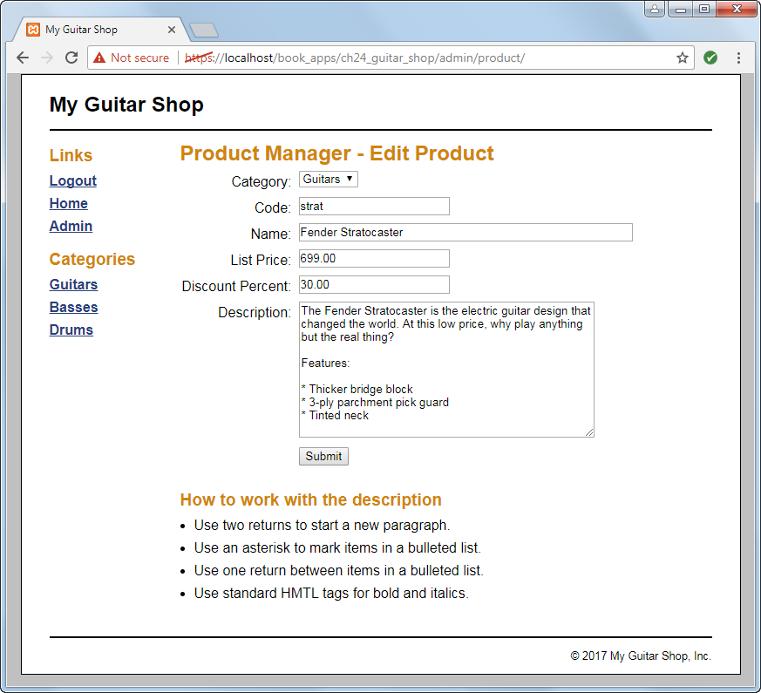
The admin/product/product_add_edit.php page

Slide 20
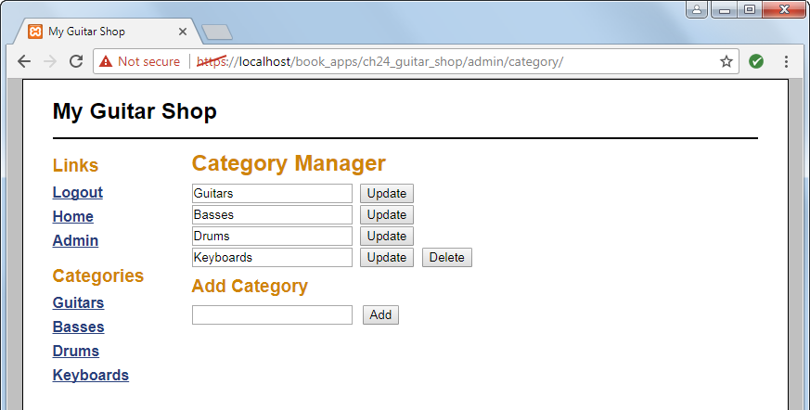
The admin/category/category_list.php page

Slide 21
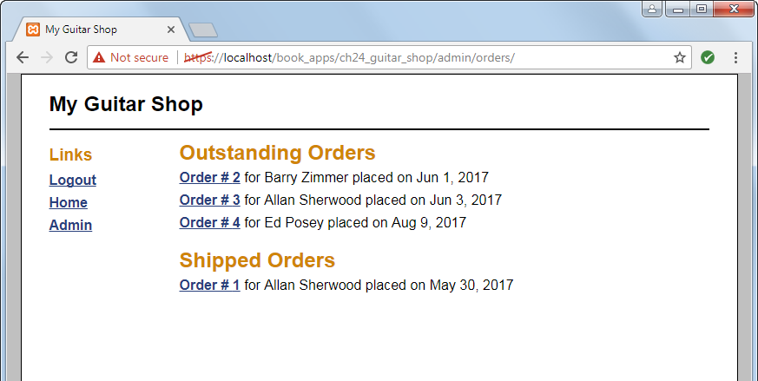
The admin/orders/orders.php page

Slide 22
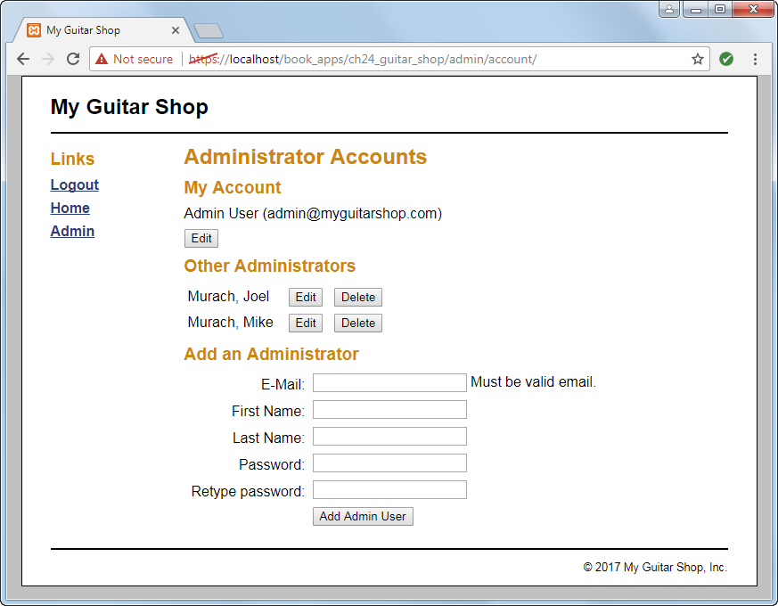
The admin/account/account_view.php page

